Slide 1
CLARITY MATRIX MULTITOUCH VIDEO WALL SYSTEM
June 2016

Slide 2
Interactive Video Walls
Trends in interactive video walls
Video wall customers in visualization and conference rooms are looking to expand their collaboration capabilities
Digital signage customers are looking to engage and interact better with their customers
Multiple user interaction with the video wall at the same time
Customers desire a turn-key touch solution

Slide 3
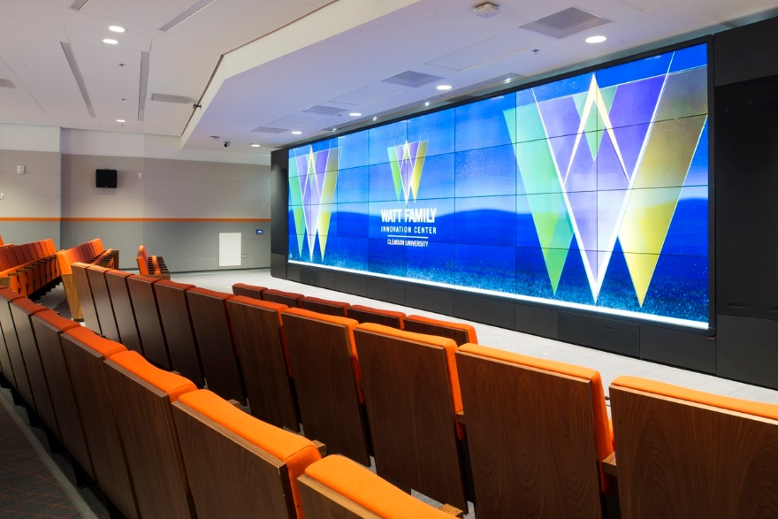
Clarity Matrix MultiTouch System
Interactive video wall
Adds multi-touch interactivity to Clarity® Matrix™ LCD Video Wall System
Supports up to 32 simultaneous touch point interactivity on the wall
Planar® ERO™ (Extended Ruggedness and Optics™) technology modular touch surface
Configurable up to 500” diagonal video walls
2x2, 3x3, and custom configurations

Slide 4
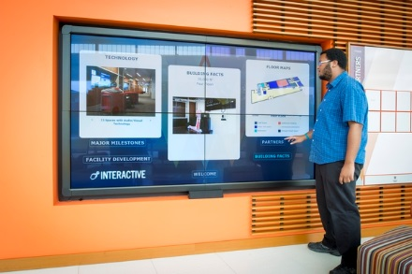
Clarity Matrix MultiTouch System
Interactive video wall
Modular Overlay Frame attaches to the sides of the Clarity Matrix
Easy to install and configure
Can be added to existing walls
Utilizes IR Technology providing the most advanced and accurate touch system
Choice of 6 or 32 Touch points
Sizes up to 300” diagonal
Better user experience
Easy set up and calibration

Slide 5
Clarity Matrix with ERO Advantage
Planar ERO technology provides a near-seamless protective touch surface
Modularity eases the installation, transportation, and serviceability of large video walls
Improves contrast

