Slide 1
CLARITY MATRIX FIBER VIDEO EXTENSION
March 2016

Slide 2
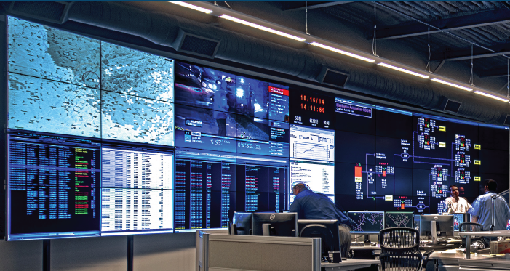
Video Fiber Extension on Video Walls
Opportunity
Customers in military “secure” environments prefer/require the use of fiber optic cable to transport data and video
While the 500 ft. supported cable distance of the Clarity® Matrix™ LCD Video Wall System with G2 Architecture is adequate for most customers, occasionally we do receive requests to go longer

Slide 3
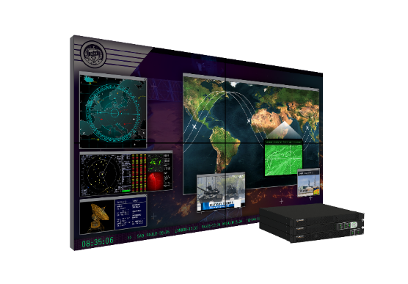
Clarity Matrix Fiber Video Extension Module Option
Highest level of protection for mission-critical information
Clarity® Matrix™ Fiber Video Extension Option will transmit the video signal over fiber optic cable between the quad and the Clarity Matrix LCD Module
One 1RU Rack unit per 4 panels
Extends the supported distance between the wall and off-board electronics
Multimode (standard): up to 1000 ft / 300 m
Single mode (option): up to 10 km
Better integration for Clarity® Matrix™ MultiTouch
Built-in USB Extension and Power
Applications:
Transportation and Traffic | Government/Military | Utilities | Corporate | Security

Slide 4
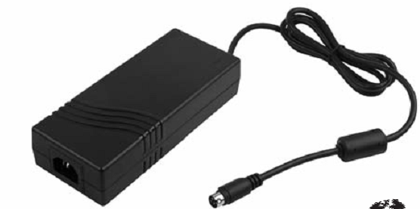
Overview of Design
Clarity Matrix Fiber Video Extension
Fiber Cables Connect Directly to Panel
Added Bonus:
USB 2.0 extension
Cat 6 Cables
Powered from AC Power Adapter

Slide 5
Fiber Video Extension Module
SFP fiber transceiver connection output to the panel
USB 2.0 input (Type-B connector)
Fiber module power switch
DC Power (4-pin mini-DIN) for Fiber module
Input from the Quad Controller

Slide 6
Panel Interface Board
IR and Ambient Light Sensor Outputs
USB 2.0 Output – Clarity Matrix MultiTouch
Power for Clarity
Matrix MultiTouch
SFP Input from Fiber Module
Power Input and Loop Through

Slide 7
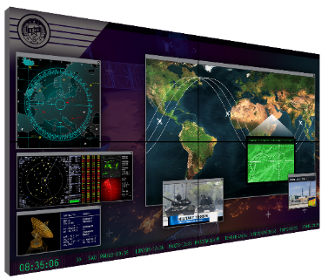
Clarity Matrix G2
Supported cable lengths
Clarity Matrix G2 Quad Controller Module
Standard length 200 ft / 61 m
Extended length
500 ft / 150m
Third party extenders
Cat 6 Cable Lengths
Bulk cables and connectors support field-terminated lengths
25 ft/7.6 m
50 ft/15.2 m
75 ft/22.8 m
100 ft/30.4m
200 ft/60m
Clarity Matrix G2 Power Supply Module
Standard configuration support – 500 ft / 152 m
Power Cable Lengths
Bulk cables and connectors support field-terminated lengths
25 ft/7.6 m
50 ft/15.2 m
75 ft/22.8 m
100 ft/30.4m
200 ft/60m
Clarity Matrix G2 Fiber Extension Module
MUTLI-MODE 1000 ft / 300 m
SINGLE MODE 10 km
FIBER CABLE LENGTHS
Bulk cables and connectors available to support field-terminated lengths
65.6 ft/20m
98.4 ft/30m

Slide 8
Fiber Video Extension Option Pricing
Clarity Matrix Fiber Extension option is not available for the following models:
HX60
LX46S-3D
MX46HDS
MX55HDS
LX46HDS
LX55HDS
Matrix | $ List Price | € List Price
LX46HDU | $4,333 | €3,535
LX46HDU-F | $7,000 | €5,535
MX46HDU | $6,333 | €5,300
MX46HDU-F | $9,000 | €7,300
LX55HDU | $7,060 | €5,900
LX55HDU-F | $9,727 | €7,900
MX55HDU | $8,660 | €7,690
MX55HDU-F | $11,327 | €9,690
Notes:
No Fiber Extension option on the following models:
HX60. Gen 1 Matrix architecture does not support fiber
LX46S-3D. End of Production product.
Plan is to offer Fiber Extension on its replacement
MX46/MX55HDS. These models will be discontinued within a year due to panel obsolescence.
Option can be added on an ad hoc basis to win a deal
LX46/L55HDS. Streamline sku count and simplify HDS messaging
Option can be added on an ad hoc basis to win a deal

Slide 9
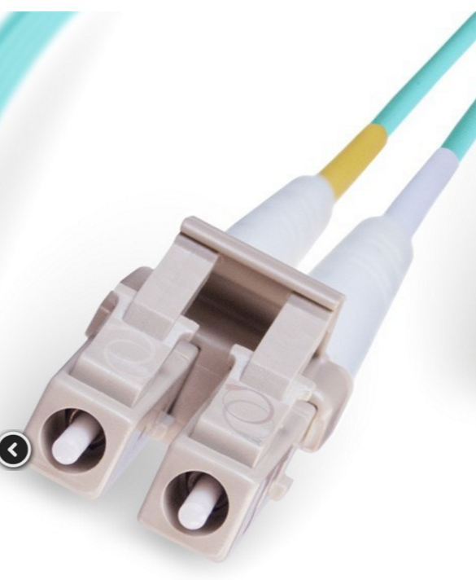
Fiber Optic Cables
Standard length multimode cables
 | Item | Description | Part Number | $ List Price
 | Fiber Multi Duplex LC- 65.6ft / 20m | 10g OM3 50/125 micron multimode duplex Plenum fiber optic cable | 159-0055-00 | $80
 | Fiber Multi Duplex LC- 98.4ft / 30m | 10g OM3 50/125 micron multimode duplex Plenum fiber optic cable | 159-0054-00 | $100
Note: Single mode supported, but single mode transceivers and cables must be sourced from third party.

Slide 10
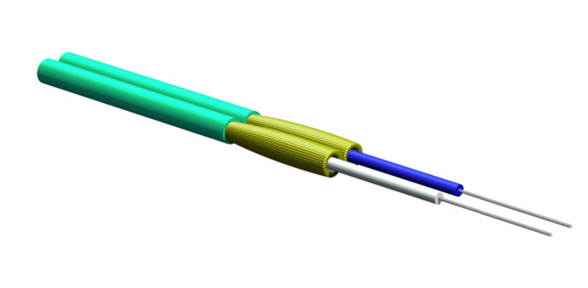
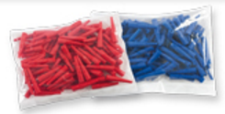
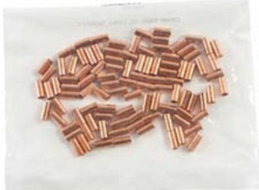
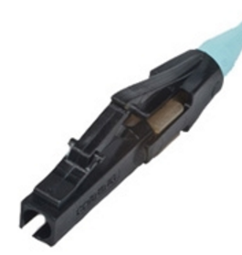
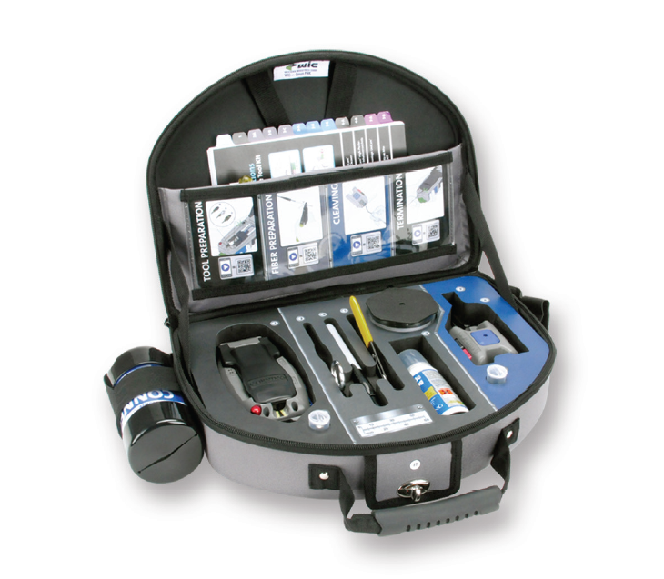
Bulk Fiber Cable and Components & Termination Kit
 | Item | Description | Part Number | $ List Price
 | Bulk cable: 1640ft / 500m | 10g OM3 50/125 micron multimode duplex Plenum fiber optic cable. | 903-1474-00 | $1420
 | Connector kit for bulk duplex fiber cable | Fiber cable connector kit to build up to 8 fiber cable assemblies. Kit contains 34 fiber connectors and 34 crimp rings, plus 17 red boots and 17 black boots to identify signal direction. | 955-0603-00 | $1100
 | Fiber Termination Kit | Pre-polished kit for field termination of multimode and single-mode LC, SC and ST® compatible connectors. | 541-0139-00 | $4025

Slide 11
Bulk Fiber Ordering Examples
Need QTY 8 200-foot multimode cables:
Bulk cable: 903-1474-00
QTY: 1
Connector Kit: 955-0603-00
QTY: 1
Termination Kit: 541-0139-00
QTY: 1

Slide 12
Bulk Fiber Ordering Examples
Need QTY 2 1000-foot multimode cables:
Bulk cable: 903-1474-00
QTY: 2
Connector Kit: 955-0603-00
QTY: 1
Termination Kit: 541-0139-00
QTY: 1

Slide 13
Bulk Fiber Ordering Examples
Need QTY 10 600-foot multimode cables:
Bulk cable:
903-1474-00
QTY: 5
(only QTY 2 600-ft cables from each 1640-ft spool)
Connector Kit: 955-0603-00
QTY: 2
Termination Kit: 541-0139-00
QTY: 1

Slide 14
Sales Tools
Updates to:
Product family brochures
Control Room
Digital Signage
Clarity Matrix G2 presentation
Clarity Matrix family web pages
Bid specification document
Clarity Matrix Calculator
New:
Product Rendering
Fiber Extension brochure
Specs sheet

