Slide 1
CLARITY MATRIX 3D
Stereoscopic LCD Video Wall Solution

Slide 2
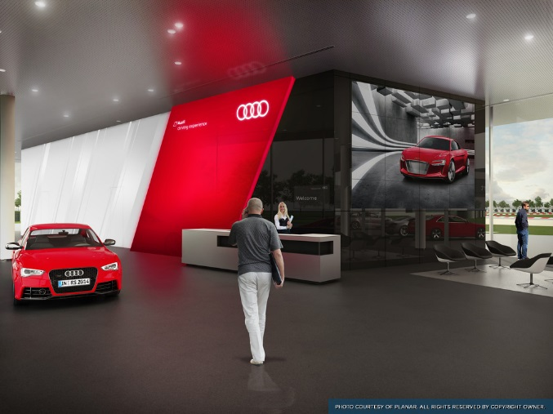
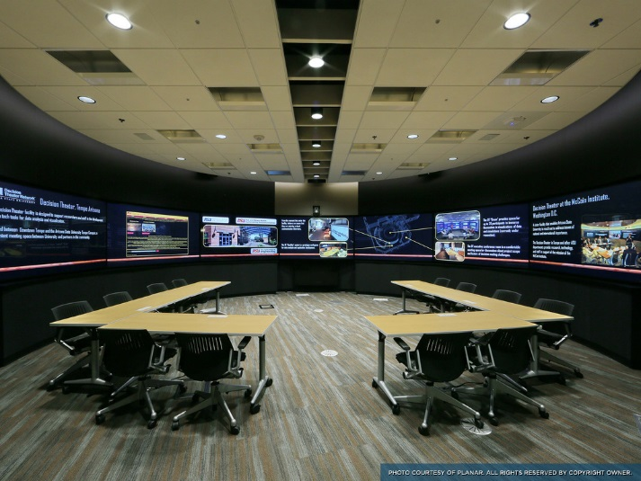
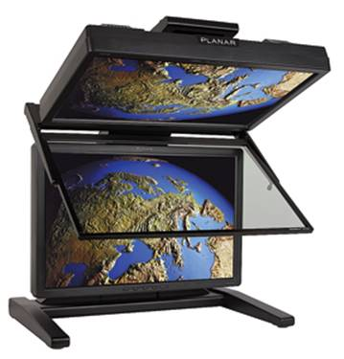
Planar’s History in Stereoscopic Displays
Industry Leading
Innovative
High Performance
Professional

Slide 3
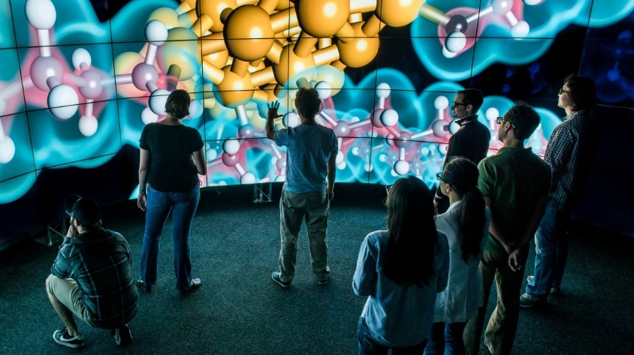
Higher Education/Simulation
University of Illinois Chicago Electronic Visualization Lab (EVL)
View Case Study

Slide 4
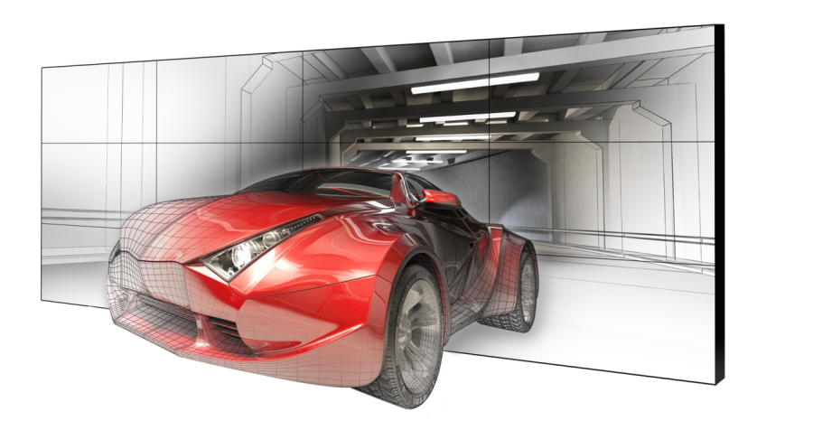
Clarity Matrix 3D
LCD video wall system
Large Format Professional 3D Visualization
Ultra-thin Profile
Flicker-Free Stereoscopic Imaging-Passive Glasses
Excellent Brightness and Contrast
2D and 3D Viewing

Slide 5
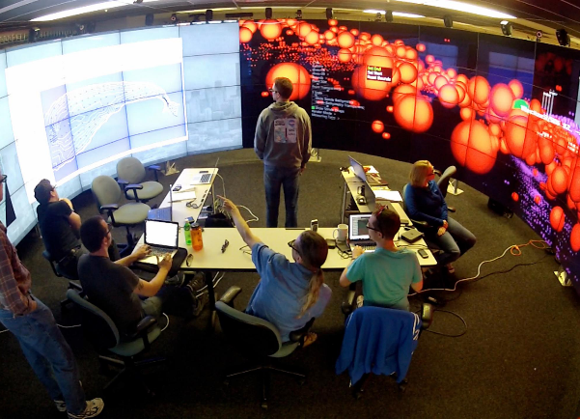
Introducing the Clarity Matrix LX46HDU 3D
The World’s Only 3D Ultra-Narrow Bezel LCD Video Wall
Large Format Professional 3D Visualization:
46” - 3.7mm ultra-narrow bezel LCD
Passive Glasses Stereo
Full HD Resolution (1920x1080)
LED Backlight
  500 Nits (10% Brighter)
  Better Uniformity
  Lower Power
EasyAxis™ Mounting System
  Thinnest installed in the Industry- 3.65”

Slide 6
Matrix 3D Market Opportunity
Large format 3D environments
Visualization labs
  Design Engineering
  Architectural
  Oil and Gas Exploration
  Geosciences
  Pharmaceutical
  Academic - Chemistry, Scientific Visualization
  Medical
CAVE environments
“Daily’s” Film and TV Production Review
Military
Department of Energy Labs
Simulation and Training

Slide 7
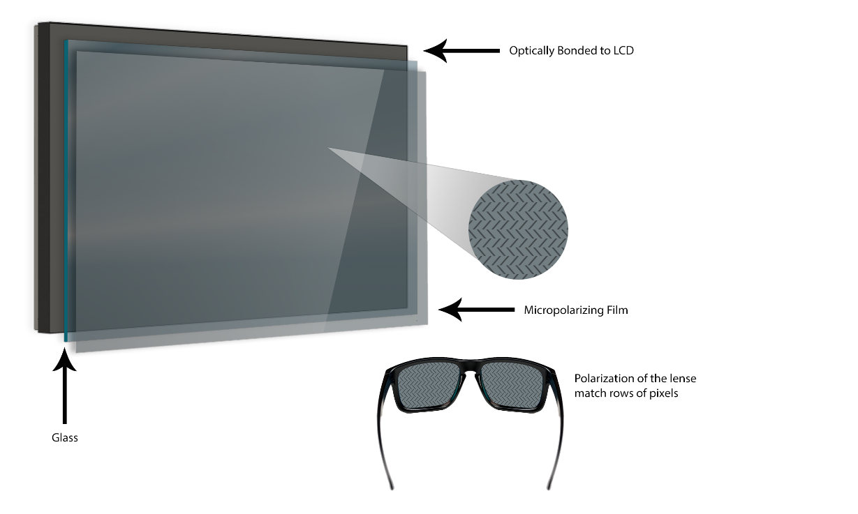
Clarity Matrix LX46HDU 3D
Technology
Clarity Matrix Stereoscopic Technology
  A micro-polarizing film is bonded to the front surface of the LCD
  Every other row of pixels is circular polarized to match one lens or the other
  The left eye sees the image its supposed to see and the right eye sees the image creating a stereoscopic image

Slide 8
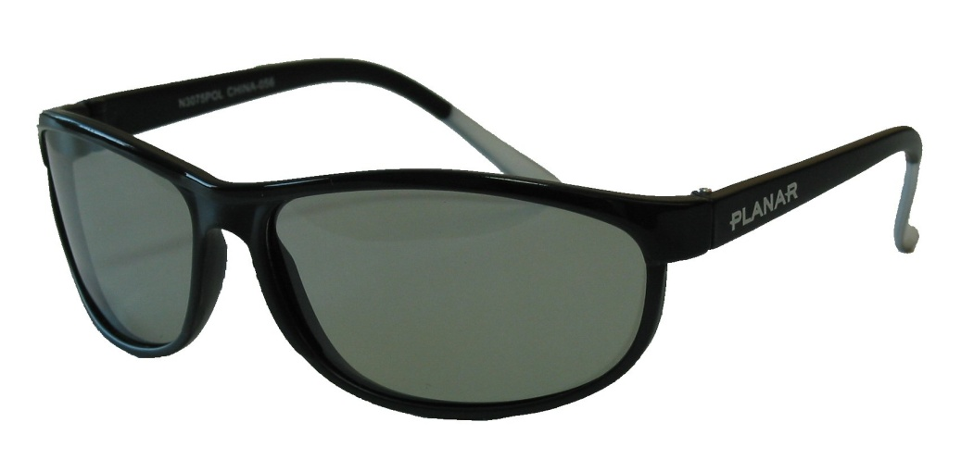
Passive vs. Active Stereo Glasses
Advantages to the Matrix 3D Passive approach
Flicker-free comfort
Lighter weight glasses
No batteries or charging required
Less expensive
No synchronization challenges

Slide 9
Large Format 3D Technology Challenges
Large Format Stereo Solution | Challenge
Low End Projection Systems | 8’-10’ depth requirement when rear projected Brightness / contrast performance Uses Active glasses Heat / noise in room
High End Projection Systems | Brightness / contrast performance Lower resolution Presenter casts shadow on image Heat / noise in room Expensive lamps and screens
Large LCD or Plasma TV | Larger bezels Active Glass Synchronization Difficult to mount Heat / Noise / Power Not commercial grade

Slide 10
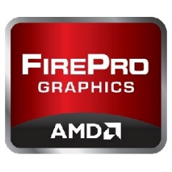
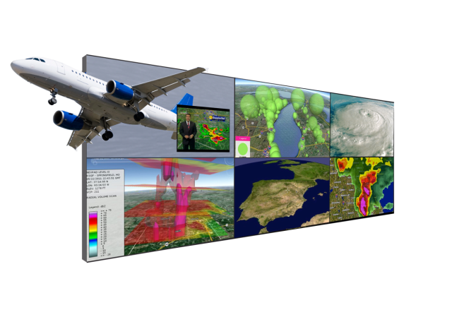
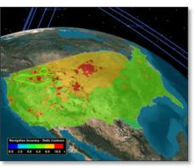
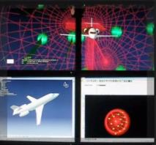


Typical Components of a Matrix 3D Video Wall
Professional Applications with 3D capabilites
OpenGL supported programs
Workstations with Graphics cards supporting the row interlaced or interleaved 3D Format
LX46HDU 3D driven at native resolution per display

Slide 11
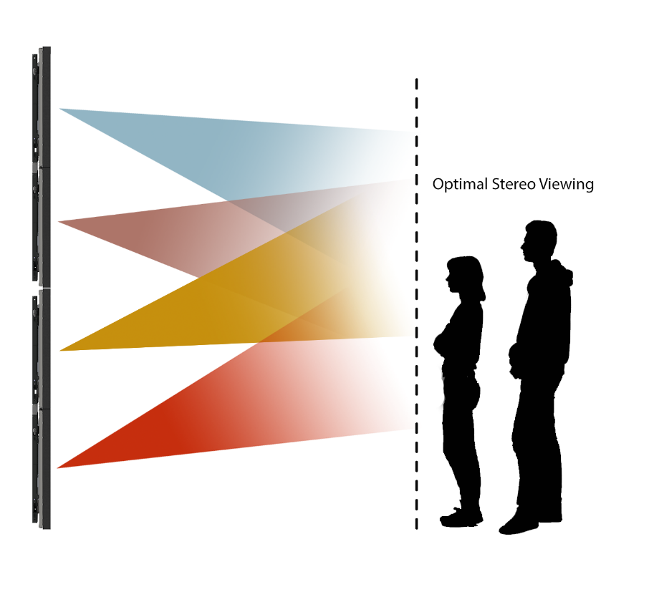
Clarity Matrix LX46HDU 3D Optimization
Optimal Viewing for CAVE2™
Clarity Matrix used in the CAVE2
CAVE2 A large-scale virtual reality environment developed by EVL using the Clarity Matrix
~72 panels (18 wide by 4 high) in a 320 cylindrical array
Optional Top and Bottom rows create a wider viewing area for tall walls or ones with close viewing distance like the CAVE2
    Most walls up to 4 high can use the standard models

Slide 12
Clarity Matrix G2
Updated Sales Tools for LX46HDU 3D Launch
Matrix 3D Brochure
Product presentations
CAD files with more configurations
Matrix family web pages
Specifications sheets
Bid Specification document
Matrix Calculator
Press Release

