Slide 1




Slide 2

Today there are 10,000,000+
professional creators and designers.

Slide 3

And 1,000,000,000+ amateur creators and designers aspiring
to be more professional .

Slide 4





New Strategy
Intersect the Inflection Points
Virtual Reality
Real-Time Game Engines
Low Level
APIs
Open Source
Software
Create
Anywhere
Design and assembly reviews; architectural walkthroughs; virtual collaborative interactions.
They are disrupting professional
creative processes.
Fastest ever adoption
rate of new APIs:
DirectX® 12 and Vulkan™.
Most modern workflows include open source software.
Millions of mobile workstations, cloud rendering, and VDI are letting professionals
create anywhere.
Notes:
Some of these inflection points render NVs tens of millions of dollars and years of SW investment moot. NV is reluctant to follow without compromising its current value props, or sinking its own SW revenue business.
VR: our minds best in 3d spatial associations, rather than 3d manipulations on a 2d screen;
Able to catch problems before a physical prototype: eg. maintenance accessibility
Real Time Game Engines: - earlier to use than rendering tools; functionality built in for immediate photorealistic immersion. Made better decisions faster.
- Low Level APIs: spurred along by game engines and VR in gaming space. AMD’s advantages: mantle origins taking advantage of AMD architectures (asynchronous compute)
- Open Source: non-proprietary. Not locked into 3rd party to provide bug fix, feature expansion, etc. Mulit-platform a must

Slide 5

Enable The Art of the Impossible

Slide 6


Three products featuring the Polaris architecture
Incredible performance and features
Qualified for workstation platforms
New look and feel
3 + 7 Year Extended Warranty

Slide 7

Testament to Product Quality
Longest warranty of any professional
graphics card on the market
7-year extension is exclusive to
Radeon Pro WX retail products
Warranty extension completely free of charge
upon online product registration

Slide 8
By the Users, for the Users
“Designing, rendering and then playing back VR content all on the same workstation is a big deal, and AMD is at the center of that with the Radeon Pro WX 7100.”
– Anthony Garreffa, TweakTown
“The Radeon Pro WX Series of professional graphics cards take a fundamentally different approach for professionals, being optimized for open source software and designed for creative professionals and those pushing the boundaries of technology.” – Mercedes Milligan, Animation Magazine
“The new Radeon WX series represent
a revolutionary approach with a commitment to open, non-proprietary software with power-rich features.”
– Akiko Ashley, Architosh
“It seems that AMD has hit the market with high-end products for a very low price tag. First was the RX 480, and now its VR capable workstation GPUs for under $1000, certainly a smart move by AMD.”
– Zab Kamal, OppTrends

Slide 9


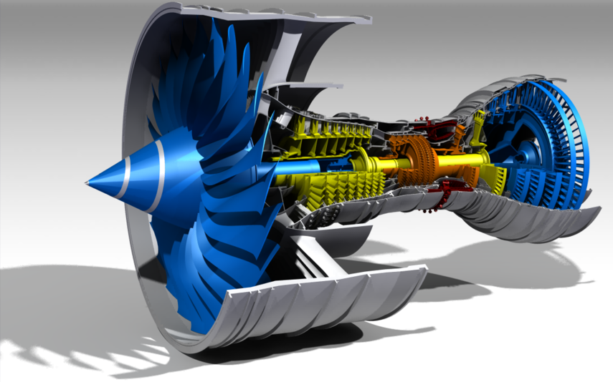
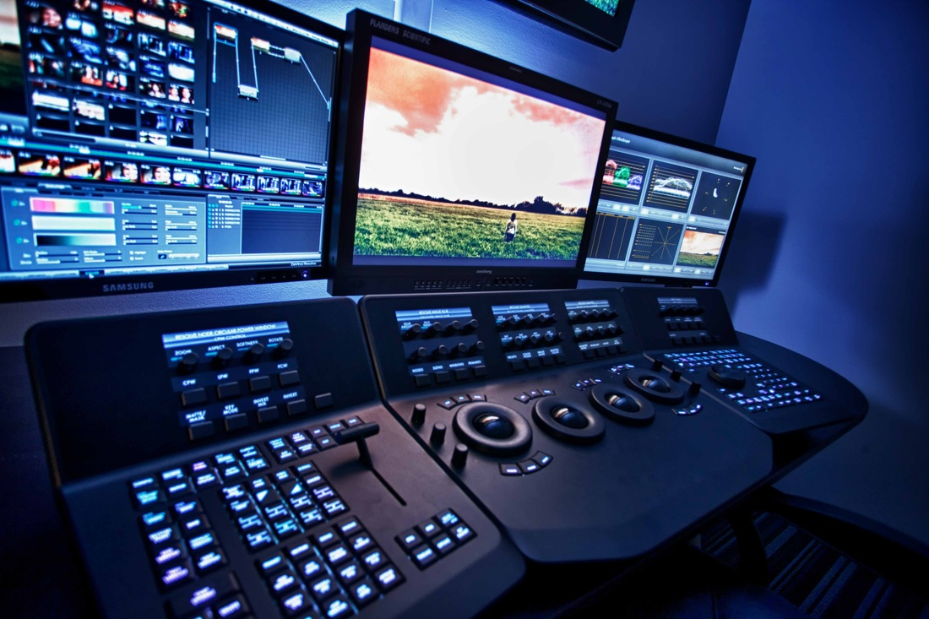
A Targeted Approach
FirePro W9100
FirePro W8100
Radeon Pro WX 7100
Radeon Pro WX 5100
Radeon Pro WX 4100
Price
FirePro W4100
FirePro W2100
Finance
Medical
2D Display
Design & Manufacturing
Media & Entertainment
Design Simulation
Performance

Slide 10

Polaris: Forward-Looking Architecture
Asynchronous Compute
Compute Preemption of Graphics
Quick Response Queue
Shader Utilization
Time
Graphics
Compute

Slide 11
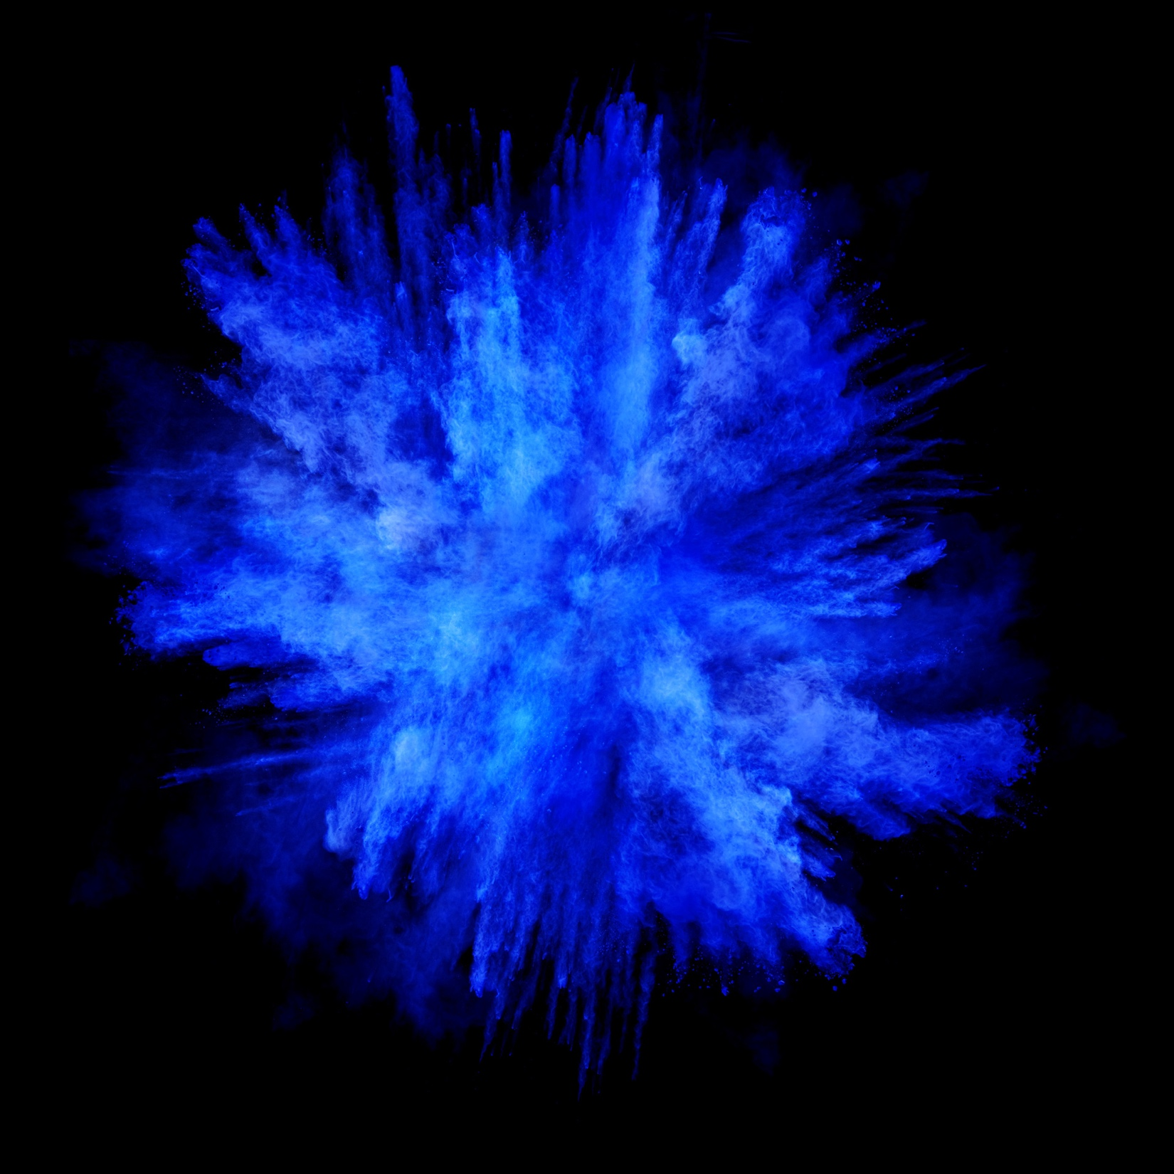
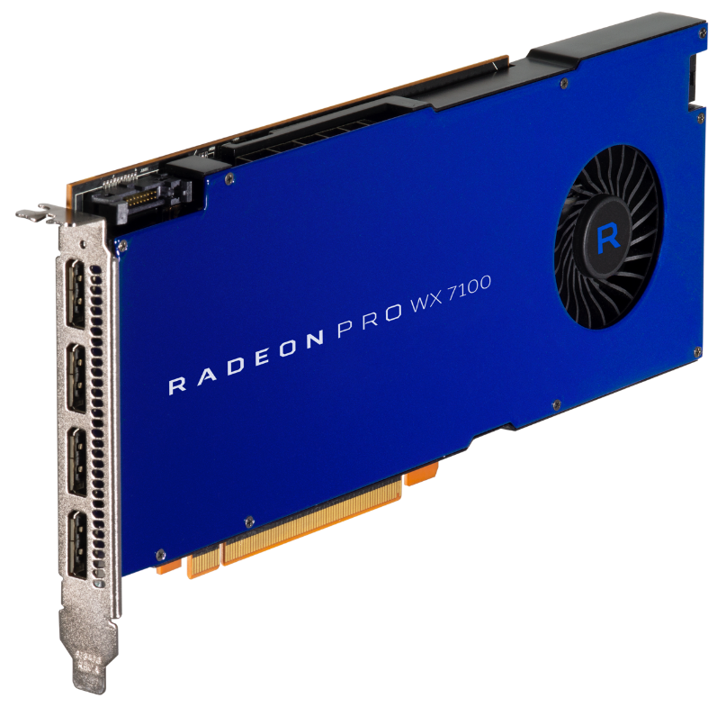
The world’s most powerful single-slot workstation GPU¹,
Ready for VR
36
5.7
4K
8GB
256
Up to 4
4th Gen GCN
Compute Units
TFLOPS Peak
Single Precision
Displays with DisplayPort 1.4 HDR
GPU Memory
Bit Memory Bandwidth
Notes:
Change to “4th Gen GCN Compute Units”
Footnote:
Based on single precision floating point performance. As of August 25, 2016, the Radeon™ Pro WX 7100 graphics card is a single-slot board that delivers up to 5.73 TFLOPS of single-precision floating point performance at maximum clock speed, and the fastest NVIDIA single-slot board is the NVIDIA Quadro M4000, with a peak single-precision floating point performance of 2.5 TFLOPS. See http://www.nvidia.com/content/pdf/line_card/5409_nv_prographicssolutions_linecard_feb13_hr.pdf RPW-6

Slide 12
GPU Architecture | GCN 4th Generation
Stream Processors | 2304
Peak Performance | 5.7 TFLOPS
Memory Type | 8 GB GDDR5
Typical Board Power | <140 W
PCI-Express Version | 3.0
AMD FreeSync™ Technology | Yes
AMD CrossFire™ Pro Technology | Yes
DisplayPort Version | 1.3 HBR3 / 1.4 HDR Ready
Display Color Depth | 10-bit Support
API Support | DirectX 12 OpenGL 4.5 OpenCL 2.0 Vulkan 1.0
Operating System Support | Windows® 7 64-bit Windows® 10 64-bit Linux® 64-bit
Form Factor | Full-Height, Full-Length
The World’s Most Powerful, Single-Slot Workstation GPU¹, Ready for VR.
Notes:
Change to “4th Gen GCN Compute Units”
Footnote
Based on single precision floating point performance. As of August 25, 2016, the Radeon™ Pro WX 7100 graphics card is a single-slot board that delivers up to 5.73 TFLOPS of single-precision floating point performance at maximum clock speed, and the fastest NVIDIA single-slot board is the NVIDIA Quadro M4000, with a peak single-precision floating point performance of 2.5 TFLOPS. See http://www.nvidia.com/content/pdf/line_card/5409_nv_prographicssolutions_linecard_feb13_hr.pdf RPW-6

Slide 13

Up to
68%
FASTER
vs. NVIDIA Quadro M4000
Replace with VR image?
Enabling unprecedented performance and industry-leading innovation, Radeon™ VR Ready Creator products like the Radeon™ Pro WX 7100, empower VR content creators and experience designers with amazingly powerful and capable development tools.​
The Radeon Pro WX7100 delivers up to 68% more performance than NVIDIA Quadro M4000 in the SteamVR Performance Test¹
Notes:
Testing conducted by AMD Performance Labs as of September 2016 on test system described below. PC manufacturers may vary configurations, yielding different results. Performance may vary based on use of latest drivers.
System: DELL Precision Tower 5810 Workstation CPU: Intel Xeon E5-1603 v3 2.80GHz, Memory: 64GB RAM, OS: Win10 Pro 64-bit Build 14393, AMD Driver: 16.40. Nvidia Driver: 369.26 Storage: SK Hynix SSD 512GB
Application: SteamVR Performance Test
Subtest: N/A
AMD WX7100 Average Quality score: 6.4
Nvidia Quadro M4000 Average Quality score: 3.8
Performance Differential: 6.40/3.80 = ~68.42% higher score on AMD
RPW-19

Slide 14
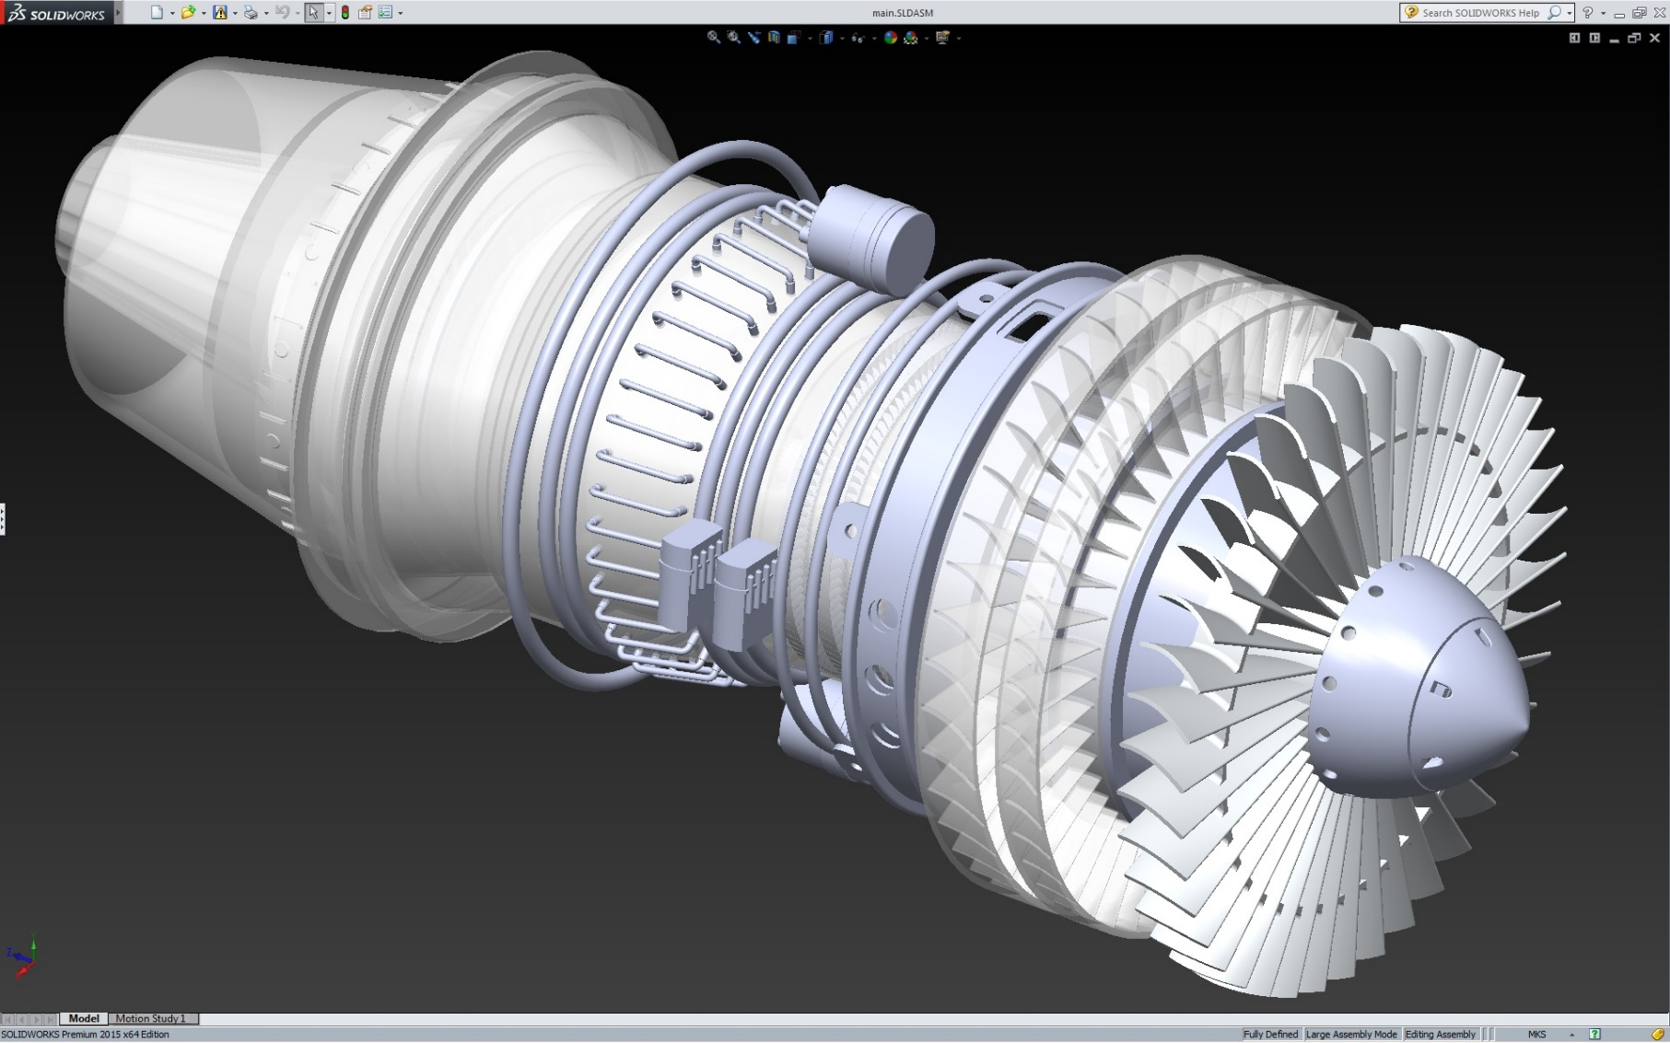
Up to
45%
FASTER
vs. NVIDIA Quadro M4000
The Radeon Pro WX7100 delivers up to 45% more performance than NVidia Quadro M4000 in SPECapc Solidworks 2015¹
Notes:
Footnote:
Testing conducted by AMD Performance Labs as of September 2016 on test system described below. PC manufacturers may vary configurations, yielding different results. Performance may vary based on use of latest drivers.
CPU: Intel E5-1650 v3 3.50GHz, Memory: 16GB RAM, OS: Win7 64-bit SP1, AMD Driver: 16.40 Beta Nvidia Driver: 368.39
Application: SPECapc Dassault SolidWorks 2015, no FSAA
Subtest: Shaded using RealView and Shadows and Ambient Occlusion Graphics Sub-composite
AMD WX7100 subtest score: 21.00
Nvidia Quadro M4000 subtest score: 14.45
Performance Differential: 21.00/14.45 = ~45.33% faster on AMD
RPW-18

Slide 15
Radeon Pro WX 7100 vs. NVIDIA Quadro M4000
22% FASTER
43% FASTER
CPU: Intel E5-1650 v3 3.50GHz, Memory: 16GB RAM, OS: Win7 64-bit SP1, AMD Driver: 15.301.2601.1002 RC3 Nvidia Driver: 368.39
68% FASTER
45% FASTER
14% FASTER
17% FASTER
Detailed performance data can be found in the appendix section
Notes:
Testing conducted by AMD Performance Labs as of September 2016 on test system described below. PC manufacturers may vary configurations, yielding different results. Performance may vary based on use of latest drivers.
CPU: Intel E5-1650 v3 3.50GHz, Memory: 16GB RAM, OS: Win7 64-bit SP1, AMD Driver: 16.40 Beta Nvidia Driver: 368.39
Application: SPECapc Dassault SolidWorks 2015, no FSAA
Subtest: Shaded using RealView and Shadows and Ambient Occlusion Graphics Sub-composite
AMD WX7100 subtest score: 21.00
Nvidia Quadro M4000 subtest score: 14.45
Performance Differential: 21.00/14.45 = ~45.33% faster on AMD
RPW-18
Testing conducted by AMD Performance Labs as of September 2016 on test system described below. PC manufacturers may vary configurations, yielding different results. Performance may vary based on use of latest drivers.
CPU: Intel E5-1650 v3 3.50GHz, Memory: 16GB RAM, OS: Win7 64-bit SP1, AMD Driver: 16.40 Beta Nvidia Driver: 368.39
Application: SPECviewperf 12.1, official resolution
Subtest: snx-02
AMD WX7100 Composite snx-02 score: 91.37
Nvidia Quadro M4000 Composite snx-02 score: 78.02
Performance Differential: 91.37/78.02 = ~17.11% faster on AMD
RPW-16
Testing conducted by AMD Performance Labs as of September 2016 on test system described below. PC manufacturers may vary configurations, yielding different results. Performance may vary based on use of latest drivers.
CPU: Intel E5-1650 v3 3.50GHz, Memory: 16GB RAM, OS: Win7 64-bit SP1, AMD Driver: 16.40 Beta Nvidia Driver: 368.39
Application: SPECapc Siemens PLM NX 10.0, FSAA
Subtest: N/A
AMD WX7100 Composite score: 5.14
Nvidia Quadro M4000 Composite score: 4.48
Performance Differential: 5.14/4.48 = ~14.73% faster on AMD
RPW-17
Radeon Pro WX7100 delivers up to 68% more performance than NVidia Quadro M4000 in SteamVR Performance Test
Testing conducted by AMD Performance Labs as of September 2016 on test system described below. PC manufacturers may vary configurations, yielding different results. Performance may vary based on use of latest drivers.
System: DELL Precision Tower 5810 Workstation CPU: Intel Xeon E5-1603 v3 2.80GHz, Memory: 64GB RAM, OS: Win10 Pro 64-bit Build 14393, AMD Driver: 16.40. Nvidia Driver: 369.26 Storage: SK Hynix SSD 512GB
Application: SteamVR Performance Test
Subtest: N/A
AMD WX7100 Average Quality score: 6.4
Nvidia Quadro M4000 Average Quality score: 3.8
Performance Differential: 6.40/3.80 = ~68.42% higher score on AMD
RPW-19
Radeon Pro WX7100 delivers up to 43% more performance than NVidia Quadro M4000 on GPU-acceleration in Adobe Premiere Pro CC 2015
Testing conducted by AMD Performance Labs as of September 2016 on test system described below. PC manufacturers may vary configurations, yielding different results. Performance may vary based on use of latest drivers.
System: DELL Precision Tower 5810 Workstation CPU: Intel Xeon E5-1603 v3 2.80GHz, Memory: 64GB RAM, OS: Win10 Pro 64-bit Build 14393, AMD Driver: 16.40. Nvidia Driver: 369.26 Storage: SK Hynix SSD 512GB
Application: Adobe Premiere Pro CC 2015
Subtest: /
AMD WX7100 time to render 37 GPU-accelerated effects: 34 mins 33 secs = 2073 seconds
Nvidia Quadro M4000 time to render 37 GPU-accelerated effects: 49mins 19 secs = 2959 seconds
Performance Differential: 2959/2073 = ~42.74% slower on Nvidia/~42.74% faster on AMD
RPW-22
Radeon Pro WX7100 delivers up to 22% more performance than NVidia Quadro M4000 in CINEBENCH
Testing conducted by AMD Performance Labs as of September 2016 on test system described below. PC manufacturers may vary configurations, yielding different results. Performance may vary based on use of latest drivers.
System: DELL Precision Tower 5810 Workstation CPU: Intel Xeon E5-1603 v3 2.80GHz, Memory: 64GB RAM, OS: Win7 64 Bit Service Pack 1 Build 14393, AMD Driver: 16.40. Nvidia Driver: 369.26 Storage: Samsung SSD 850 PRO 512GB
Application: CINEBENCH Windows 64 Bit
Subtest: OpenGL Test
AMD WX7100 subtest score: 133.11
Nvidia Quadro M4000 subtest score: 109.08
Performance Differential: 133.11/109.08 = ~22.03% faster on AMD
RPW-23

Slide 16
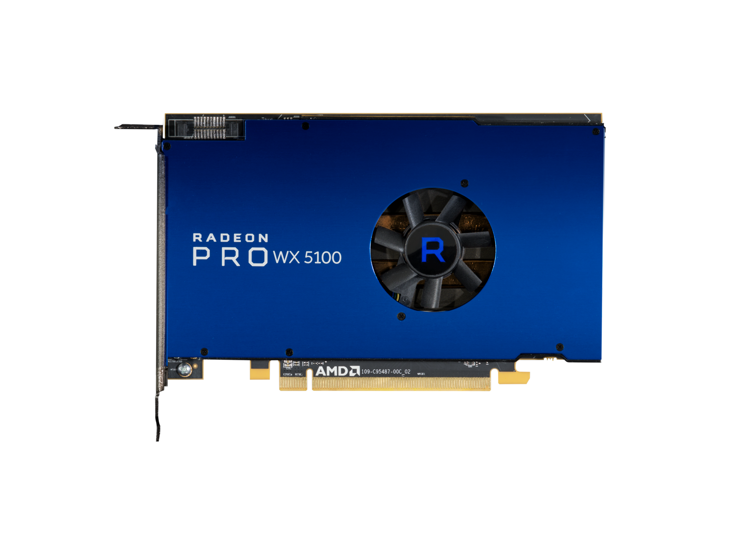
Ready for the Game Engine Revolution in CAD
28
3.9
4K
8GB
256
Up to 4
4th Gen GCN Compute Units
TFLOPS Peak
Single Precision
Displays with DisplayPort 1.4 HDR
GPU Memory
Bit Memory Bandwidth

Slide 17
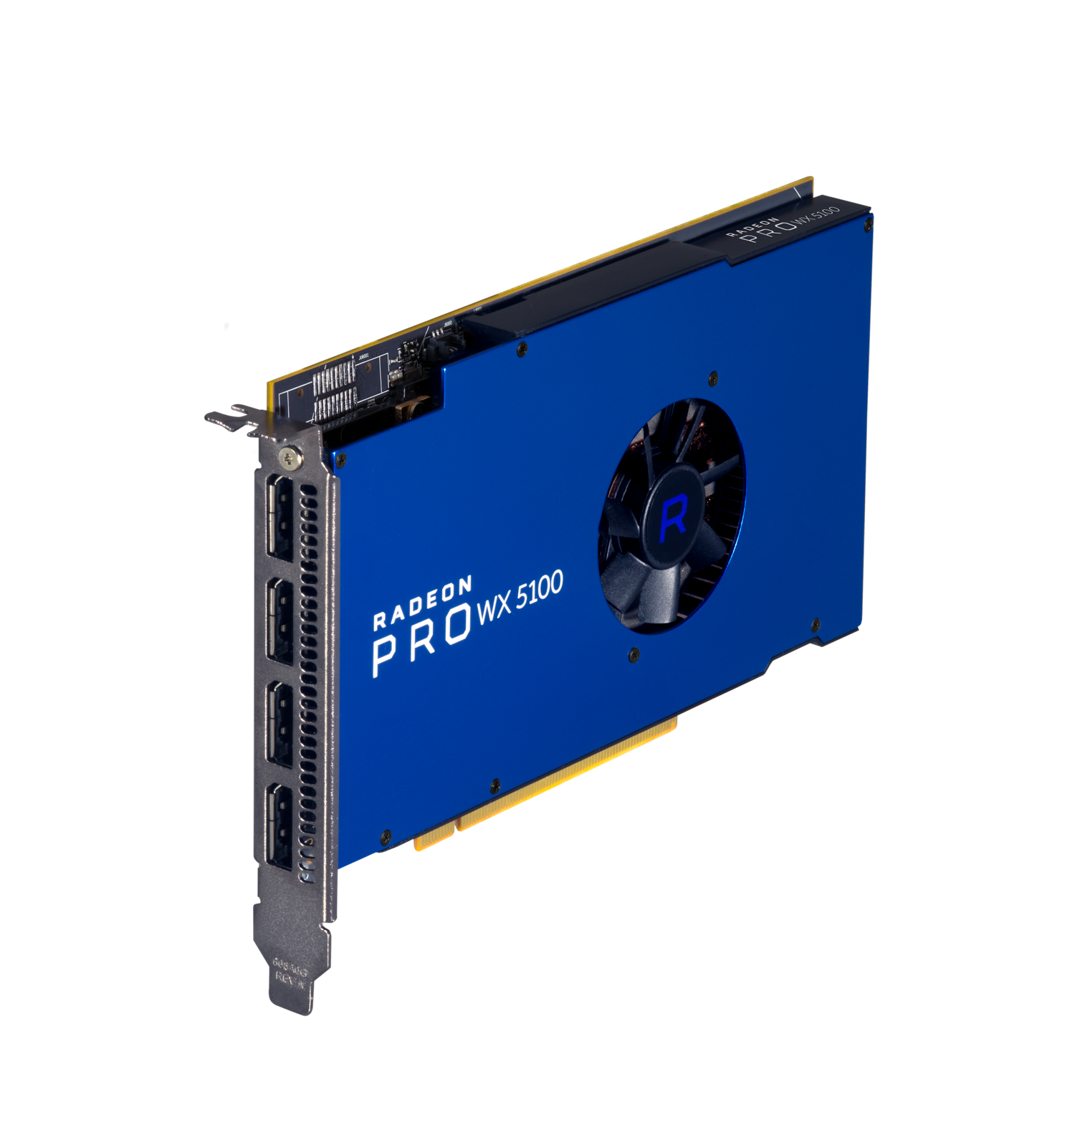
GPU Architecture | GCN 4th Generation
Stream Processors | 1792
Peak Performance | 3.9 TFLOPS
Memory Type | 8 GB GDDR5
Typical Board Power | <75 W
PCI-Express Version | 3.0
AMD FreeSync™ Technology | Yes
AMD CrossFire™ Pro Technology | Yes
DisplayPort Version | 1.3 HBR3 / 1.4 HDR Ready
Display Color Depth | 10-bit Support
API Support | DirectX 12 OpenGL 4.5 OpenCL 2.0 Vulkan 1.0
Operating System Support | Windows® 7 64-bit Windows® 10 64-bit Linux® 64-bit
Form Factor | Full-Height, Half-Length
Ready for the Game Engine
Revolution in CAD

Slide 18
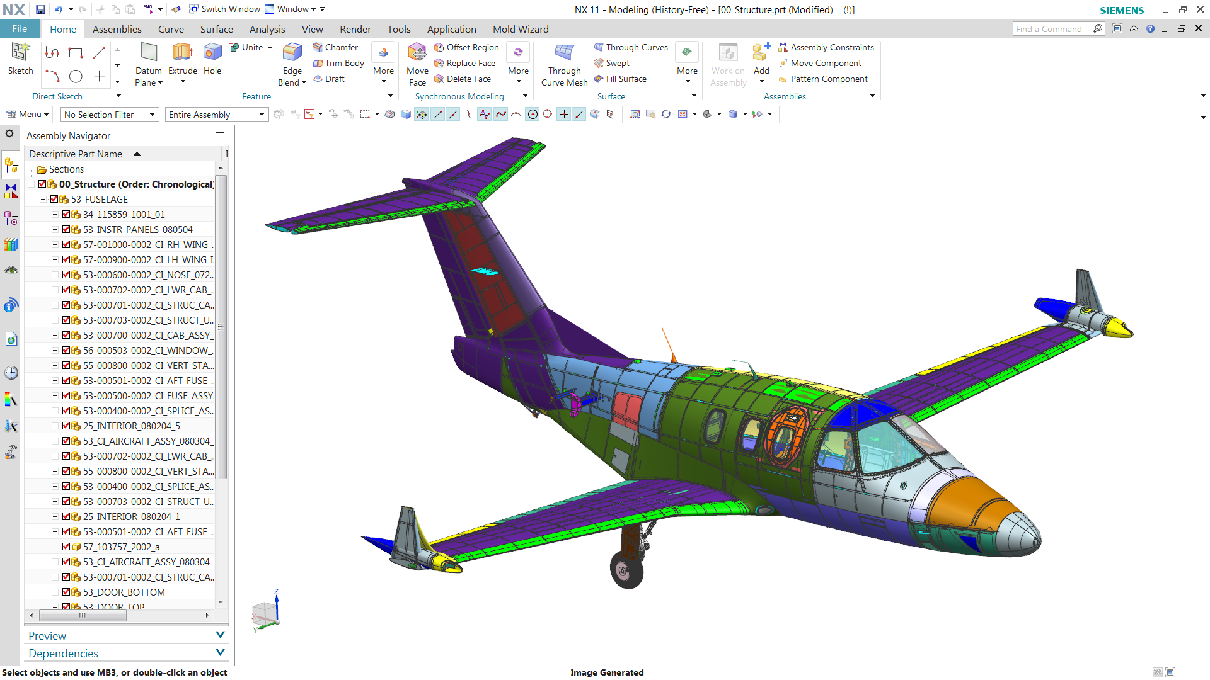
Up to
41%
FASTER
vs. NVIDIA Quadro M2000
The Radeon Pro WX5100 delivers up to 41% more performance than NVIDIA Quadro M2000 in Siemens NX SPECviewperf 12.1¹
Notes:
Footnote:
Testing conducted by AMD Performance Labs as of September 2016 on test system described below. PC manufacturers may vary configurations, yielding different results. Performance may vary based on use of latest drivers.
CPU: Intel E5-1650 v3 3.50GHz, Memory: 16GB RAM, OS: Win7 64-bit SP1, AMD Driver: 16.40 Beta Nvidia Driver: 368.39
Application: SPECviewperf 12.1, official resolution
Subtest: snx-02
AMD WX5100 Composite snx-02 score: 76.28
Nvidia Quadro M2000 Composite snx-02 score: 54.05
Performance Differential: 76.28/54.05 = ~41.13% faster on AMD
RPW-13

Slide 19
Radeon Pro WX 5100 vs. NVIDIA Quadro M2000
34% FASTER
CPU: Intel E5-1650 v3 3.50GHz, Memory: 16GB RAM, OS: Win7 64-bit SP1, AMD Driver: 15.301.2601.1002 RC3 Nvidia Driver: 368.39
11% FASTER
41% FASTER
Detailed performance data can be found in the appendix section
Notes:
Footnotes:
Testing conducted by AMD Performance Labs as of September 2016 on test system described below. PC manufacturers may vary configurations, yielding different results. Performance may vary based on use of latest drivers.
CPU: Intel E5-1650 v3 3.50GHz, Memory: 16GB RAM, OS: Win7 64-bit SP1, AMD Driver: 16.40 Beta Nvidia Driver: 368.39
Application: SPECviewperf 12.1, official resolution
Subtest: snx-02
AMD WX5100 Composite snx-02 score: 76.28
Nvidia Quadro M2000 Composite snx-02 score: 54.05
Performance Differential: 76.28/54.05 = ~41.13% faster on AMD
RPW-13
Testing conducted by AMD Performance Labs as of September 2016 on test system described below. PC manufacturers may vary configurations, yielding different results. Performance may vary based on use of latest drivers.
CPU: Intel E5-1650 v3 3.50GHz, Memory: 16GB RAM, OS: Win7 64-bit SP1, AMD Driver: 16.40 Beta Nvidia Driver: 368.39
Application: SPECapc Dassault SolidWorks 2015, no FSAA
Subtest: Shaded using RealView and Shadows and Ambient Occlusion Graphics Sub-composite
AMD WX5100 subtest score: 15.57
Nvidia Quadro M2000 subtest score: 11.60
Performance Differential: 15.57/11.60 = ~34.22% faster on AMD
RPW-14
Testing conducted by AMD Performance Labs as of September 2016 on test system described below. PC manufacturers may vary configurations, yielding different results. Performance may vary based on use of latest drivers.
CPU: Intel E5-1650 v3 3.50GHz, Memory: 16GB RAM, OS: Win7 64-bit SP1, AMD Driver: 15.301.2601.1002 RC3 Nvidia Driver: 368.39
Application: SPECviewperf 12.1, official resolution
Subtest: 3dsmax-05
AMD WX5100 Composite 3dsmax-05 score: 67.88
Nvidia Quadro M2000 Composite 3dsmax-05 score: 61.00
Performance Differential: 67.88/61.00 = ~11.28% faster on AMD
RPW-15

Slide 20
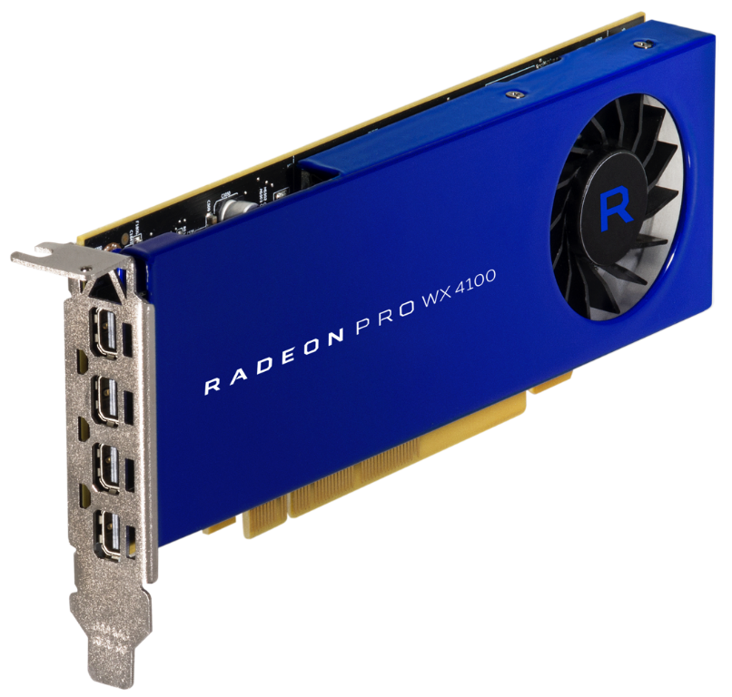
World‘s Fastest Low-Profile Workstation Graphics Card¹
16
2.4
4K
4GB
128
Up to 4
4th Gen GCN Compute Units
TFLOPS Peak
Single Precision
Displays with DisplayPort 1.4 HDR
GPU Memory
Bit Memory Bandwidth
Notes:
Footnote:
Based on single precision compute performance. As of August 25, 2016, the Radeon™ Pro WX 4100 graphics card delivers up to 2.46 TFLOPS single precision compute performance at maximum clock speed vs. NVIDIA’s fastest low-profile offering, the Quadro K1200, which offers up to 1 TFLOP single precision compute performance. AMD’s fastest low-profile card prior to the Radeon Pro WX 4100 was the AMD FirePro™ W4300, delivering 1.43 TFLOPS single precision compute performance. See http://www.nvidia.com/content/pdf/line_card/5409_nv_prographicssolutions_linecard_feb13_hr.pdf RPW-2

Slide 21
GPU Architecture | GCN 4th Generation
Stream Processors | 1024
Peak Performance | 2.4 TFLOPS
Memory Type | 4 GB GDDR5
Typical Board Power | <50 W
PCI-Express Version | 3.0
AMD FreeSync™ Technology | Yes
AMD CrossFire™ Pro Technology | Yes
DisplayPort Version | 1.3 HBR3 / 1.4 HDR Ready
Display Color Depth | 10-bit Support
API Support | DirectX 12 OpenGL 4.5 OpenCL 2.0 Vulkan 1.0
Operating System Support | Windows® 7 64-bit Windows® 10 64-bit Linux® 64-bit
Form Factor | Half-Height, Half-Length
World‘s Fastest Low-Profile
Workstation Graphics Card¹
Notes:
Footnote:
Based on single precision compute performance. As of August 25, 2016, the Radeon™ Pro WX 4100 graphics card delivers up to 2.46 TFLOPS single precision compute performance at maximum clock speed vs. NVIDIA’s fastest low-profile offering, the Quadro K1200, which offers up to 1 TFLOP single precision compute performance. AMD’s fastest low-profile card prior to the Radeon Pro WX 4100 was the AMD FirePro™ W4300, delivering 1.43 TFLOPS single precision compute performance. See http://www.nvidia.com/content/pdf/line_card/5409_nv_prographicssolutions_linecard_feb13_hr.pdf RPW-2

Slide 22
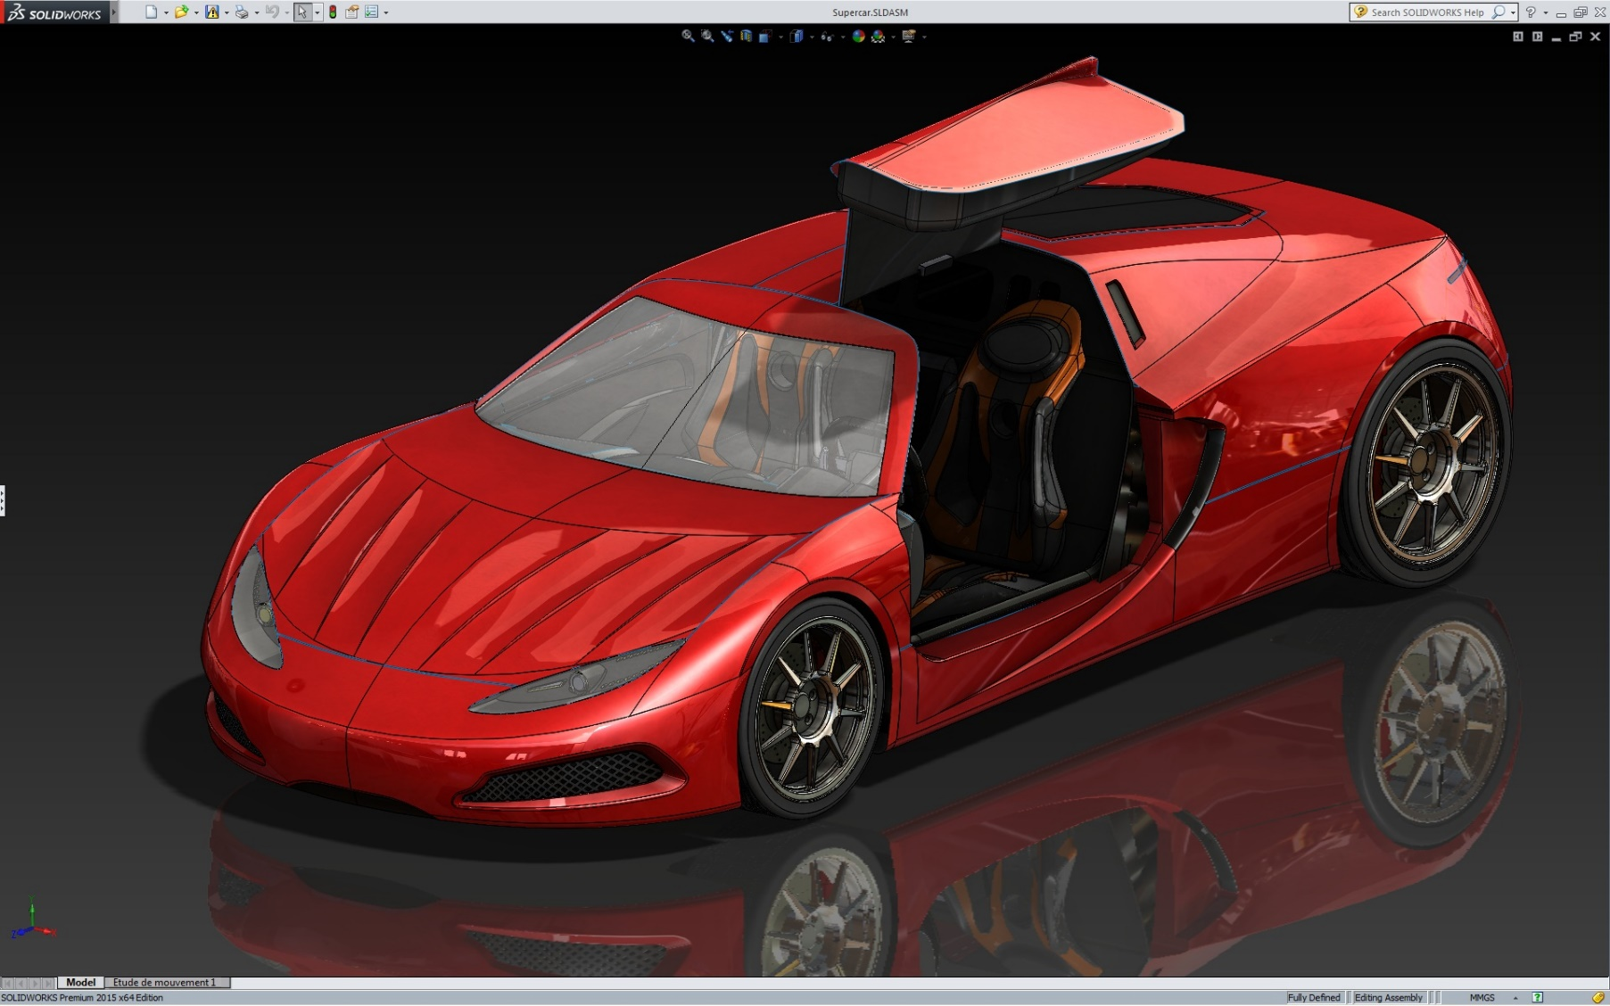
Up to
97%
FASTER
vs. NVIDIA Quadro K1200
The Radeon™ Pro WX4100 delivers up to 97% more performance than NVIDIA Quadro K1200 in SPECapc SOLIDWORKS 2015
Notes:
Footnote:
Testing conducted by AMD Performance Labs as of September 2016 on test system described below. PC manufacturers may vary configurations, yielding different results. Performance may vary based on use of latest drivers.
CPU: Intel E5-1650 v3 3.50GHz, Memory: 16GB RAM, OS: Win7 64-bit SP1, AMD Driver: 16.40 Beta Nvidia Driver: 368.39
Application: SPECapc Dassault SolidWorks 2015, no FSAA
Subtest: Shaded using RealView and Shadows and Ambient Occlusion Graphics Sub-composite
AMD WX4100 subtest score: 14.32
Nvidia Quadro K1200 subtest score: 7.26
Performance Differential: 14.32/7.26 = ~97.25% faster on AMD
RPW-11

Slide 23
Radeon Pro WX 4100 vs. NVIDIA Quadro K1200
46% FASTER
97% FASTER
CPU: Intel E5-1650 v3 3.50GHz, Memory: 16GB RAM, OS: Win7 64-bit SP1, AMD Driver: 15.301.2601.1002 RC3 Nvidia Driver: 368.39
93% FASTER
43% FASTER
50% FASTER
36% FASTER
Detailed performance data can be found in the appendix section
Notes:
Footnotes:
Testing conducted by AMD Performance Labs as of September 2016 on test system described below. PC manufacturers may vary configurations, yielding different results. Performance may vary based on use of latest drivers.
CPU: Intel E5-1650 v3 3.50GHz, Memory: 16GB RAM, OS: Win7 64-bit SP1, AMD Driver: 15.301.2601.1002 RC3 Nvidia Driver: 368.39
Application: SPECviewperf 12.1, official resolution
Subtest: 3dsmax-05
AMD WX4100 Composite 3dsmax-05 score: 49.30
Nvidia Quadro K1200 Composite 3dsmax-05 score: 36.24
Performance Differential: 49.30/36.24 = ~36.04% faster on AMD
RPW-7
Testing conducted by AMD Performance Labs as of September 2016 on test system described below. PC manufacturers may vary configurations, yielding different results. Performance may vary based on use of latest drivers.
CPU: Intel E5-1650 v3 3.50GHz, Memory: 16GB RAM, OS: Win7 64-bit SP1, AMD Driver: 16.40 Beta Nvidia Driver: 368.39
Application: SPECviewperf 12.1, official resolution
Subtest: catia-04
AMD WX4100 Composite catia-04 score: 53.37
Nvidia Quadro K1200 Composite catia-04 score: 35.37
Performance Differential: 53.37/35.37 = ~50.89% faster on AMD
RPW-8
Testing conducted by AMD Performance Labs as of September 2016 on test system described below. PC manufacturers may vary configurations, yielding different results. Performance may vary based on use of latest drivers.
CPU: Intel E5-1650 v3 3.50GHz, Memory: 16GB RAM, OS: Win7 64-bit SP1, AMD Driver: 16.40 Beta Nvidia Driver: 368.39
Application: SPECviewperf 12.1, official resolution
Subtest: creo-01
AMD WX4100 Composite creo-01 score: 53.24
Nvidia Quadro K1200 Composite creo-01 score: 36.99
Performance Differential: 53.24/36.99 = ~43.93% faster on AMD
RPW-9
Testing conducted by AMD Performance Labs as of September 2016 on test system described below. PC manufacturers may vary configurations, yielding different results. Performance may vary based on use of latest drivers.
CPU: Intel E5-1650 v3 3.50GHz, Memory: 16GB RAM, OS: Win7 64-bit SP1, AMD Driver: 16.40 Beta Nvidia Driver: 368.39
Application: SPECviewperf 12.1, official resolution
Subtest: snx-02
AMD WX4100 Composite snx-02 score: 56.34
Nvidia Quadro K1200 Composite snx-02 score: 29.14
Performance Differential: 56.34/29.14 = ~93.34% faster on AMD
RPW-10
Testing conducted by AMD Performance Labs as of September 2016 on test system described below. PC manufacturers may vary configurations, yielding different results. Performance may vary based on use of latest drivers.
CPU: Intel E5-1650 v3 3.50GHz, Memory: 16GB RAM, OS: Win7 64-bit SP1, AMD Driver: 16.40 Beta Nvidia Driver: 368.39
Application: SPECapc Dassault SolidWorks 2015, no FSAA
Subtest: Shaded using RealView and Shadows and Ambient Occlusion Graphics Sub-composite
AMD WX4100 subtest score: 14.32
Nvidia Quadro K1200 subtest score: 7.26
Performance Differential: 14.32/7.26 = ~97.25% faster on AMD
RPW-11
Testing conducted by AMD Performance Labs as of September 2016 on test system described below. PC manufacturers may vary configurations, yielding different results. Performance may vary based on use of latest drivers.
CPU: Intel E5-1650 v3 3.50GHz, Memory: 16GB RAM, OS: Win7 64-bit SP1, AMD Driver: 16.40 Beta Nvidia Driver: 368.39
Application: SPECviewperf 12.1, official resolution
Subtest: maya-04
AMD WX4100 Composite maya-04 score: 44.75
Nvidia Quadro K1200 Composite maya-04 score: 30.64
Performance Differential: 44.75/30.64 = ~46.05% faster on AMD
RPW-12

Slide 24




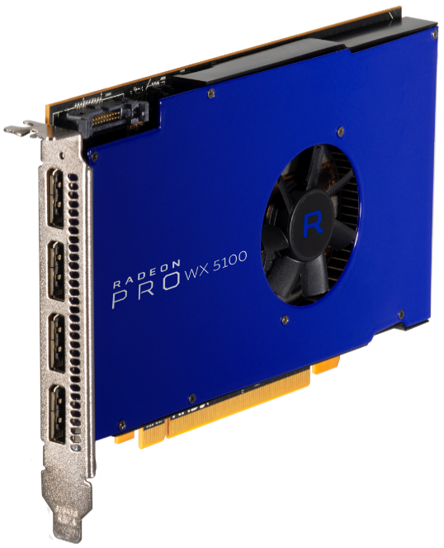

The Most Affordable Workstation Solution
for Professional VR Content Creation
Ready for the Game Engine
Revolution in CAD
Putting Pro Performance into
SFF Workstations
$799
$499
$399
Planned availability Q4 2016
Notes:
Add the MSRPs

Slide 25
Radeon Pro Enterprise Driver

Slide 26
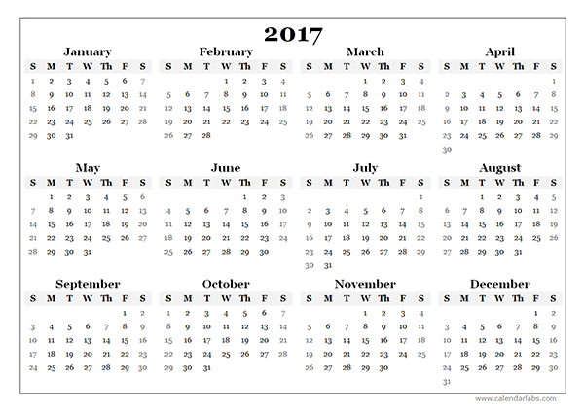
Radeon Pro Enterprise Driver: Commitment to Updates
Predictable Feature, Performance and Stability Improvements
Quarterly Driver Updates
  January 10th, April 11th, July 11th, October 10th, 2017
Enterprise Driver Program to include:
  Industry-leading stability and performance
  New productivity features
  Prioritized Support
Available on: AMD Radeon Pro WX-Series
Windows 7/10, Linux
Notes:
Starting with this Radeon Pro WHQL 16.10 driver, AMD is making a commitment to release Enterprise Driver updates to both end-users and OEMs on the 2nd Tuesday of each quarter.
The Enterprise Driver Program updates will include industry-leading stability and performance, new productivity features, and prioritized support.
Forward compatibility ready for Windows 10 and Radeon Pro Polaris-powered hardware.
In between quarters, Production Driver releases will add new features while continuing to provide the same industry-leading stability & performance for Professionals who need access to the latest Radeon Pro technologies.

Slide 27
Radeon Pro Enterprise Driver: Stability
Unprecedented Driver Quality and Reliability
Q&A IMAGE TBD
Continuing AMD’s stability story in 2016: only 2 customer field issues so far.
On top-tier ISV applications AMD has as few as zero issues:
  Only one issue in Siemens NX all year.
Q&A Labs stats and quote [TBA]
Sasa’s team to update
  "AMD consistently delivers quality drivers for AMD FirePro professional graphics matched with performance and robust support, so that Creo customers can accomplish their design potential.” Paul Sagar, Vice President of Product Management, MCAD Segment, PTC

Slide 28






Radeon Pro Enterprise Driver: Certifications
AMD is Certified on Leading ISV Applications
Certified in over 100 industry leading applications in multiple verticals, including media and entertainment, engineering and design, geographical information systems, life sciences and oil and gas.
Applications include
Autodesk 3ds Max Allplan Autodesk AutoCAD PTC Creo Blackmagic Design DaVinci Resolve | EnSight Siemens Femap SideFX Houdini Siemens NX Adobe Premiere Pro Dassault Systèmes SOLIDWORKS
Available on: Windows, OS X, Linux

Slide 29
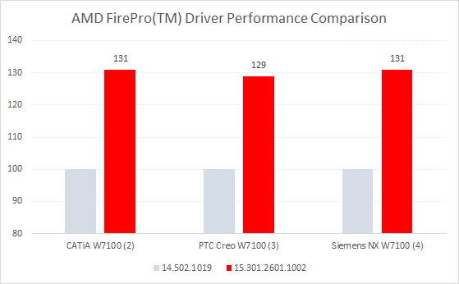
Radeon Pro Enterprise Driver: Performance
AMD FirePro™ and Radeon Pro Performance Leads in Key Applications
Carrying over improvements from our July AMD FirePro™ performance driver to our quarterly Enterprise Driver.
Get up to a 31% improvement in applications like CATIA , PTC Creo, and Siemens NX.
  "AMD's improved benchmark results meet our customer's expectations of high quality and increased performance. Siemens PLM Software relies on the latest AMD professional graphics drivers built for performance and reliability to enhance customer productivity for their design, engineering and manufacturing efforts.“ Chris Brosz, Vice President, Technical Operations, Siemens PLM Software

Slide 30
Radeon Pro Enterprise Driver: Value
Unprecedented Driver Quality and Reliability
Sasa’s team to update

Slide 31


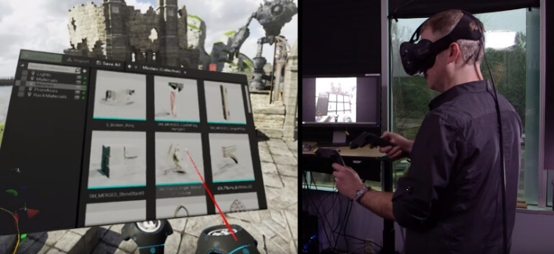


Radeon Pro Enterprise Driver: VR HMD Support
VR HMD Support for Content Creators
View content in VR in applications such as:
  Maya (via 3rd party plug-in)
  Autodesk VRED™ 3D
  Dassault Systèmes 3DEXPERIENCE
Ready to revolutionary tools like Unity VR Editor, Unreal Engine VR Editor
No longer a need to use separate hardware to view and edit content
Features
Support for VR HMD’s on VR Ready Creator hardware
Available on: AMD Radeon™ Pro WX 7100
Windows 7/10
Notes:
Allows content creators to view their work in VR in applications like Maya (via 3rd-party plug-in), Autodesk’s VRED™ 3D visualization software and the VR functionality of Dassault Systèmes 3DEXPERIENCE platform.
Ready for the Q4 release of upcoming revolutionary tools like the Unity VR Editor and Unreal Engine VR Editor.
VR and 360-video content creators no longer need to use separate hardware to view their content while working on it.
Features
Support for VR HMD’s on VR Ready Creator hardware.

Slide 32

Radeon Pro Enterprise Driver: LiquidVR™ Support
Brings AMD LiquidVR™ Technology to Professional Graphics
LiquidVR™ enables fully immersive and comfortable VR experiences by creating technology that fully exploits the capabilities of VR Ready Radeon Pro GPUs.
Features
  Support for LiquidVR™ features of the LiquidVR™ SDK
    TrueAudio Next.
    Asynchronous Shaders.
    Affinity Multi-GPU.
Available on: AMD Radeon Pro WX 7100
Windows 7/10

Slide 33


Radeon Pro Enterprise Driver: Hybrid Linux Driver
Combines the Best of Both Worlds for Linux Professional Graphics
AMD’s first release of the AMDGPU-PRO Hybrid Driver approach that combines an open-source core Linux driver with AMD’s closed-source Radeon Pro technologies.
Features
  Open Source: Base Graphics and Multimedia support.
  Closed Source: OpenCL, OpenGL.
  30-bit RGB color format for display.
  Virtual connector management.
Available on: AMD Radeon Pro WX Series GPUs,
Ubuntu, Red Hat Enterprise Linux

Slide 34

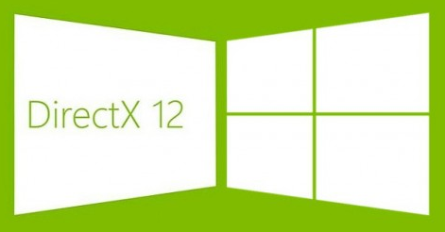
Radeon Pro Enterprise Driver: DirectX 12 and Vulkan™ Support
Low-level API Support for Next-Gen Applications
Support for DirectX 12 and Vulkan™ is critical due to the trend of real-time game engines that use these APIs disrupting content creation workflows.
Other leading content-creation tools are being updated to support these new low-level APIs.
Features
  Close-to-metal control enabling faster performance across Windows 7/8.1/10 for Vulkan™ and Windows 10 for DirectX 12.
  Compared to OpenGL, Vulkan™ substantially reduces “API overhead.”
  DirectX 12 asynchronous shaders allow the GPU to execute multiple tasks at the same time.
Available on: AMD Radeon Pro WX Series GPUs
Vulkan ™ : Windows 7/10 DX12: Windows 10

Slide 35
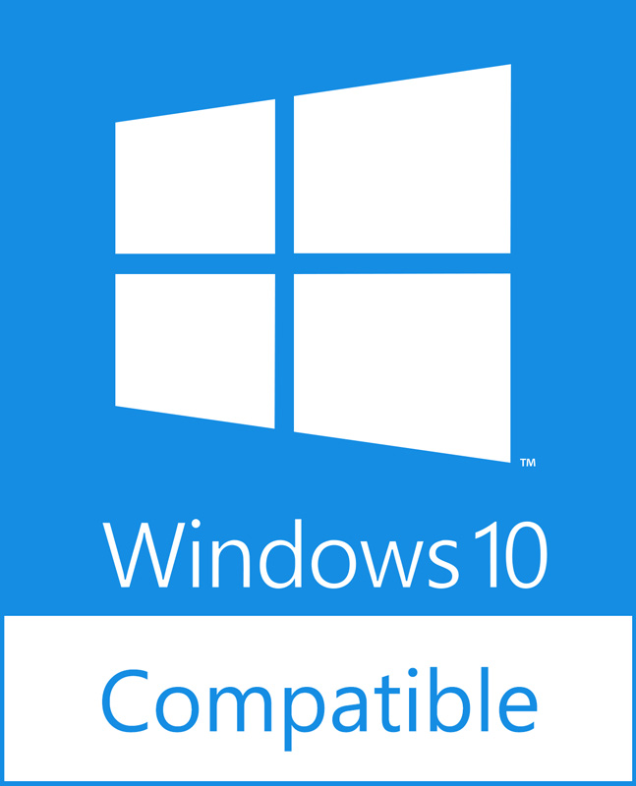
Radeon Pro Enterprise Driver: Windows 10 AU Support
Certified Support for the Windows 10 Anniversary Update
Radeon Pro WHQL Enterprise Driver.
Support for Windows 10 Device Guard, Microsoft’s new advanced malware protection feature.
Available on: AMD Radeon Pro WX Series GPUs
Windows 10 AU

Slide 36
Our Software Approach
Open & Non-Proprietary
Low-Level Access
Royalty-Free
Inclusive

Slide 37
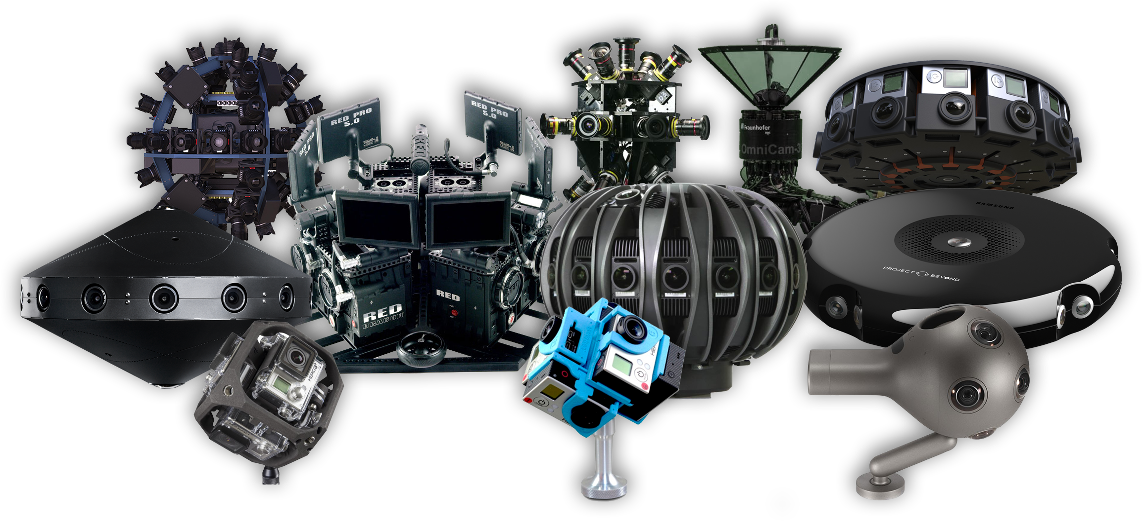

The Challenge of Real-Time 360 Video

Slide 38

RADEON
LOOM
A STITCH IN REAL-TIME
Real-time 360 video stitching solution for professional use
4-24 cameras, 1080p @ 60 fps outputting 4K @ 30 fps to HMDs and mobile devices
Enabled by Direct GMA
Planned availability as open source on GPUOpen later this year

Slide 39
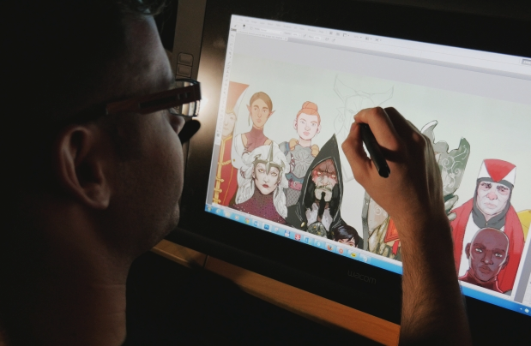

Our Passion
Empower story tellers. Support design and art technology that brings alive the visions for;
Professional designers, artists
Amateur designers, artists
Students of architecture, design, art and film
Casual creators
Anyone who wants to create
Concept artist Nick Thornborrow at work
in BioWare’s main studio in Edmonton

Slide 40

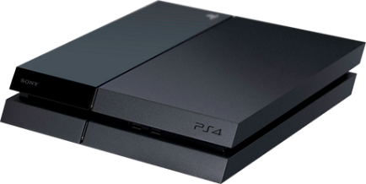
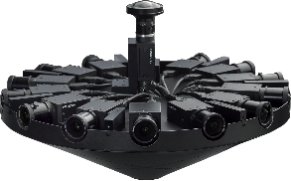










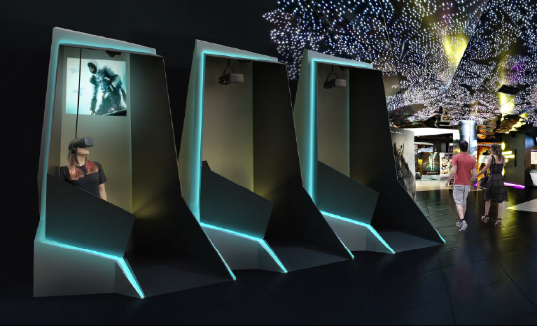







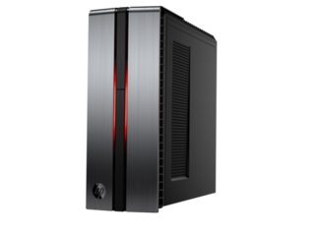
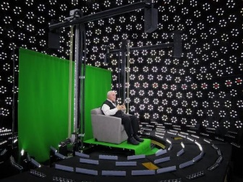






The Digital Content Pipeline
Asset Creation
Engines
Tools
Content Creators
Platforms
Cameras
Console
Renderers
Location based
Lightfields
PC

Slide 41
Engagement
500+ VR engagements
500+ game engagements
4000 members of the VES
1500 games developers
251 game publishers
100+ movie studios
6 film schools

Slide 42

Professional Focus Areas
GPU COMPUTING
HDR
RENDERING
LIQUIDVR™
DIRECTX® 12+ VULKAN™

Slide 43




Rendering on Radeon Pro
Partner Applications
Open Source Solutions

Slide 44


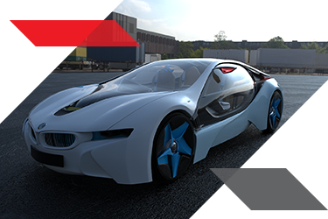
GPU Accelerated Ray Tracing
No-cost, open source
Powers AMD Technology like TrueAudio Next
Part of GPUOpen Initiative
Source: https://www.facebook.com/groups/VRayRT/permalink/655699424582634/
Notes:
Radeon Rays (formerly AMD Fire​Rays) is a high efficiency, high performance GPU accelerated ray tracing software.
Radeon Rays powers AMD technology like TrueAudio Next.
No-cost, open source, and license-free.
Features
Part of the GPUOpen initiative.
Radeon Rays works with a variety of low-level APIs including OpenCL.

Slide 45

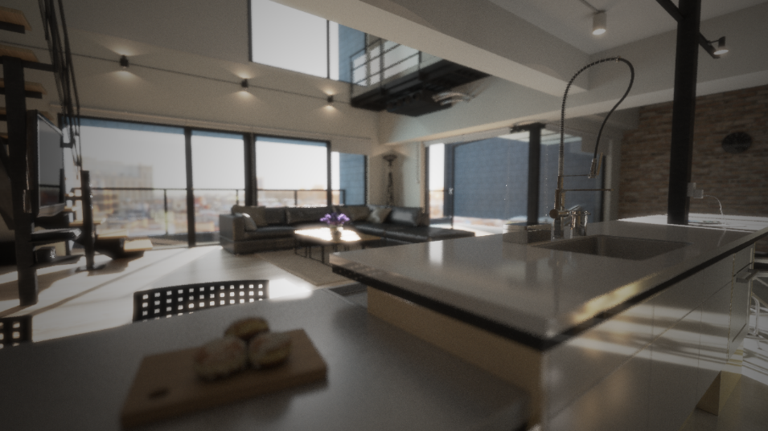
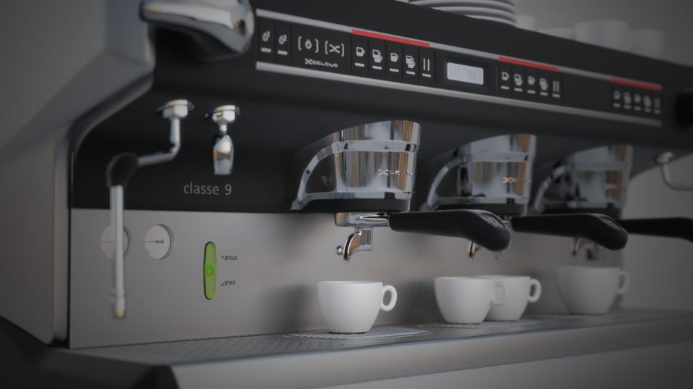
Open Source Rendering
GPU-accelerated
Non-proprietary compute
Open source
Notes:
Radeon ProRender is a powerful physically-based rendering engine that enables creative professionals to produce stunningly photorealistic images
Radeon ProRender plug-ins are now available for a broad selection of leading 3D content creation tools.

Slide 46



Notes:
Features
Already available plug-ins for Autodesk 3ds Max and Maya, Rhino and SOLIDWORKS.
Beta plug-in now available for Maxon’s Cinema 4D [TBD].

Slide 47











Slide 48

We’re serious about VR
The best experiences, expanding the ecosystem, and enabling developers

Slide 49
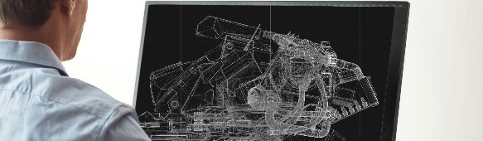
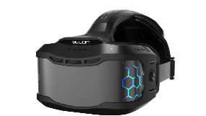
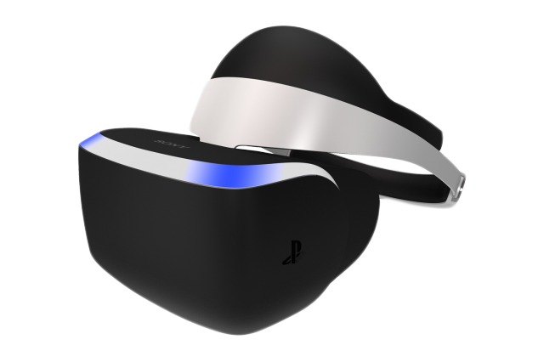





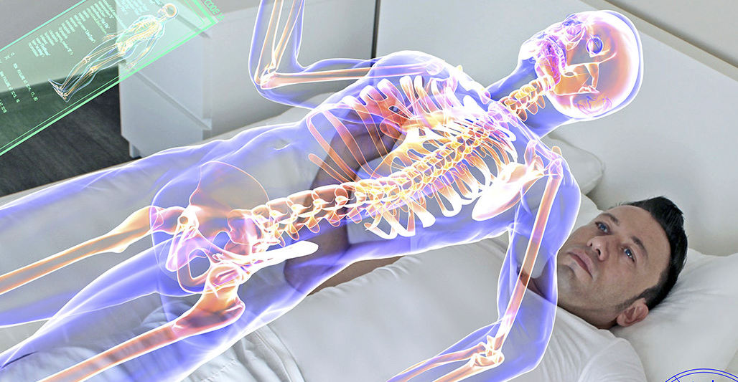



VR Ecosystem
VR PLATFORMS
FORM FACTORS
LOCATION BASED VR
VR CAFES
VR INDUSTRIES
GAMING
ENTERTAINMENT
EDUCATION
MEDICINE
DESIGN
VISUALIZATION
JOURNALISM

Slide 50


Solving big data set problems

Slide 51
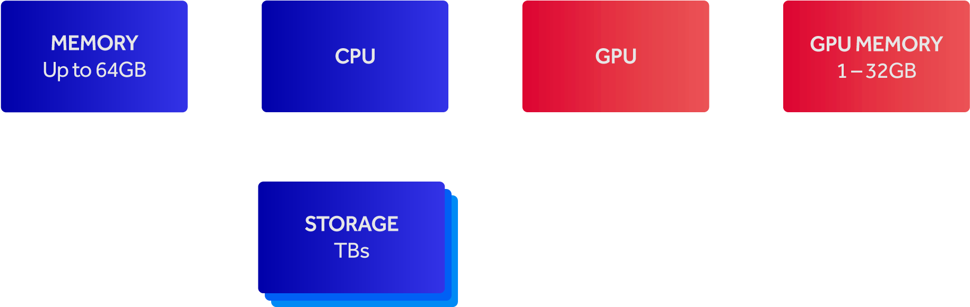
Transforming Workstation Architecture

Slide 52

Project Delta
Secret project started in May 2013 that asked what if...
What if we have direct control over memory with no latency?
What if we had 1TB+ non-volatile memory directly accessibly from the GPU?
What if we could have persistent large GPU assets?

Slide 53
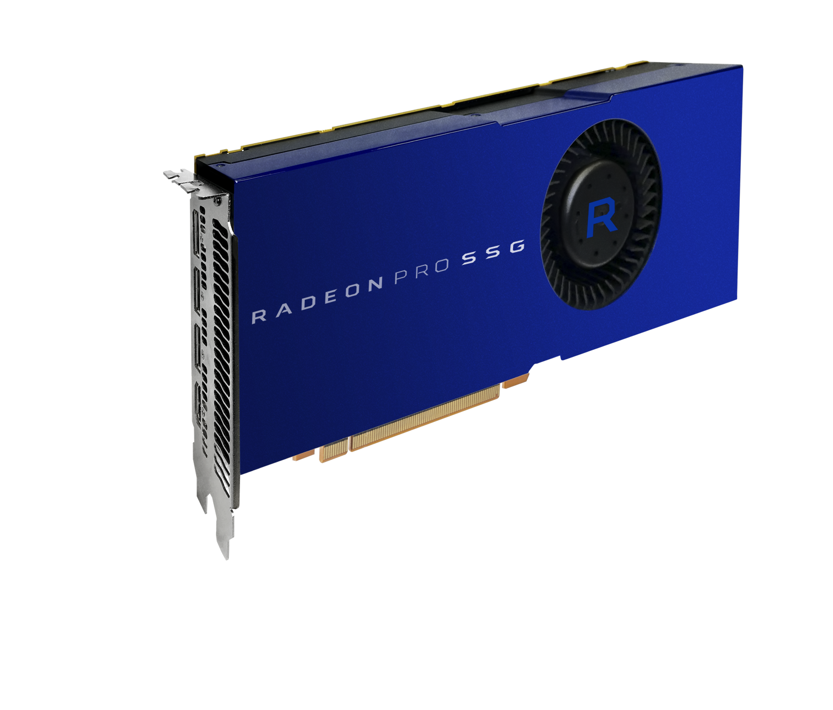
SSG
A Fundamental Change to Workstation Architecture

Slide 54
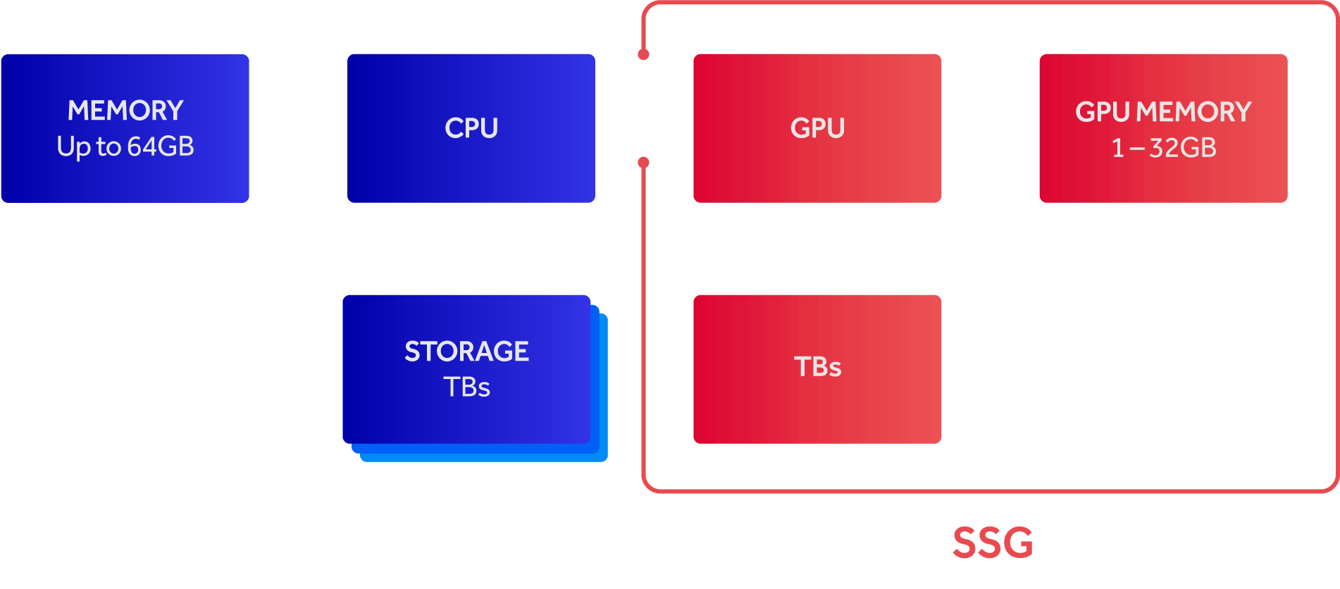
Transforming Workstation Architecture
SSG

Slide 55

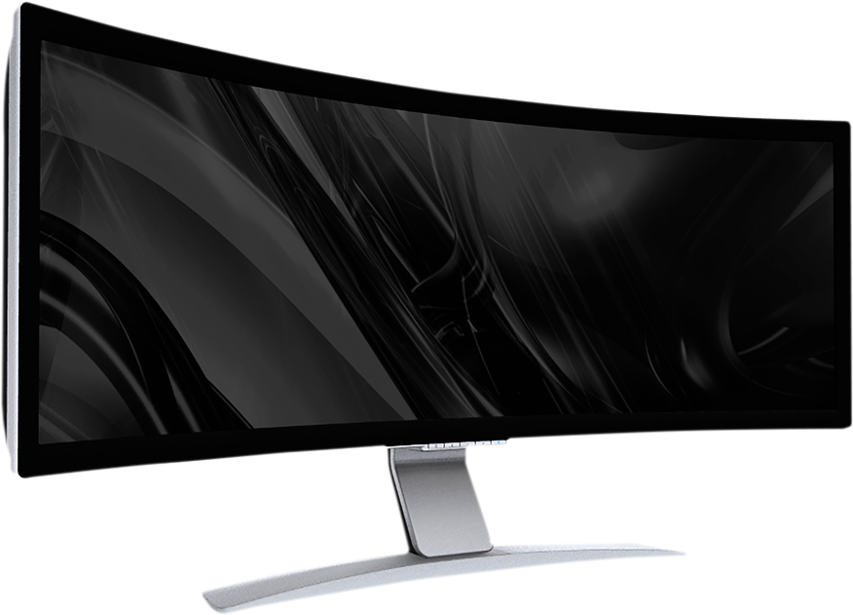
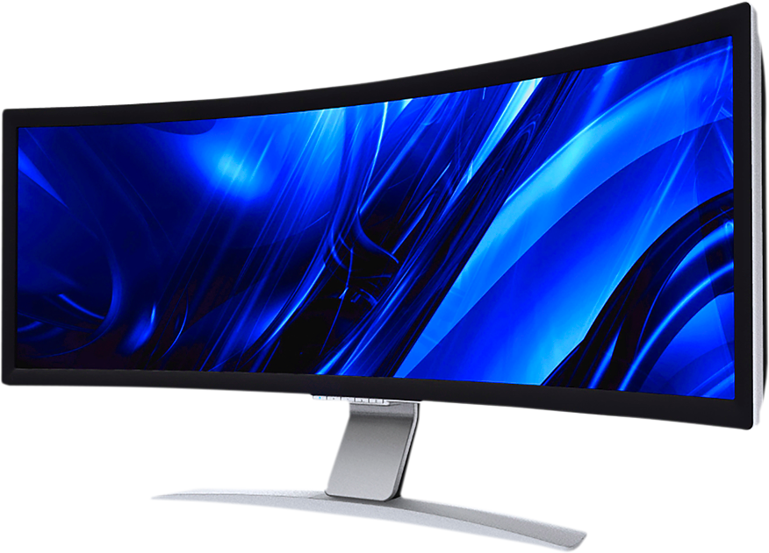
5X+ FASTER
Without Radeon Pro SSG
0.85 GB/s @ 17 fps
with Radeon Pro SSG
4.59 GB/s @ 92 fps
8K Uncompressed Editing Workflow
See endslate for details

Slide 56


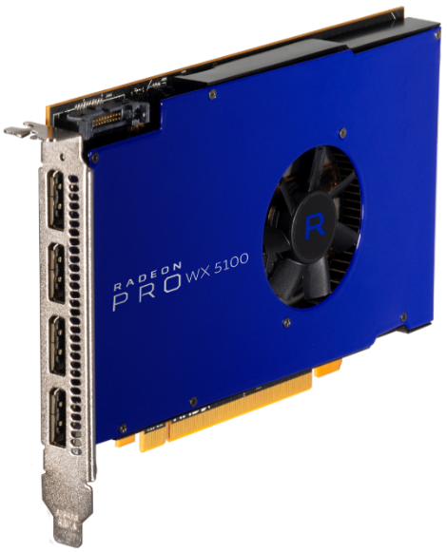

PROJECT
LOOM
A STITCH IN REAL-TIME

Slide 57
Appendix

Slide 58
Performance Data 1/5
Radeon Pro WX4100 delivers up to 36% more performance than NVidia Quadro K1200 in 3DSMax SPECviewperf 12.1 | Testing conducted by AMD Performance Labs as of September 2016 on test system described below. PC manufacturers may vary configurations, yielding different results. Performance may vary based on use of latest drivers. CPU: Intel E5-1650 v3 3.50GHz, Memory: 16GB RAM, OS: Win7 64-bit SP1, AMD Driver: 15.301.2601.1002 RC3 Nvidia Driver: 368.39 Application: SPECviewperf 12.1, official resolution Subtest: 3dsmax-05 AMD WX4100 Composite 3dsmax-05 score: 49.30 Nvidia Quadro K1200 Composite 3dsmax-05 score: 36.24 Performance Differential: 49.30/36.24 = ~36.04% faster on AMD RPW-7
Radeon Pro WX4100 delivers up to 50% more performance than NVidia Quadro K1200 in Catia SPECviewperf 12.1 | Testing conducted by AMD Performance Labs as of September 2016 on test system described below. PC manufacturers may vary configurations, yielding different results. Performance may vary based on use of latest drivers. CPU: Intel E5-1650 v3 3.50GHz, Memory: 16GB RAM, OS: Win7 64-bit SP1, AMD Driver: 16.40 Beta Nvidia Driver: 368.39 Application: SPECviewperf 12.1, official resolution Subtest: catia-04 AMD WX4100 Composite catia-04 score: 53.37 Nvidia Quadro K1200 Composite catia-04 score: 35.37 Performance Differential: 53.37/35.37 = ~50.89% faster on AMD RPW-8
Radeon Pro WX4100 delivers up to 43% more performance than NVidia Quadro K1200 in Creo SPECviewperf 12.1 | Testing conducted by AMD Performance Labs as of September 2016 on test system described below. PC manufacturers may vary configurations, yielding different results. Performance may vary based on use of latest drivers. CPU: Intel E5-1650 v3 3.50GHz, Memory: 16GB RAM, OS: Win7 64-bit SP1, AMD Driver: 16.40 Beta Nvidia Driver: 368.39 Application: SPECviewperf 12.1, official resolution Subtest: creo-01 AMD WX4100 Composite creo-01 score: 53.24 Nvidia Quadro K1200 Composite creo-01 score: 36.99 Performance Differential: 53.24/36.99 = ~43.93% faster on AMD RPW-9

Slide 59
Performance Data 2/5
Radeon Pro WX4100 delivers up to 93% more performance than NVidia Quadro K1200 in Siemens NX SPECviewperf 12.1 | Testing conducted by AMD Performance Labs as of September 2016 on test system described below. PC manufacturers may vary configurations, yielding different results. Performance may vary based on use of latest drivers. CPU: Intel E5-1650 v3 3.50GHz, Memory: 16GB RAM, OS: Win7 64-bit SP1, AMD Driver: 16.40 Beta Nvidia Driver: 368.39 Application: SPECviewperf 12.1, official resolution Subtest: snx-02 AMD WX4100 Composite snx-02 score: 56.34 Nvidia Quadro K1200 Composite snx-02 score: 29.14 Performance Differential: 56.34/29.14 = ~93.34% faster on AMD RPW-10
Radeon Pro WX4100 delivers up to 97% more performance than NVidia Quadro K1200 in SPECapc Solidworks 2015 | Testing conducted by AMD Performance Labs as of September 2016 on test system described below. PC manufacturers may vary configurations, yielding different results. Performance may vary based on use of latest drivers. CPU: Intel E5-1650 v3 3.50GHz, Memory: 16GB RAM, OS: Win7 64-bit SP1, AMD Driver: 16.40 Beta Nvidia Driver: 368.39 Application: SPECapc Dassault SolidWorks 2015, no FSAA Subtest: Shaded using RealView and Shadows and Ambient Occlusion Graphics Sub-composite AMD WX4100 subtest score: 14.32 Nvidia Quadro K1200 subtest score: 7.26 Performance Differential: 14.32/7.26 = ~97.25% faster on AMD RPW-11
Radeon Pro WX4100 delivers up to 46% more performance than NVidia Quadro K1200 in Maya SPECviewperf 12.1 | Testing conducted by AMD Performance Labs as of September 2016 on test system described below. PC manufacturers may vary configurations, yielding different results. Performance may vary based on use of latest drivers. CPU: Intel E5-1650 v3 3.50GHz, Memory: 16GB RAM, OS: Win7 64-bit SP1, AMD Driver: 16.40 Beta Nvidia Driver: 368.39 Application: SPECviewperf 12.1, official resolution Subtest: maya-04 AMD WX4100 Composite maya-04 score: 44.75 Nvidia Quadro K1200 Composite maya-04 score: 30.64 Performance Differential: 44.75/30.64 = ~46.05% faster on AMD RPW-12

Slide 60
Performance Data 3/5
Radeon Pro WX5100 delivers up to 41% more performance than NVidia Quadro M2000 in Siemens NX SPECviewperf 12.1 | Testing conducted by AMD Performance Labs as of September 2016 on test system described below. PC manufacturers may vary configurations, yielding different results. Performance may vary based on use of latest drivers. CPU: Intel E5-1650 v3 3.50GHz, Memory: 16GB RAM, OS: Win7 64-bit SP1, AMD Driver: 16.40 Beta Nvidia Driver: 368.39 Application: SPECviewperf 12.1, official resolution Subtest: snx-02 AMD WX5100 Composite snx-02 score: 76.28 Nvidia Quadro M2000 Composite snx-02 score: 54.05 Performance Differential: 76.28/54.05 = ~41.13% faster on AMD RPW-13
Radeon Pro WX5100 delivers up to 34% more performance than NVidia Quadro M2000 in SPECapc Solidworks 2015 | Testing conducted by AMD Performance Labs as of September 2016 on test system described below. PC manufacturers may vary configurations, yielding different results. Performance may vary based on use of latest drivers. CPU: Intel E5-1650 v3 3.50GHz, Memory: 16GB RAM, OS: Win7 64-bit SP1, AMD Driver: 16.40 Beta Nvidia Driver: 368.39 Application: SPECapc Dassault SolidWorks 2015, no FSAA Subtest: Shaded using RealView and Shadows and Ambient Occlusion Graphics Sub-composite AMD WX5100 subtest score: 15.57 Nvidia Quadro M2000 subtest score: 11.60 Performance Differential: 15.57/11.60 = ~34.22% faster on AMD RPW-14
Radeon Pro WX5100 delivers up to 11% more performance than NVidia Quadro M2000 in 3DSMax SPECviewperf 12.1 | Testing conducted by AMD Performance Labs as of September 2016 on test system described below. PC manufacturers may vary configurations, yielding different results. Performance may vary based on use of latest drivers. CPU: Intel E5-1650 v3 3.50GHz, Memory: 16GB RAM, OS: Win7 64-bit SP1, AMD Driver: 15.301.2601.1002 RC3 Nvidia Driver: 368.39 Application: SPECviewperf 12.1, official resolution Subtest: 3dsmax-05 AMD WX5100 Composite 3dsmax-05 score: 67.88 Nvidia Quadro M2000 Composite 3dsmax-05 score: 61.00 Performance Differential: 67.88/61.00 = ~11.28% faster on AMD RPW-15

Slide 61
Performance Data 4/5
Radeon Pro WX7100 delivers up to 17% more performance than NVidia Quadro M4000 in Siemens NX SPECviewperf 12.1 | Testing conducted by AMD Performance Labs as of September 2016 on test system described below. PC manufacturers may vary configurations, yielding different results. Performance may vary based on use of latest drivers. CPU: Intel E5-1650 v3 3.50GHz, Memory: 16GB RAM, OS: Win7 64-bit SP1, AMD Driver: 16.40 Beta Nvidia Driver: 368.39 Application: SPECviewperf 12.1, official resolution Subtest: snx-02 AMD WX7100 Composite snx-02 score: 91.37 Nvidia Quadro M4000 Composite snx-02 score: 78.02 Performance Differential: 91.37/78.02 = ~17.11% faster on AMD RPW-16
Radeon Pro WX7100 delivers up to 14% more performance than NVidia Quadro M4000 in SPECapc Siemens PLM NX 10.0 | Testing conducted by AMD Performance Labs as of September 2016 on test system described below. PC manufacturers may vary configurations, yielding different results. Performance may vary based on use of latest drivers. CPU: Intel E5-1650 v3 3.50GHz, Memory: 16GB RAM, OS: Win7 64-bit SP1, AMD Driver: 16.40 Beta Nvidia Driver: 368.39 Application: SPECapc Siemens PLM NX 10.0, FSAA Subtest: N/A AMD WX7100 Composite score: 5.14 Nvidia Quadro M4000 Composite score: 4.48 Performance Differential: 5.14/4.48 = ~14.73% faster on AMD RPW-17
Radeon Pro WX7100 delivers up to 45% more performance than NVidia Quadro M4000 in SPECapc Solidworks 2015 | Testing conducted by AMD Performance Labs as of September 2016 on test system described below. PC manufacturers may vary configurations, yielding different results. Performance may vary based on use of latest drivers. CPU: Intel E5-1650 v3 3.50GHz, Memory: 16GB RAM, OS: Win7 64-bit SP1, AMD Driver: 16.40 Beta Nvidia Driver: 368.39 Application: SPECapc Dassault SolidWorks 2015, no FSAA Subtest: Shaded using RealView and Shadows and Ambient Occlusion Graphics Sub-composite AMD WX7100 subtest score: 21.00 Nvidia Quadro M4000 subtest score: 14.45 Performance Differential: 21.00/14.45 = ~45.33% faster on AMD RPW-18

Slide 62
Performance Data 5/5
Radeon Pro WX7100 delivers up to 68% more performance than NVidia Quadro M4000 in SteamVR Performance Test | Testing conducted by AMD Performance Labs as of September 2016 on test system described below. PC manufacturers may vary configurations, yielding different results. Performance may vary based on use of latest drivers. System: DELL Precision Tower 5810 Workstation CPU: Intel Xeon E5-1603 v3 2.80GHz, Memory: 64GB RAM, OS: Win10 Pro 64-bit Build 14393, AMD Driver: 16.40. Nvidia Driver: 369.26 Storage: SK Hynix SSD 512GB Application: SteamVR Performance Test Subtest: N/A AMD WX7100 Average Quality score: 6.4 Nvidia Quadro M4000 Average Quality score: 3.8 Performance Differential: 6.40/3.80 = ~68.42% higher score on AMD RPW-19
Radeon Pro WX7100 delivers up to 43% more performance than NVidia Quadro M4000 on GPU-acceleration in Adobe Premiere Pro CC 2015 | Testing conducted by AMD Performance Labs as of September 2016 on test system described below. PC manufacturers may vary configurations, yielding different results. Performance may vary based on use of latest drivers. System: DELL Precision Tower 5810 Workstation CPU: Intel Xeon E5-1603 v3 2.80GHz, Memory: 64GB RAM, OS: Win10 Pro 64-bit Build 14393, AMD Driver: 16.40. Nvidia Driver: 369.26 Storage: SK Hynix SSD 512GB Application: Adobe Premiere Pro CC 2015 Subtest: / AMD WX7100 time to render 37 GPU-accelerated effects: 34 mins 33 secs = 2073 seconds Nvidia Quadro M4000 time to render 37 GPU-accelerated effects: 49mins 19 secs = 2959 seconds Performance Differential: 2959/2073 = ~42.74% slower on Nvidia/~42.74% faster on AMD RPW-22
Radeon Pro WX7100 delivers up to 22% more performance than NVidia Quadro M4000 in CINEBENCH | Testing conducted by AMD Performance Labs as of September 2016 on test system described below. PC manufacturers may vary configurations, yielding different results. Performance may vary based on use of latest drivers. System: DELL Precision Tower 5810 Workstation CPU: Intel Xeon E5-1603 v3 2.80GHz, Memory: 64GB RAM, OS: Win7 64 Bit Service Pack 1 Build 14393, AMD Driver: 16.40. Nvidia Driver: 369.26 Storage: Samsung SSD 850 PRO 512GB Application: CINEBENCH Windows 64 Bit Subtest: OpenGL Test AMD WX7100 subtest score: 133.11 Nvidia Quadro M4000 subtest score: 109.08 Performance Differential: 133.11/109.08 = ~22.03% faster on AMD RPW-23

Slide 63
Disclaimers & Attribution
Slides 23, 24 and 25, discrete AMD Radeon™ and Radeon™ Pro GPUs based on the Graphics Core Next architecture consist of multiple discrete execution engines known as a Compute Unit (“CU”). Each CU contains 64 shaders (“Stream Processors”) working together. GD-78
Slides 23 and 27, in AMD internal testing, the Radeon™ Pro WX 7100 exceeded the minimum requirements of the SteamVR test.
Slide 61, Radeon Pro SSG demo: System 1: w/out Radeon Pro SSG, CPU: i7 4790K, RAM: 16GB DDR3 1600Mhz, Motherboard: Gigabyte GA-Z97X- Gaming5, PSU: 1200W, GPU: Radeon R9 Nano, SSD (OS): Samsung 850 Evo 250GB, SSD2 (demo content) - M.2 Samsung 950 Pro 512GB, GPU driver: 16.30.2010-160629n- 304071E, Video Player: AMD LiquidFlashPlayer - internal app, Demo Content - Raw 8K Video file, OS: Win 10 64bit. System 2: w/ Radeon Pro SSG, CPU: i7 4790K, RAM: 16GB DDR3 1600Mhz, Motherboard: Gigabyte GA-Z97X- Gaming5, PSU: 1200W, GPU: RadeonPro SSG, SSD (OS): Samsung 850 Evo 250GB, GPU driver: 16.30.2010-160629n- 304071E, Video Player: AMD LiquidFlashPlayer - internal app, Demo Content - Raw 8K Video file, OS: Win 10 64bit. System with Radeon Pro SSG scores 0.85 GB/s @ 17 fps. System with Radeon Pro SSG scores 4.59 GB/s @ 92 fps, more than 5X that of the system without Radeon Pro SSG.

Slide 64
Disclaimers & Attribution
The information presented in this document is for informational purposes only and may contain technical inaccuracies, omissions and typographical errors.
The information contained herein is subject to change and may be rendered inaccurate for many reasons, including but not limited to product and roadmap changes, component and motherboard version changes, new model and/or product releases, product differences between differing manufacturers, software changes, BIOS flashes, firmware upgrades, or the like. AMD assumes no obligation to update or otherwise correct or revise this information. However, AMD reserves the right to revise this information and to make changes from time to time to the content hereof without obligation of AMD to notify any person of such revisions or changes.
AMD MAKES NO REPRESENTATIONS OR WARRANTIES WITH RESPECT TO THE CONTENTS HEREOF AND ASSUMES NO RESPONSIBILITY FOR ANY INACCURACIES, ERRORS OR OMISSIONS THAT MAY APPEAR IN THIS INFORMATION.
AMD SPECIFICALLY DISCLAIMS ANY IMPLIED WARRANTIES OF MERCHANTABILITY OR FITNESS FOR ANY PARTICULAR PURPOSE. IN NO EVENT WILL AMD BE LIABLE TO ANY PERSON FOR ANY DIRECT, INDIRECT, SPECIAL OR OTHER CONSEQUENTIAL DAMAGES ARISING FROM THE USE OF ANY INFORMATION CONTAINED HEREIN, EVEN IF AMD IS EXPRESSLY ADVISED OF THE POSSIBILITY OF SUCH DAMAGES.
ATTRIBUTION
© 2016 Advanced Micro Devices, Inc. All rights reserved. AMD, the AMD Arrow logo, Radeon and combinations thereof are trademarks of Advanced Micro Devices, Inc. in the United States and/or other jurisdictions. DirectX is a registered trademark of Microsoft Corporation in the US and other jurisdictions. HDMI, the HDMI logo and High-Definition Multimedia Interface are trademarks or registered trademarks of HDMI Licensing, LLC in the United States and other countries. Vulkan and the Vulkan logo are trademarks of Khronos Group Inc. 3DMark is a registered trademark of the Futuremark Corporation. Other names are for informational purposes only and may be trademarks of their respective owners.

