Slide 1
Industry leading led line-up
June 2016

Slide 2
Agenda
LED Product Line overview
Planar and Leyard LED product families
Selecting the right model
Questions & Answers

Slide 3
A Stronger LED Product Line For You
What Leyard/Planar Brings
More products so you can meet requirements of more deals
  Indoor, outdoor, fine pitch, standard pitch, specialty
Market power – #1 worldwide leader in fine pitch LED video walls
  Superior technology, deepest expertise, aggressive cost, highest profile installs
Spirit of Innovation
  Pioneered fine-pitch LED video wall category, big plans in the pipeline
Partnerships
  Commitment to reseller partner success

Slide 4
LED Product Landscape
Larger Pitch
Rental & Staging
Specialty
20mm
Standard Pitch
6mm
Indoor / Outdoor
2.5 – 3 mm
Fine Pitch
(“NPP” – Narrow Pixel Pitch)
Indoor
Indoor / Outdoor
0.9mm
Indoor

Slide 5
LED Product Landscape
20mm
Indoor arena
Outdoor arena
Outdoor billboard
Building facade
Events
Semi-fixed
Light hanging
Curves
Right angle corners
6mm
Larger indoor space
Airport
Mall
Museum (further viewing)
Gaming Sports Book
Control room
Conference room / Decision room
Corporate lobby and common areas
Auditorium
Broadcast on-air
Museum (close viewing)
In-Store Retail
High end home
Atrium / Architectural
Indoor / Outdoor
2.5 – 3 mm
Indoor
Indoor / Outdoor
0.9mm
Indoor
Applications

Slide 6
LED Product Landscape
Larger Pitch
Rental & Staging
Specialty
20mm
Leyard uLV
Leyard NVH
Leyard CarbonLight CLO, CLM
Leyard CarbonLight
CLA (arc)
CLI (indoor)
CLO (outdoor)
CLM (mesh)
CLF (floor)
Standard Pitch
6mm
Leyard uEV
Leyard CarbonLight CLI
Indoor / Outdoor
2.5 – 3 mm
Fine Pitch
(“NPP” – Narrow Pixel Pitch)
Indoor
Planar DirectLight™
Leyard TVH
Leyard TW / TWA
Leyard CarbonLight™ CLA
Indoor / Outdoor
0.9mm
Indoor
Product Lines

Slide 7
Expanded LED Product Line-up
Product | Planar® DirectLight™ | Leyard® TVH | Leyard® TWA / TW | Leyard® uEV | Leyard® NVH | Leyard® uLV | Leyard® CarbonLight™ CLA | Leyard® CarbonLight™ CLI | Leyard® CarbonLight™ CLO | Leyard® CarbonLight™ CLF | Leyard® CarbonLight™ CLM
Indoor | X | X | X | X | X |  | X | X |  | X
Outdoor |  |  |  |  | X | X |  |  | X | X | X
Rental |  |  |  |  | X |  | X | X | X | X | X
Cab Size (mm) | 400 x 300 | 400 x 300 | 1200 x 675 | 720 x 960 | 640 x 480 | 1280 x 960 | 250 x 250 | 500 x 500 | 500 x 500 | 500 x 500 | 1000 x 500
Pitch: <1mm
1.2 |  |  | 1.2
1.5 | 1.6 | 1.6 |  |  |  |  | 1.5
2.0 | 1.9 | 1.9 | 1.8 |  |  |  | 1.9
2.5 | 2.5 | 2.5 | 2.5 |  |  |  |  | 2.6
3.0 | 3.1
4.0 |  |  |  | 4 |  |  |  | 3.9 | 3.9
5.0 and up |  |  |  | 5, 6 | 8 | 10, 16, 20 |  | 5.2 | 5.2, 7.8 | 5.2, 6.2, 10.4 | 10.4, 15.6

Slide 8
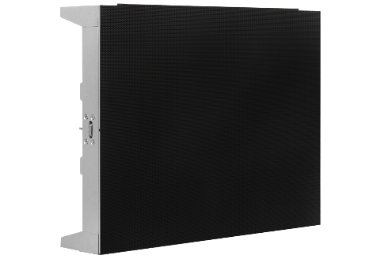
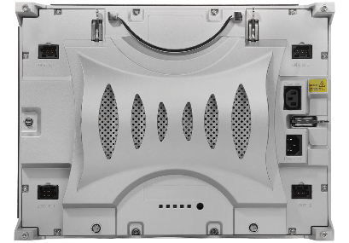
Leyard TVH Series
Industry leading fine pitch solution
Family of high performance, fine-pitch video wall displays
Proven industry-leading image quality
Fit a wide range of indoor installation environments
Advanced design offering redundancy and precision alignment
Compact 400 x 300mm Cabinet
Pitches: 1.6, 1.9, and 2.5mm

Slide 9
Proven Image Quality by Design
Outstanding black levels – black LEDs and MicroGrid shader
Wide viewing angles with excellent off-axis uniformity
Advanced calibration for maximum full screen color and brightness uniformity
Smooth and consistent grayscale even at low brightness
Color control to optimize for particular applications

Slide 10
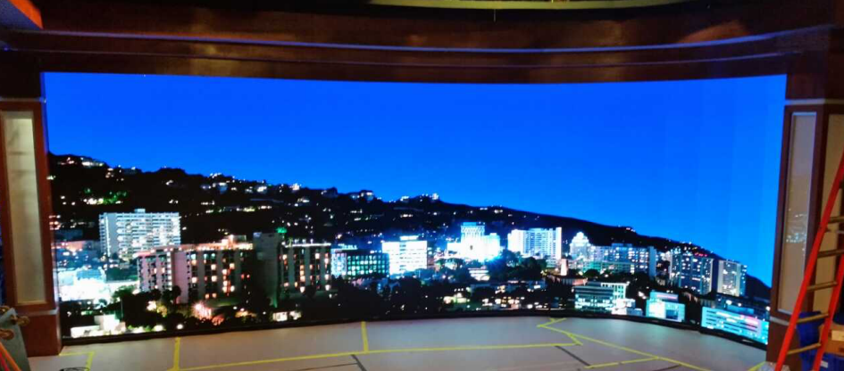
Fits More Environments
Compact 400 x 300mm cabinet (19.5” diagonal)
Easy to handle
Allows for more exact fit to wall size
Works nicely with concave curved installations
ABC Jimmy Kimmel set
TVH 1.6 – 32’ x 9’
Smooth “J” shape requires tight curve capability

Slide 11
Optimized for 16:9 Aspect Ratio
Perfectly display existing Full HD content and sources
11.8’ / 3.6m
289.1” / 7.3m
8.9’ / 2.7m
216.8” / 5.5m
5.9’ / 1.8m
144.5” / 3.7m
3.0’ / 0.9m
72.3” / 1.8m
5.3’ 1.6m
10.5’ 3.2m
15.8’ 4.8m
21.0’ 6.4m
TVH 1.6 | 960 x 540 | 1,920 x 1,080 | 2,880 x 1,620 | 3,840 x 2,160
TVH 1.9 | 832 x 468 | 1,664 x 936 | 2,496 x 1,404 | 3,328 x 1,872
TVH 2.5 | 640 x 360 | 1,280 x 720 | 1,920 x 1,080 | 2,560 x 1,440

Slide 12
Broadcast
NBC Sports – Stamford, CT
Leyard TVH1.9 and TVH2.5

Slide 13
TVH Specifications
Industry Leading Fine Pitch Solution
 | TVH 1.6 | TVH 1.9 | TVH 2.5
Pitch (mm) | 1.667mm | 1.923mm | 2.5mm
Pixels per cabinet | 240 x 180 | 208 x 156 | 160 x120
Cabinet size (WxHxD) mm | 400 x 300 x 93 | 400 x 300 x 93 | 400 x 300 x 93
Brightness (calibrated) | 800 nits | 800 nits | 800 nits
LED lifetime | 100,000 hr | 100,000 hr | 100,000 hr
Viewing angles (H / V) ° | 160 / 140 | 160 / 140 | 160 / 140
Weight per cabinet | 13.2lb / 6kg | 13.2lb / 6kg | 13.2lb / 6kg
Serviceability | Rear | Rear | Rear
Environment | Indoor | Indoor | Indoor

Slide 14
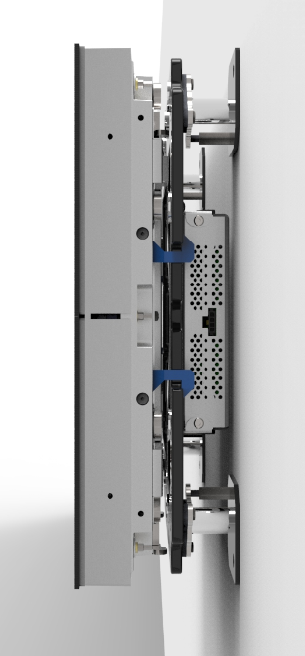
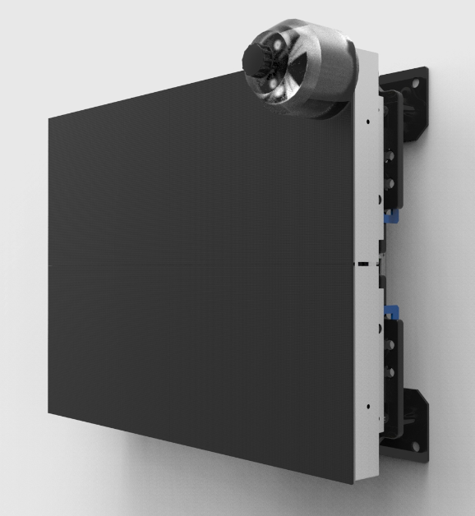
Planar DirectLight™
Premier Ultra-Slim Fine Pitch Solution
Unique fine-pitch video wall system available in range of pitches
Wall-mounted, full front access video wall that takes less room
Incorporated mount and alignment features that reduce time to deployment and produce perfectly aligned walls
Built for image quality, reliability, redundancy and long life
Ultra-slim 400 x 300mm Display Module
Pitches: 1.6, 1.9, 2.5 and 3.1mm

Slide 15
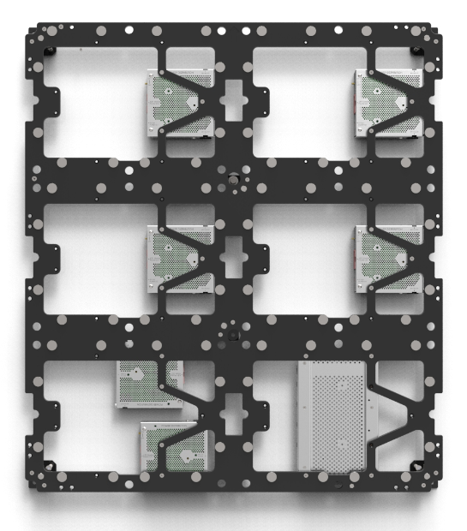
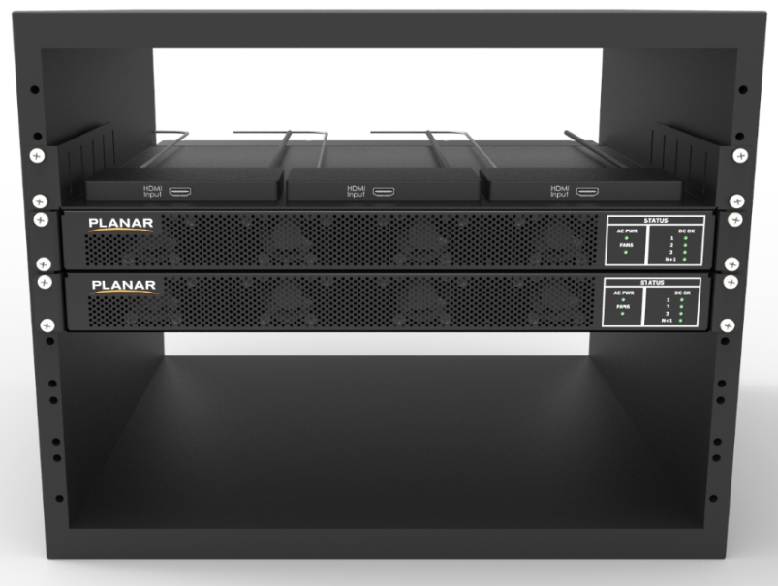
Complete LED Video Wall System
Adjustable Wall Mount
Front Access Display Module
Alignment features
< 4” depth mounted
Off-board, Redundant Power
DirectLight Control software for management

Slide 16
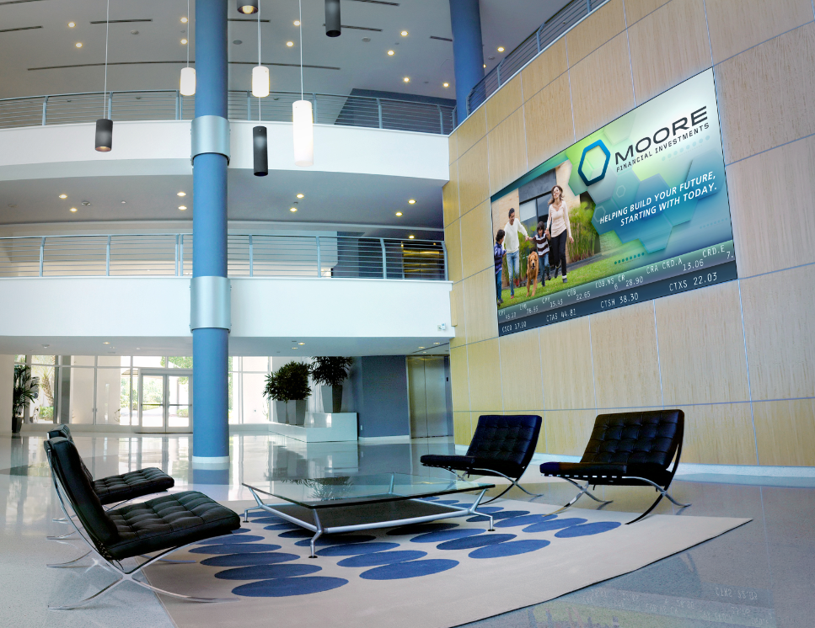
Perfect Installations

Slide 17
DirectLight Specifications
Premier Ultra-Slim Fine Pitch Solution
 | DL 1.6 | DL 1.9 | DL 2.5 | DL 3.1
Pitch (mm) | 1.667mm | 1.923mm | 2.5mm | 3.1mm
Pixels per cabinet | 240 x 180 | 208 x 156 | 160 x120 | 128 x 96
Cabinet size (WxHxD) mm | 400 x 300 x 67 | 400 x 300 x 67 | 400 x 300 x 67 | 400 x 300 x 67
Brightness (calibrated) | 900 nits | 900 nits | 900 nits | 900 nits
LED lifetime | 100,000 hr | 100,000 hr | 100,000 hr | 100,000 hr
Viewing angles (H / V) ° | 160 / 155 | 160 / 155 | 160 / 155 | 160 / 155
Weight per cabinet | 11.5lb / 5.2kg | 11.5lb / 5.2kg | 11.5lb / 5.2kg | 11.5lb / 5.2kg
Serviceability | Front | Front | Front | Front
Environment | Indoor | Indoor | Indoor | Indoor

Slide 18
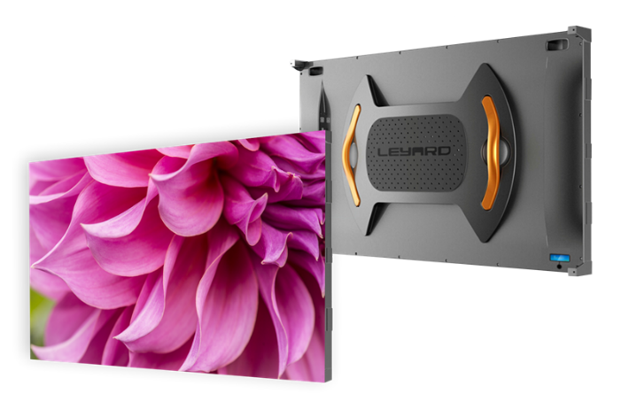
Leyard TWA Series LED Video Walls
Industry’s first flat-panel LED video wall
Family of LED video wall displays supporting even the closest viewing distances
Delivers benefits of unique “flat panel” design
Outstanding image quality
Advanced design for reliability and ease of installation and service
54” diagonal, flat panel design
Pitches: 1.2, 1.8 and 2.5mm (TW)

Slide 19
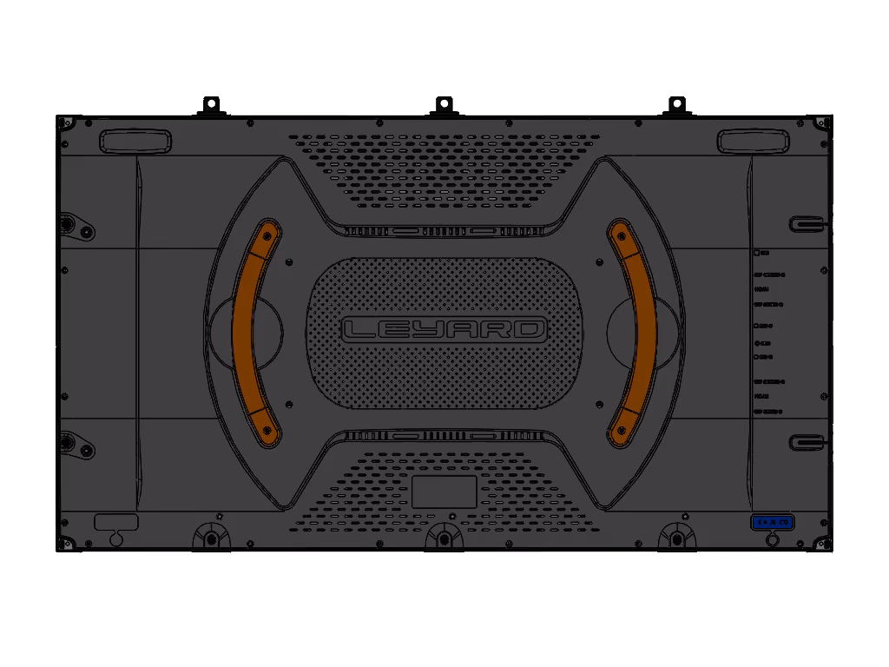
Leyard TWA Series Design
Unique all-in-one 54 inch diagonal cabinet design
Pixel density and form-factor matches LCD and Rear Projection, but with seamless implementation of any size
  Compatible with more existing installations
  16:9 form factor and popular resolutions make content development and processing easier
Consistent, self-contained cabinet design across pitches simplifies design and installation process
Advanced design for high reliability, ease of installation, and simplified service

Slide 20
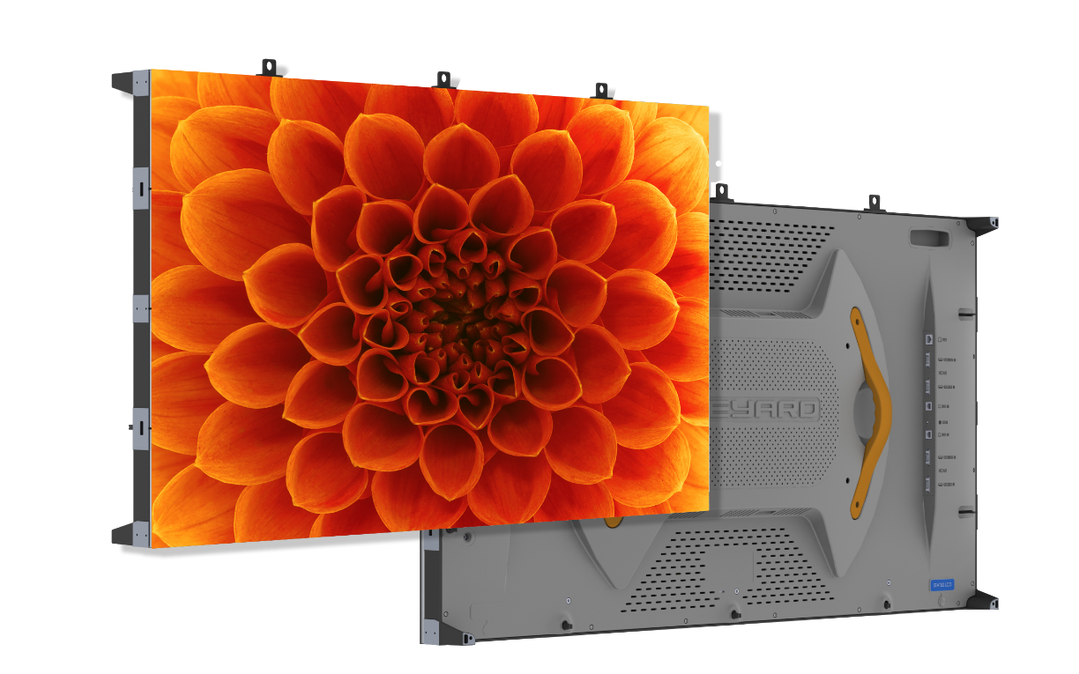
New and Improved Leyard TW Series
Leyard TWA Series available in 1.2mm and 1.8mm models
Power-efficient design
  Delivers significant reduction in maximum and typical power
  Compares favorably to industry’s low power LED video walls
Image quality enhancements

Slide 21

Designed for Alignment and Image Optimization
Larger cabinet size means more of your wall is factory aligned
  Machine vision alignment of intra-cabinet LED tiles
  Fewer seams to align in the field
Advanced calibration for maximum color and brightness uniformity
  Factory calibration of entire LED video wall minimizes image optimization during installation

Slide 22
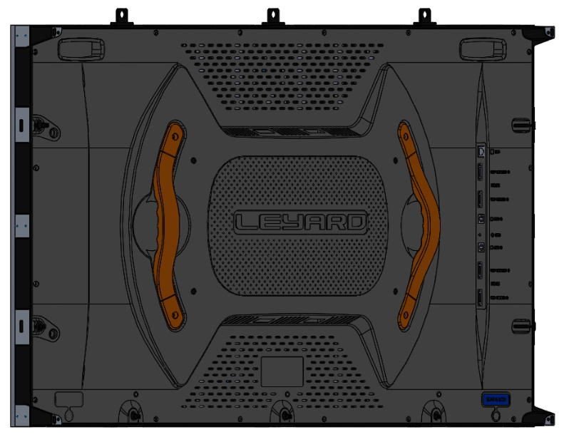
Fast and Efficient Installation
Consistent cabinet across pitches simplifies design process
Fewer cabinets and convenient I/O panel reduces installation time
Less complex and expensive mounting structures
Extruded aluminum mounting points in (4) corners
Convenient I/O panel for cleaner cabling

Slide 23
Designed for Serviceability
Modular internal component quickly and easily accessed by simply removing rear cover
Internal Field replaceable units (FRUs) allow for fast repairs
All LED cabinets are easily repaired or replaced
LED tiles removable from back to front
Rear cover removal exposes internal FRUs

Slide 24
TWA 16:9 Aspect Ratio Walls
17.7’ / 5.4m
15.5’ / 4.7m
13.3’ / 4.1m
11.1’ / 3.4m
8.9’ / 2.7m
6.6’ / 2m
4.4’ / 1.4m
7.9’ / 2.4m
11.8’ / 3.6m
15.7’ / 4.8m
19.7’ / 6m
23.6’ / 7.2m
27.6’ / 8.4m
31.5’ / 9.6m

Slide 25
TW Specifications
Industry’s First Flat Panel LED Video Wall
 | TWA 1.2 | TWA 1.8 | TW 2.5
Pitch (mm) | 1.25 | 1.875 | 2.5
Pixels per cabinet | 960 x 540 | 640 x 360 | 480 x 270
Cabinet size (WxHxD) mm | 1,200 x 675 x 100 | 1,200 x 675 x 100 | 1,200 x 675 x 100
Brightness (calibrated) | 800 nits | 800 nits | 800 nits
LED lifetime | 100,000 hr | 100,000 hr | 100,000 hr
Viewing angles (H / V) ° | 160 / 140 | 160 / 140 | 160 / 140
Weight per cabinet | 60.6lb / 27.5kg | 60.6lb / 27.5kg | 60.6lb / 27.5kg
Serviceability | Rear | Rear | Rear
Environment | Indoor | Indoor | Indoor

Slide 26
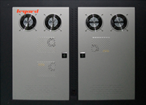
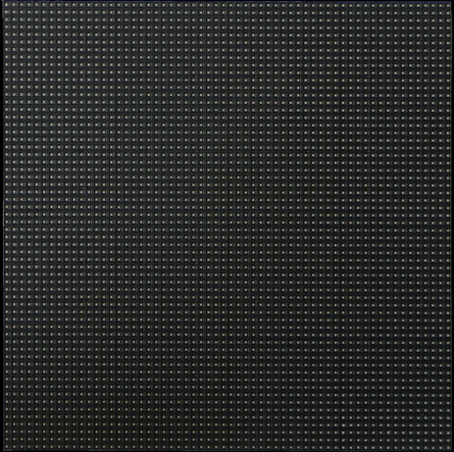
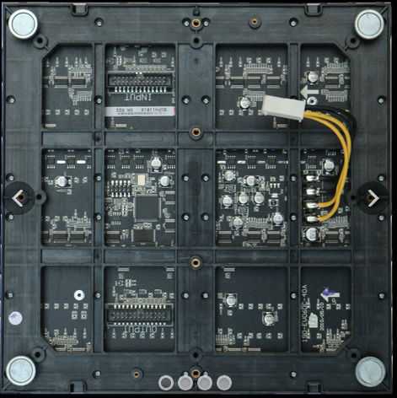
Leyard uEV Series
The indoor signage standard
Family of standard pitch LED video wall displays ideal for signage applications
Outstanding image quality
Durable, quiet design for reliable performance and long life
Remote diagnostics and front module replacement for outstanding serviceability
Front Service 720 x 960mm Cabinet
Pitches: 4, 5, and 6mm

Slide 27
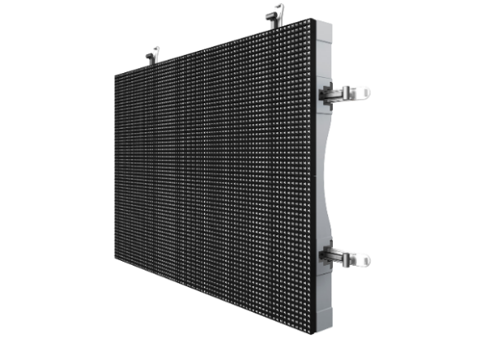
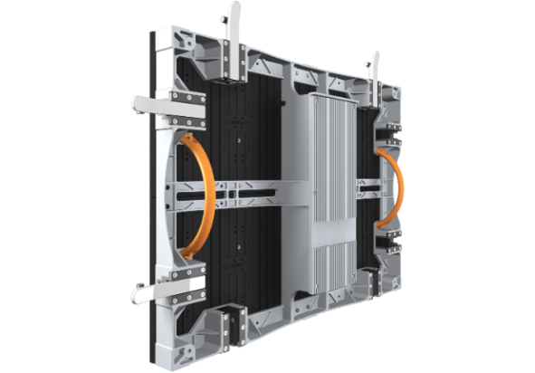
Leyard NVH Series
The most versatile LED display
Versatile LED video wall suitable for indoor, outdoor, fixed, and rental
Lightweight, slim, easy to handle cabinets
Wide brightness range for variety of applications
Silent operation and outstanding image performance
Light weight 640 x 480mm cabinet
Pitches: 8mm

Slide 28
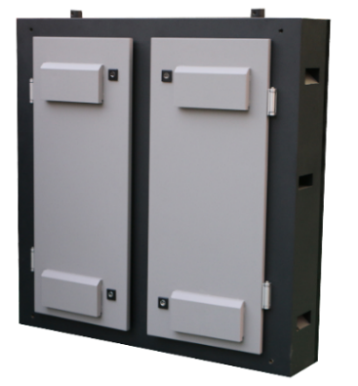
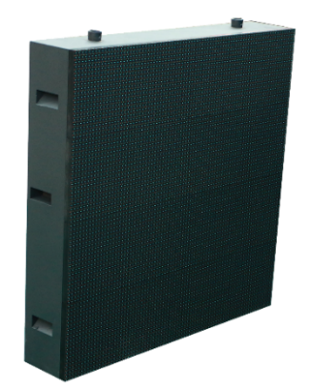
Leyard uLV Series
High-brightness outdoor family
Family of scalable outdoor LED video wall displays
Rugged cabinet design for long-life outdoor use
Optimized high-brightness performance stands up in bright environments
Built for reliability and ease of service with front tile replacement
Durable 1280 x 960mm Cabinet
Pitches: 10, 16, 20mm

Slide 29
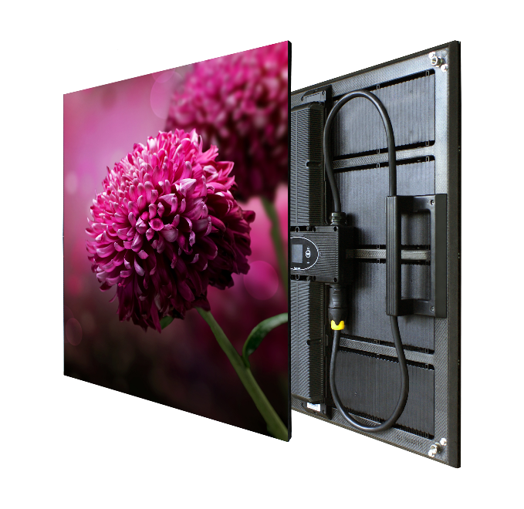
Leyard® CarbonLight™ LED Displays
Lightweight, Flexible and Easy to Deploy
Broad range of LED products to perfectly fit a variety of uses and environments
Patented, state-of-the-art carbon fiber construction
Precision-made mechanical design
Common architecture that makes the products easy to master
Built for easy serviceability
Notes:
Developed with the Rental and Staging markets as the primary target so the features are really geared towards R&S.
However, think about the applications where these attributes might serve your customers needs where a “traditional” fixed product might not:
Seamless curved display for a conference room
Weight or structural concerns
Perfect corners
Semi-permanent or mobile

Slide 30
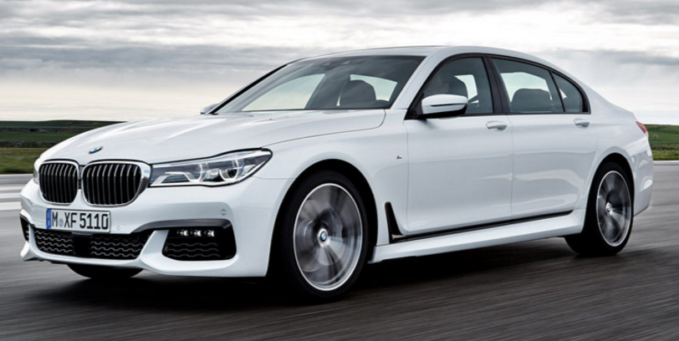
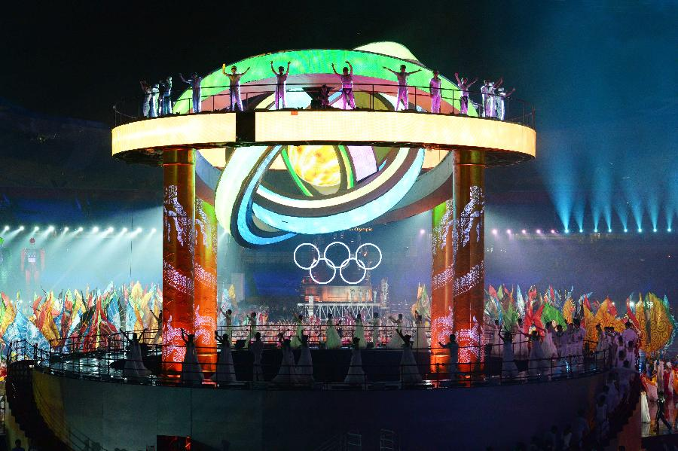

State-of-the-Art Material Choice
BMW 7 Series Carbon Core
Leyard CarbonLight
Carbon Fiber
Light Thin Strong
60% lighter than typical LED displays

Slide 31
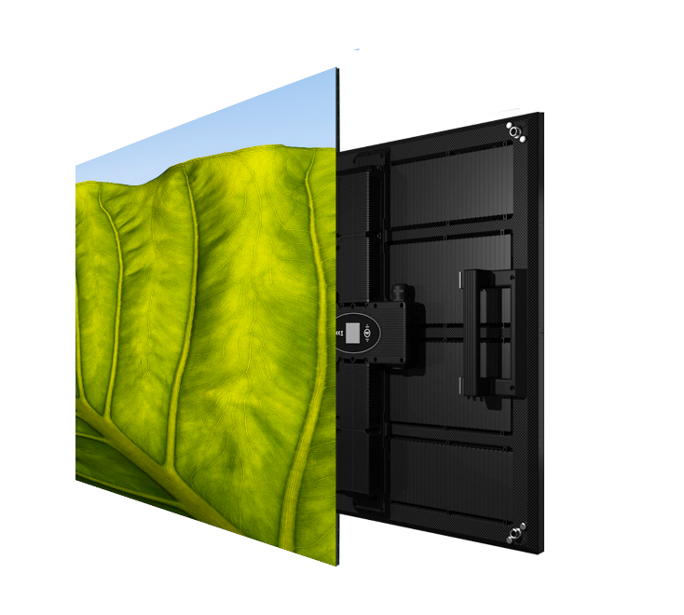
Leyard CarbonLight CLI Series
Setting the standard for lightweight, easy to setup indoor LED displays
Light and thin carbon fiber construction
Fast and easy installation
45° display edge for 90° assembly
Hanging or standing installation
Pixel Pitch (mm) | 2.6, 3.9, 5.2
Panel Size (W x H x D) | 500 x 500 x 53mm
 | 19.69” x 19.69" x 2.09"
Weight (per display) | 3.9kg (single PSU)
 | 8.6lb
Weight (per area) | 15.6kg/m²
 | 3.2lb/ft²

Slide 32

Leyard CarbonLight CLO Series
Light and thin Outdoor LED Video Wall
Light and thin carbon fiber construction
45° display edge for 90° installation
IP65 protection rating
Hanging or standing installation
Suitable for indoor or outdoor applications
Pixel Pitch (mm) | 3.9, 5.2, 7.8
Panel Size (W x H x D) | 500 x 500 x 56mm
 | 19.69” x 19.69" x 2.20"
Weight (per display) | 5kg
 | 11lb
Weight (per area) | 20kg/m²
 | 4.1lb/ft²
Notes:
IP65 Protection Rating
6 = Dust Tight: No ingress of dust; complete protection against contact.
5 = Water jets: Water projected by a nozzle (6.3mm) against enclosure from any direction shall have no harmful effects.

Slide 33
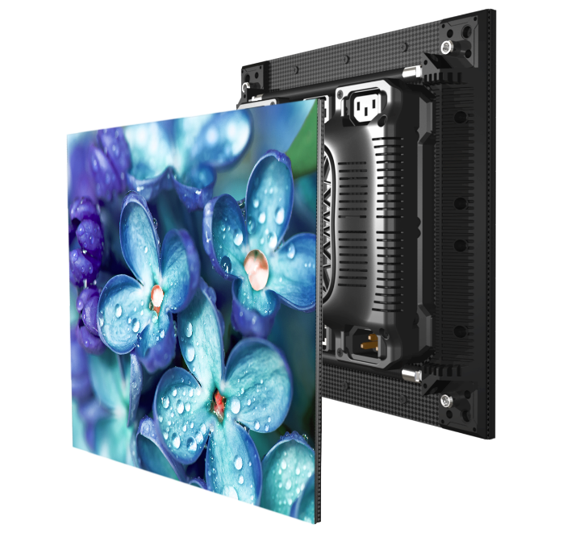
Leyard CarbonLight CLA Series
Fine-pitch, flexible LED displays for seamless curves
Light and thin carbon fiber construction
45° display edge for 90° assembly
Leyard PrecisionArc bending technology for seamless concave, convex and wave shaped installations
Hanging or standing installation
Pixel Pitch (mm) | 1.5, 1.9
Panel Size (W x H x D) | 250 x 250 x 58mm
 | 9.84” x 9.84" x 2.28"
Weight (per display) | 2kg (single PSU)
 | 4.4lb
Weight (per area) | 15.6kg/m²
 | 6.55lb/ft²

Slide 34
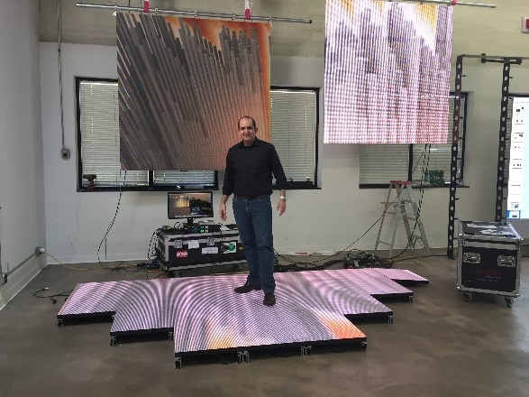
Leyard CarbonLight CLF Series
Lightweight, strong and easy to setup LED Flooring System
Lightweight
High-strength, wear proof mask
Capable of supporting loads up to 500kg/panel
IP65 protection rating
Suitable for indoor or outdoor
Pixel Pitch (mm) | 5.2, 6.2, 10.4
Panel Size (W x H x D) | 500 x 500 x 82mm
 | 19.69” x 19.69" x 3.23"
Weight (per display) | 8kg
 | 17.64lb
Weight (per area) | 32kg/m²
 | 6.55lb/ft²

Slide 35
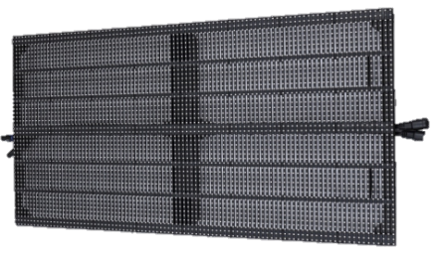
Leyard CarbonLight CLM Series
Lightweight, easy to setup mesh LED displays featuring low wind resistance and high transparency
Lightweight
High transparency, low wind-resistance
45° display edges for 90° assembly
IP65 protection rating
Hanging or standing installation
Pixel Pitch (mm) | 10.4, 15.6
Panel Size (W x H x D) | 1000 x 500 x 45mm
 | 39.37” x 19.69" x 1.77"
Weight (per display) | 4.8kg
 | 10.6lb
Weight (per area) | 9.6kg/m²
 | 1.97lb/ft²
Notes:
High transparency: 10mm ~40%, 15mm ~55%

Slide 36
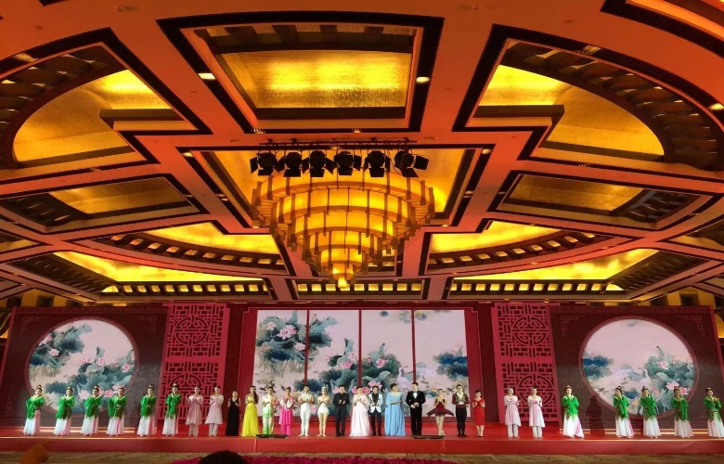
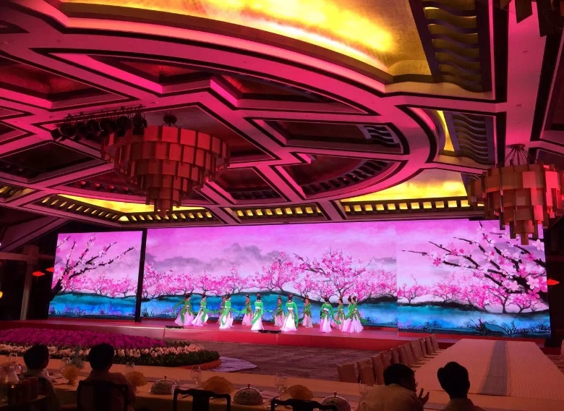
The Result: Eye-Catching and Unique Installations
120 m² Leyard CarbonLight CLI (IDsn3E) series
70th Anniversary of the Victories of War

Slide 37
The Leyard CarbonLight Product Lines
Five product lines to meet a range of installation needs
Series | Meaning | Use | Pitches (mm) | Size | Brightness Max (Cd/m²) | IP Rating
Leyard® CarbonLight™ CLA Series | Arc | Curved walls | 1.5, 1.9 | 250 x 250 x 58mm | 1000 | IP40
 |  |  |  | 9.84 x 9.84 x 2.28in.
Leyard® CarbonLight™ CLI Series | Indoor | Indoor flat walls | 2.6, 3.9, 5.2 | 500 x 500 x 53mm | 1000 | IP40
 |  |  |  | 19.69 x 19.69 x 2.09in
Leyard® CarbonLight™ CLO Series | Outdoor | Outdoor flat walls | 3.9, 5.2, 7.8 | 500 x 500 x 56mm | 6000 | IP65
 |  |  |  | 19.69 x 19.69 x 2.20in
Leyard® CarbonLight™ CLF Series | Floor | Floors | 5.2, 6.2, 10.4 | 500 x 500 x 82mm | 2000 (5.2), 5000 | IP65
 |  |  |  | 19.69 x 19.69 x 3.23in
Leyard® CarbonLight™ CLM Series | Mesh | Outdoor displays | 10.4, 15.6 | 1000 x 500 x 45mm | 5000 | IP65
 |  |  |  | 39.37 x 19.69 x 1.77in

Slide 38
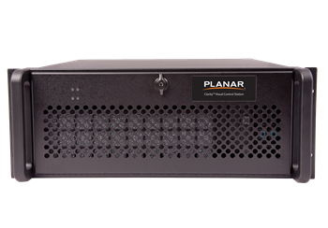
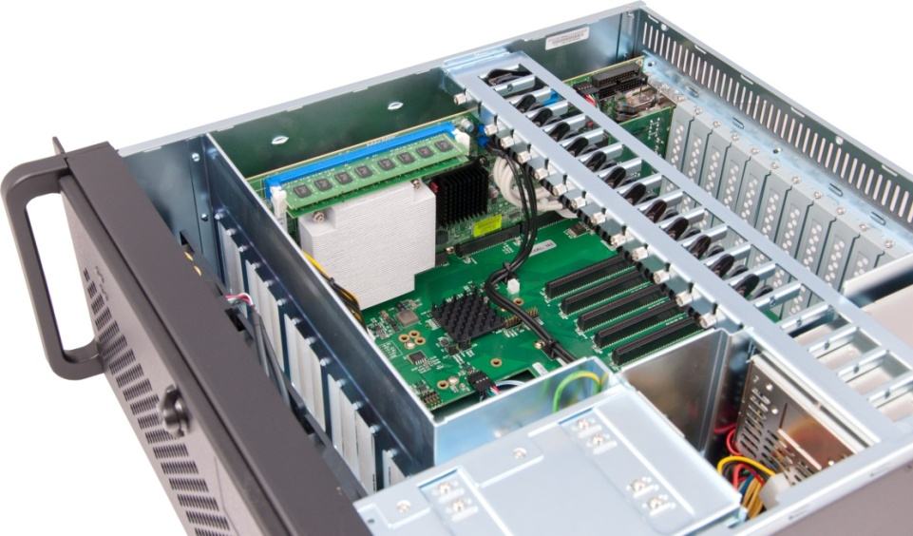
Image Processing & Content Management
Broad compatibility with leading image processing and content management systems such as Clarity® Visual Control Station™ (VCS)
Clarity VCS Video Wall Processor
  Flexible and easy-to-use video wall controller
  All-in-one hardware and software solution
  Drives video walls of up to 40 high resolution displays
  Locally or remotely controlled

Slide 39

Meeting Indoor Customer Needs – Which Product?
Requirement | Planar® DirectLight™ | Leyard® TVH | Leyard® TWA | Leyard® uEV | Leyard® CarbonLight™ CLA | Leyard® CarbonLight™ CLI
Standard Pitch |  |  |  | 4, 5, 6 mm |  | 3.9, 5.2
Fine Pitch | 1.6, 1.9, 2.5, 3.1 | 1.6, 1.9, 2.5 | 1.8, 2.5 |  | 1.5, 1.9 | 2.6
Very Fine Pitch |  |  | 1.2
ADA-Compliant (<4”)
Front Access | Included EasyAlign | (3rd Party Mount) | (3rd Party Mount) | (Magnetic tiles) | (3rd Party Mount) | (3rd Party Mount)
Tile-level In-wall Replace
Mount to Wall | Included EasyAlign
Off-board Power
Concave Wall | 400 x 300mm | 400 x 300mm | (larger facet) |  | 250 x 250mm smooth curve | (larger facet)
Convex or Wave

Slide 40
Meeting Indoor Customer Needs – Which Product? (cont.)
Requirement | Planar® DirectLight™ | Leyard® TVH | Leyard® TWA | Leyard® uEV | Leyard® CarbonLight™ CLA | Leyard® CarbonLight™ CLI
Lightweight, Hanging
Semi-Fixed, Movable
“Flat Panel” design
3 Year Warranty | Standard | Option | Option | Option
Assembled in US
TAA Compliant | Option | Option | Option
Faster Installation
Short Lead Time

Slide 41
Thank you

Slide 42
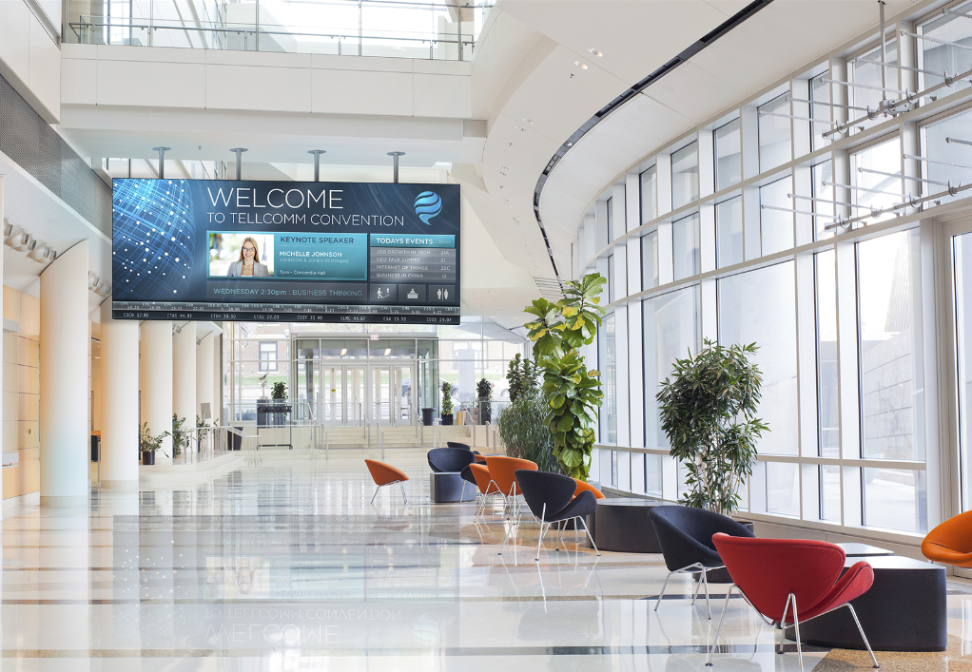

Planar® DirectLight™ LED Video Wall System
Family of Best-in-Class Direct View LED Video Walls for Digital Signage & Control Rooms
Superior Visual Performance
Mission-Critical Reliability
Optimized For Your Unique Indoor Environment
From a Partner you Trust:

Slide 43
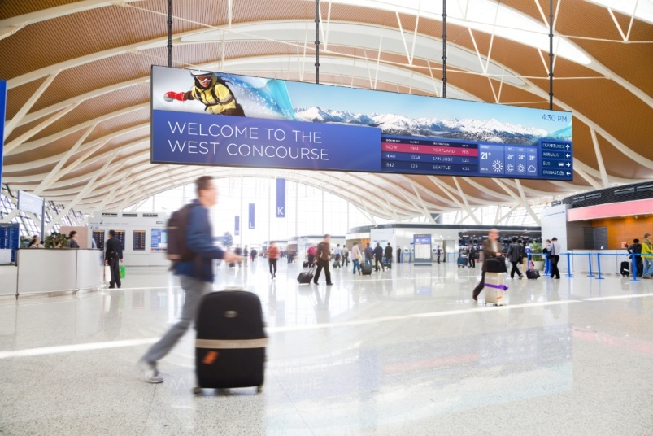
Truly Seamless, Ultra-Fine Pitch with Unmatched Image Quality
Available in 1.6, 1.9, 2.5 and 3.1mm pitches in a single architecture
Seamless bezel-free - no more seams dividing your content
Black resin LEDs and Planar® MicroGrid Shader™ for deeper blacks, higher contrast and lower reflectance
Maintains color calibration even at low brightness
Excellent off-axis viewing with no color shift

Slide 44
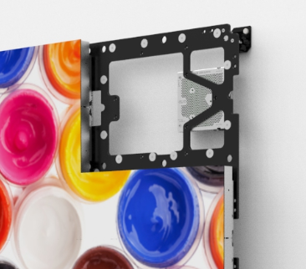
Precision Alignment & Image Optimization
Achieved with Revolutionary Mounting System and Software:
Planar® DirectLight™ Control Software for automated fine-tune optimization
Planar EasyAlign Mounting System for ultra-fine 6-axis adjustments

Slide 45
Unique Off-Board Power Architecture Delivers 24x7 Reliability
Centrally-locate with other electronics up to 200’/61M away from the LED video wall
Easy-to-access location minimizes disruption at the LED video wall
Rack mounted power supply allows for efficient cooling and improved maintenance access
Redundant power supply, video source and cabling options available to ensure uninterrupted operation
Fiber Optic and HDBaseT video extenders available

Slide 46
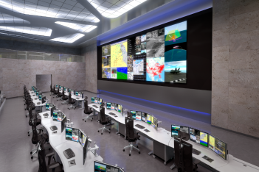

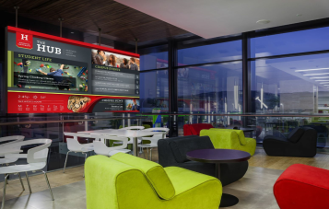
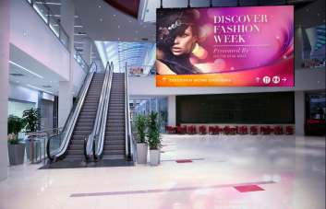
Extensible to Wide Variety of Environments
Optimized for 16:9 aspect ratio, 1080p & 4K formats
Wide variety of configurations possible
Maintains color calibration even at low brightness
Excellent off-axis viewing with no color shift
Broad compatibility with leading image processing and content management systems
Thinnest direct view LED video wall available
Eliminates the need for rear access, freeing valuable space
No AC power outlets required behind the LED video wall
Delivers whisper quiet, fan-less operation
Control Room
Corporate
University
Public Spaces

Slide 47
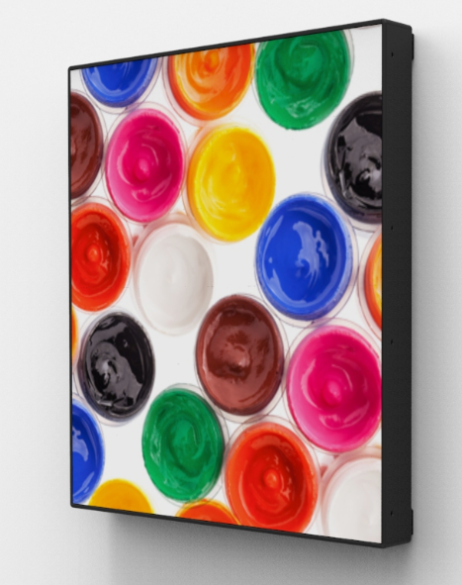
Super Slim Profile
Ideal for Space-Constrained Environments:
Less than 4”/102mm total mounted depth
Americans with Disabilities Act-compliant (ADA )
Eliminates need for recessed video wall, saving time consuming building modifications

