Slide 1
LEYARD FINE PITCH LED DISPLAYS
January 2017

Slide 2
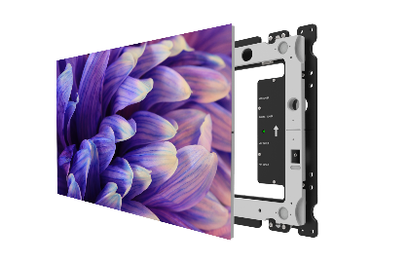
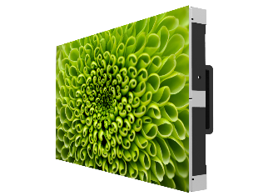
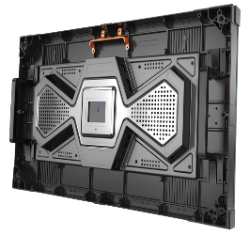
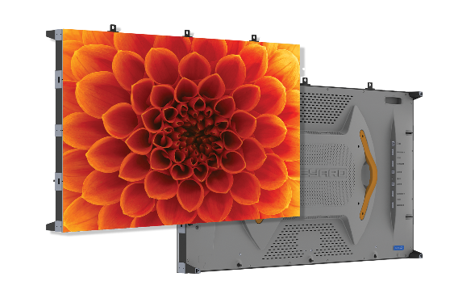
New Fine Pitch LED Lines
Leyard DirectLight Series
27” diagonal wall-mount, front-access, off-board power design
0.9, 1.2, 1.5, 1.8
Leyard TWS Series
27” diagonal all-in-one design
0.9, 1.2, 1.5, 1.8
Leyard TWA Series
54” diagonal all-in-one design
0.9, 1.2, 1.4, 1.8, 2.5

Slide 3

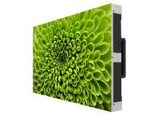

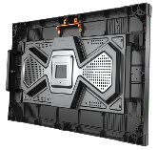
New Fine Pitch LED Offering
0.9
1.2
1.4
1.8
2.5
0.9
1.2
1.5
1.8
0.9
1.2
1.5
1.8
54”
27”
27”
Leyard TWA Series
“LCD” Sizing – All-in-One
Fastest flat-wall installation
Fewer points of alignment
Fewer points of service
Includes 2.5mm pitch (TW today)
Lowest priced line
Shipping now
Leyard TWS Series
Flexible Installation – All-in-One
Smaller cabinet can exactly fit horizontal and vertical spaces
Smaller cabinet for closely-faceted concave walls
Higher max brightness
MicroGrid™ shader down to 1.5
Lightest weight per square meter
Mid-range priced line
Shipping Q1’17
Leyard DirectLight Video Wall System
Front Service – Wall Mount – Off-Board
Wall mounted (no structure required)
< 4” depth (ADA compliant)
Front serviceable
Off-board power for fewer service points, less heat and no outlets at the wall
90° corner wrap support
Smaller cabinet fits certain horizontal and vertical spaces more exactly (like TWS)
Smaller cabinet for more closely-faceted concave walls (like TWS)
Higher max brightness (like TWS)
MicroGrid™ shader down to 1.5 (like TWS)
Price includes mount
Highest priced line
Shipping Q1’17

Slide 4

Leyard TWA Series
Industry’s First Flat-Panel LED Video Wall
Family of LED video wall displays supporting even the closest viewing distances
54” diagonal, flat panel design
Pitches: 0.9, 1.2, 1.4, 1.8 and 2.5mm
Hits Full HD, 4K, 8K exactly
Delivers benefits of unique “flat panel” design
Outstanding image quality with low power consumption
Advanced design for reliability and ease of installation and service

Slide 5
Innovative “Flat Panel” Design Benefits
Slim 54” 16:9 form factor
Self-contained units with std HDMI in / out – no extra boxes, simpler cabling
Larger size means more of your wall is factory aligned
  Fewer seams to align in the field; more seams factory calibrated
Reduced installation time – by up to one half
Less complex and expensive mounting frame
Fewer panels means fewer points of service
16:9 form factor and HD and Ultra HD resolutions make content development and processing easier out of the box
Compatibility with more existing installations and existing processors

Slide 6
TWA Low Power Consumption Design
*
 | Measured Power | Measured Brightness | Watts/ Nit | Savings
Leyard TW1.2 | 620W | 600 nits | 1.033
Leyard TWA1.2 | 360W |  | 0.600 | 42% Lower than TW

Slide 7
TWA Low Power Consumption Design
 | Max Brightness | Max Power for the wall | Watts/ Nit | Savings
NanoSlim 1.2 | 650 nits | 24,475 | 38
Leyard TWA1.2 | 600 nits | 10,116 | 17 | 55% less power
NanoSlim data from a Nanolumens quote Dec 2016.
Comparison on per nit, per area basis to account for different levels of max brightness.
1.2mm of TWS was 54% lower and DL2 was about 35% lower.
Internal only
Notes:
Make point about Nano energy waste of offboard power claim.

Slide 8
Reduced Standby Power
With direct view LED displays, “off” is more typically “display black”
As a result, LED displays draw significant power even when “off”
TWA implements a Standby mode that greatly reduces power when the LED video wall is not in use
TWA uses 74 -78% less power in Standby or “off” mode than with typical LED displays
For a video wall operating even 12 hours per day, the savings Is substantial
True for TWS and DL2 as well
 | TWA | TVH, DL1 | Brand X 1.9
Display Black | 85W / sq m | 160W / sq m | 190W / sq m
Standby Mode | 42W / sq m | NA | NA

Slide 9
Leyard TWA Series
Key Selling Points
Fullest range of fine-pitch LED displays in the industry
  0.9, 1.2, 1.4, 1.8, 2.5
Easiest, fastest flat-wall install product available
Lowest cost of ownership – fewer points of service
TW/TWA2.5 is industry’s only seamless direct replacement for LCD
Lowest power LED design in the industry
Optimized for Full HD, 4K and 8K
Very aggressive price/pixel position
From the worldwide market leader in fine-pitch LED

Slide 10
Leyard TWS Series
High-Performance LED Video Wall
Family of fine-pitch LED video wall displays for high-performance and extended duty-cycles
Light-weight, convenient form-factor fits more installation environments, more exactly
27” diagonal, all-in-one design
Pitches: 0.9, 1.2, 1.5 and 1.8mm
Hits Full HD, 4K, 8K exactly
Built for image quality, reliability, redundancy and long life
Low power consumption by design

Slide 11
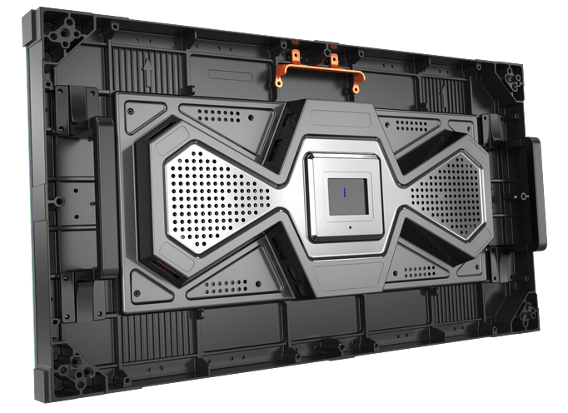
Fits More Installation Environments
Magnesium alloy chassis – 30% lighter than aluminum with enhanced heat dissipation
Easy single-person handling
27” diagonal 16:9 size – small enough to fit room dimensions closely, large enough for fast install
Works well with concave curved video walls
600 x 337.5mm (23.6” x 13.3”)
Only 4.7kg (10.4lb)
Every pitch hits Full HD, 4K, 8K exactly

Slide 12
Leyard TWS Series
Key Selling Points
Full range of fine-pitch LED displays
  0.9, 1.2, 1.5, 1.8
Super light-weight, thermally efficient cabinet design
All-in-one, simple to deploy design
Optimal size for fit, efficient set-up and concave wall construction
MicroGrid™ Shader at 1.5mm produces deep blacks
Power-efficient LED design
Optimized for Full HD, 4K and 8K
From the worldwide market leader in fine-pitch LED

Slide 13
Leyard DirectLight Series
Premier Ultra-Slim Fine Pitch Solution
Unique fine-pitch video wall system available in range of pitches
Wall-mounted, full front access video wall that takes less room
Ultra-slim 27” diagonal display
Pitches: 0.9, 1.2, 1.5 and 1.8mm
Hits Full HD, 4K, 8K exactly
Incorporates mount and alignment features that reduce time to deployment and produce perfectly aligned walls
Built for image quality, reliability, redundancy, hot-swap and long life
Low power consumption and circuit consumption by design

Slide 14
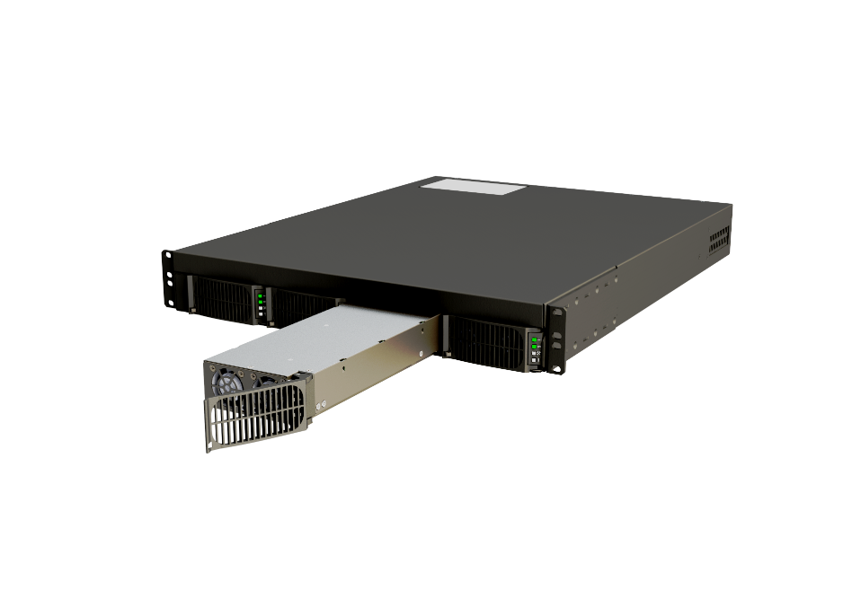
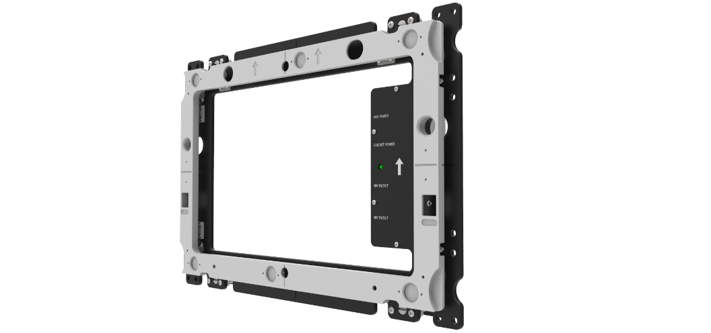
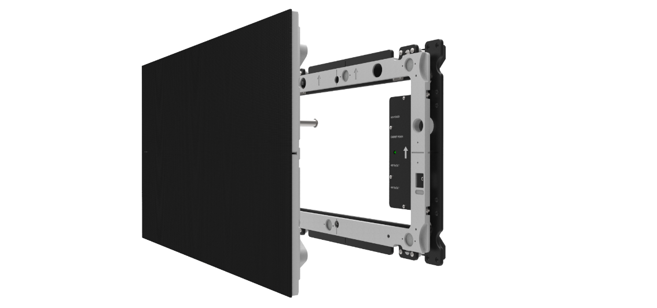
Complete LED Video Wall System
Adjustable Wall Mount
Front Access Display Module
Alignment features
< 4” depth mounted
Off-board, Redundant Power with Hot-swap and 220V support
Leyard LED Control software for management

Slide 15
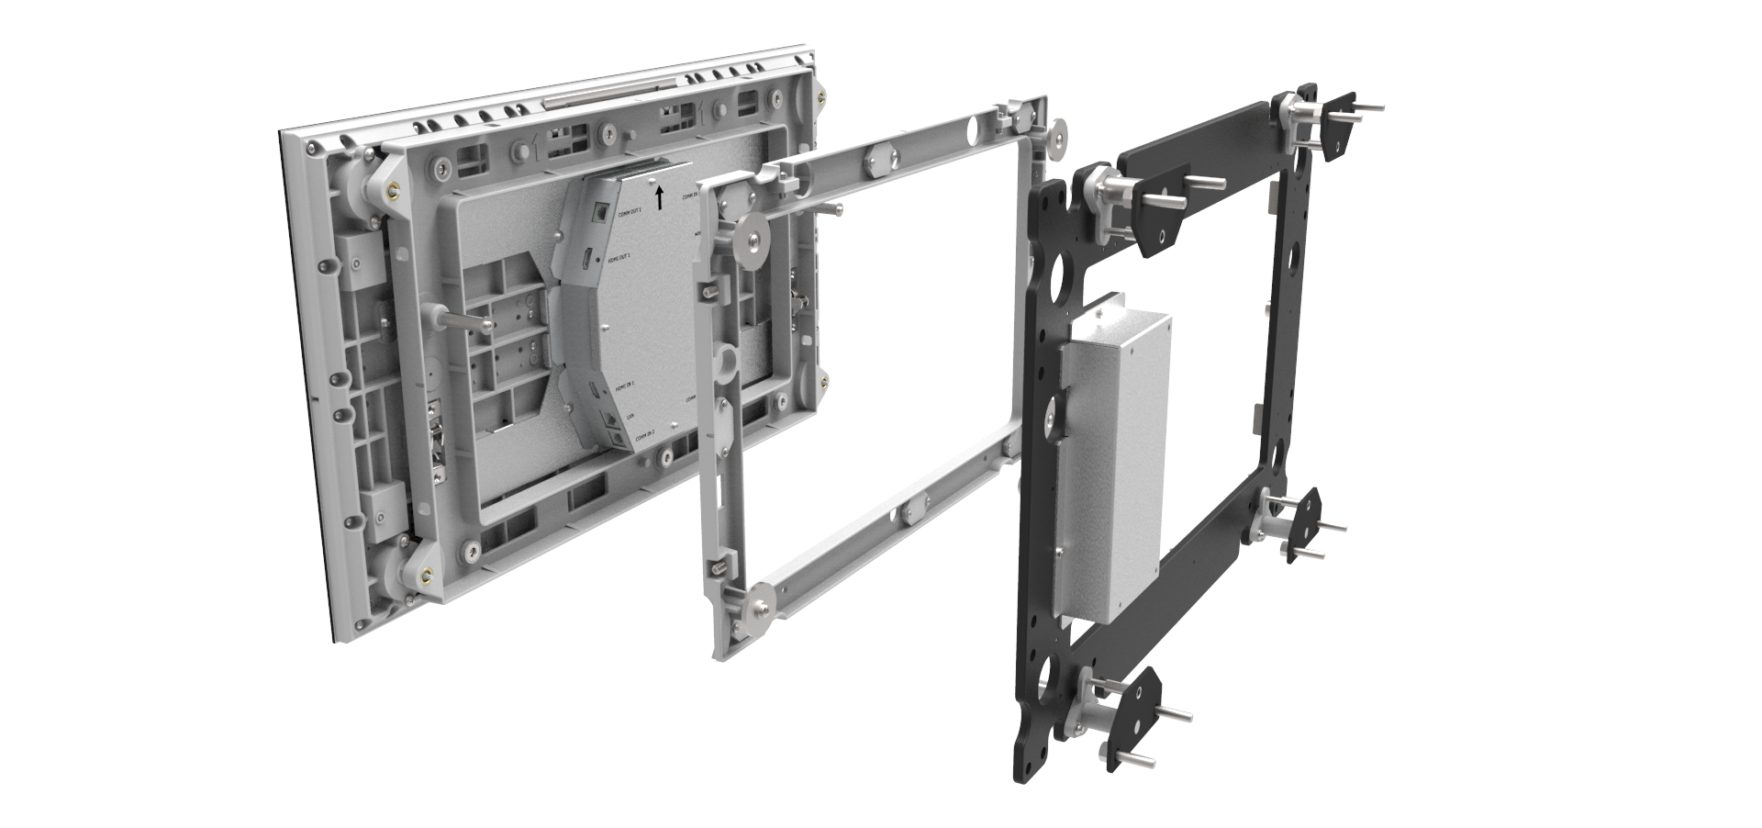
Front Access – Next Generation EasyAlign™ Mount
New 3-part construction and numerous mechanical improvements make it:
  Easier to install
  Easier to eject
  Smoother to align
  More securely in place

Slide 16
Superior Front Access with DirectLight 2
Front Access Feature | DirectLight 2 | Other Guys
Wall mounted | Yes | ??
Includes the wall mount | Yes | ??
Front installable | Yes | ??
Front replace modules | Yes | ??
Front replace cables | Yes | ??
Front replace power and electronics | Yes | ??
2 levels of Z axis plus X and Y axis adjustment | Yes | ??
Positive locking for forward tilt walls | Yes | ??
Supports concave walls while maintaining front service | Yes | ??
Supports 90° corner with wall mount and front access | Yes | ??
Hot swap power supplies (via remote power supply) | Yes | ??

Slide 17
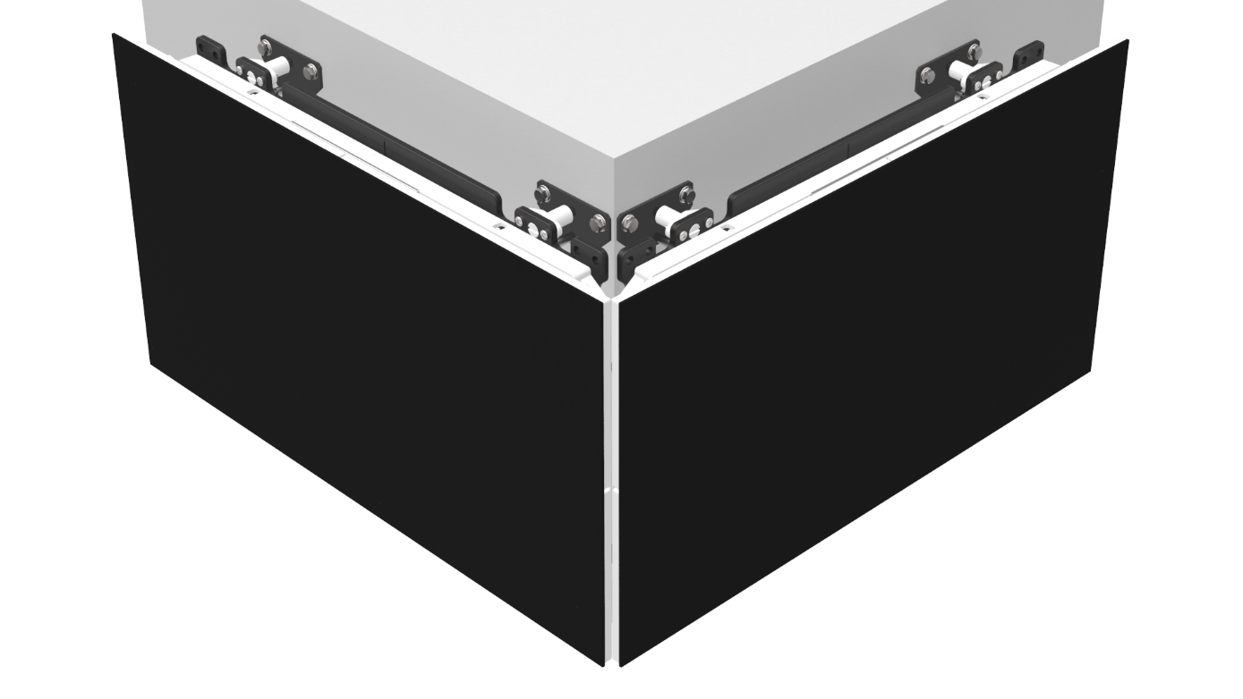
90° Corner Support – built in
Support for 90° exterior corners built in
EasyAlign™ mount designed to accommodate required spacing
Front service features still operate properly
15mm corner seam can be trimmed to black

Slide 18
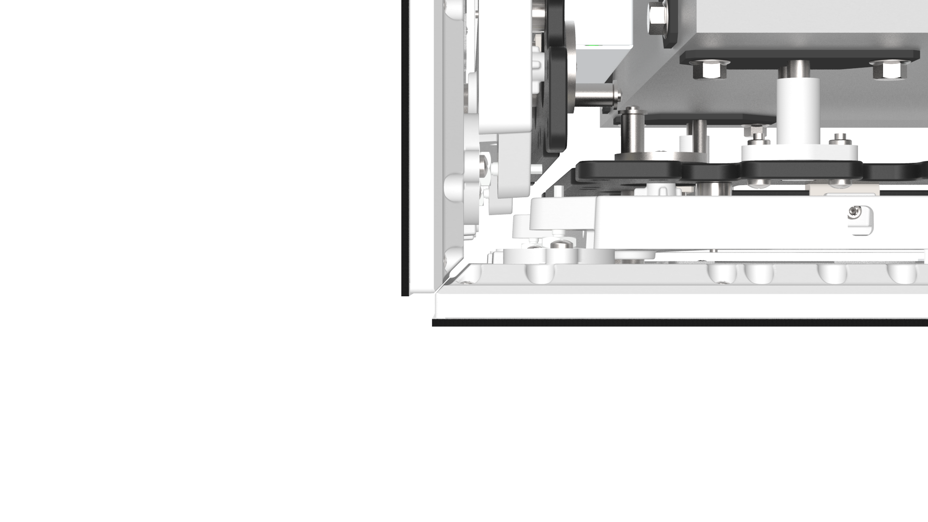
90° Corner Support – built in
Mounting, alignment and service access features all continue to work, unobstructed

Slide 19
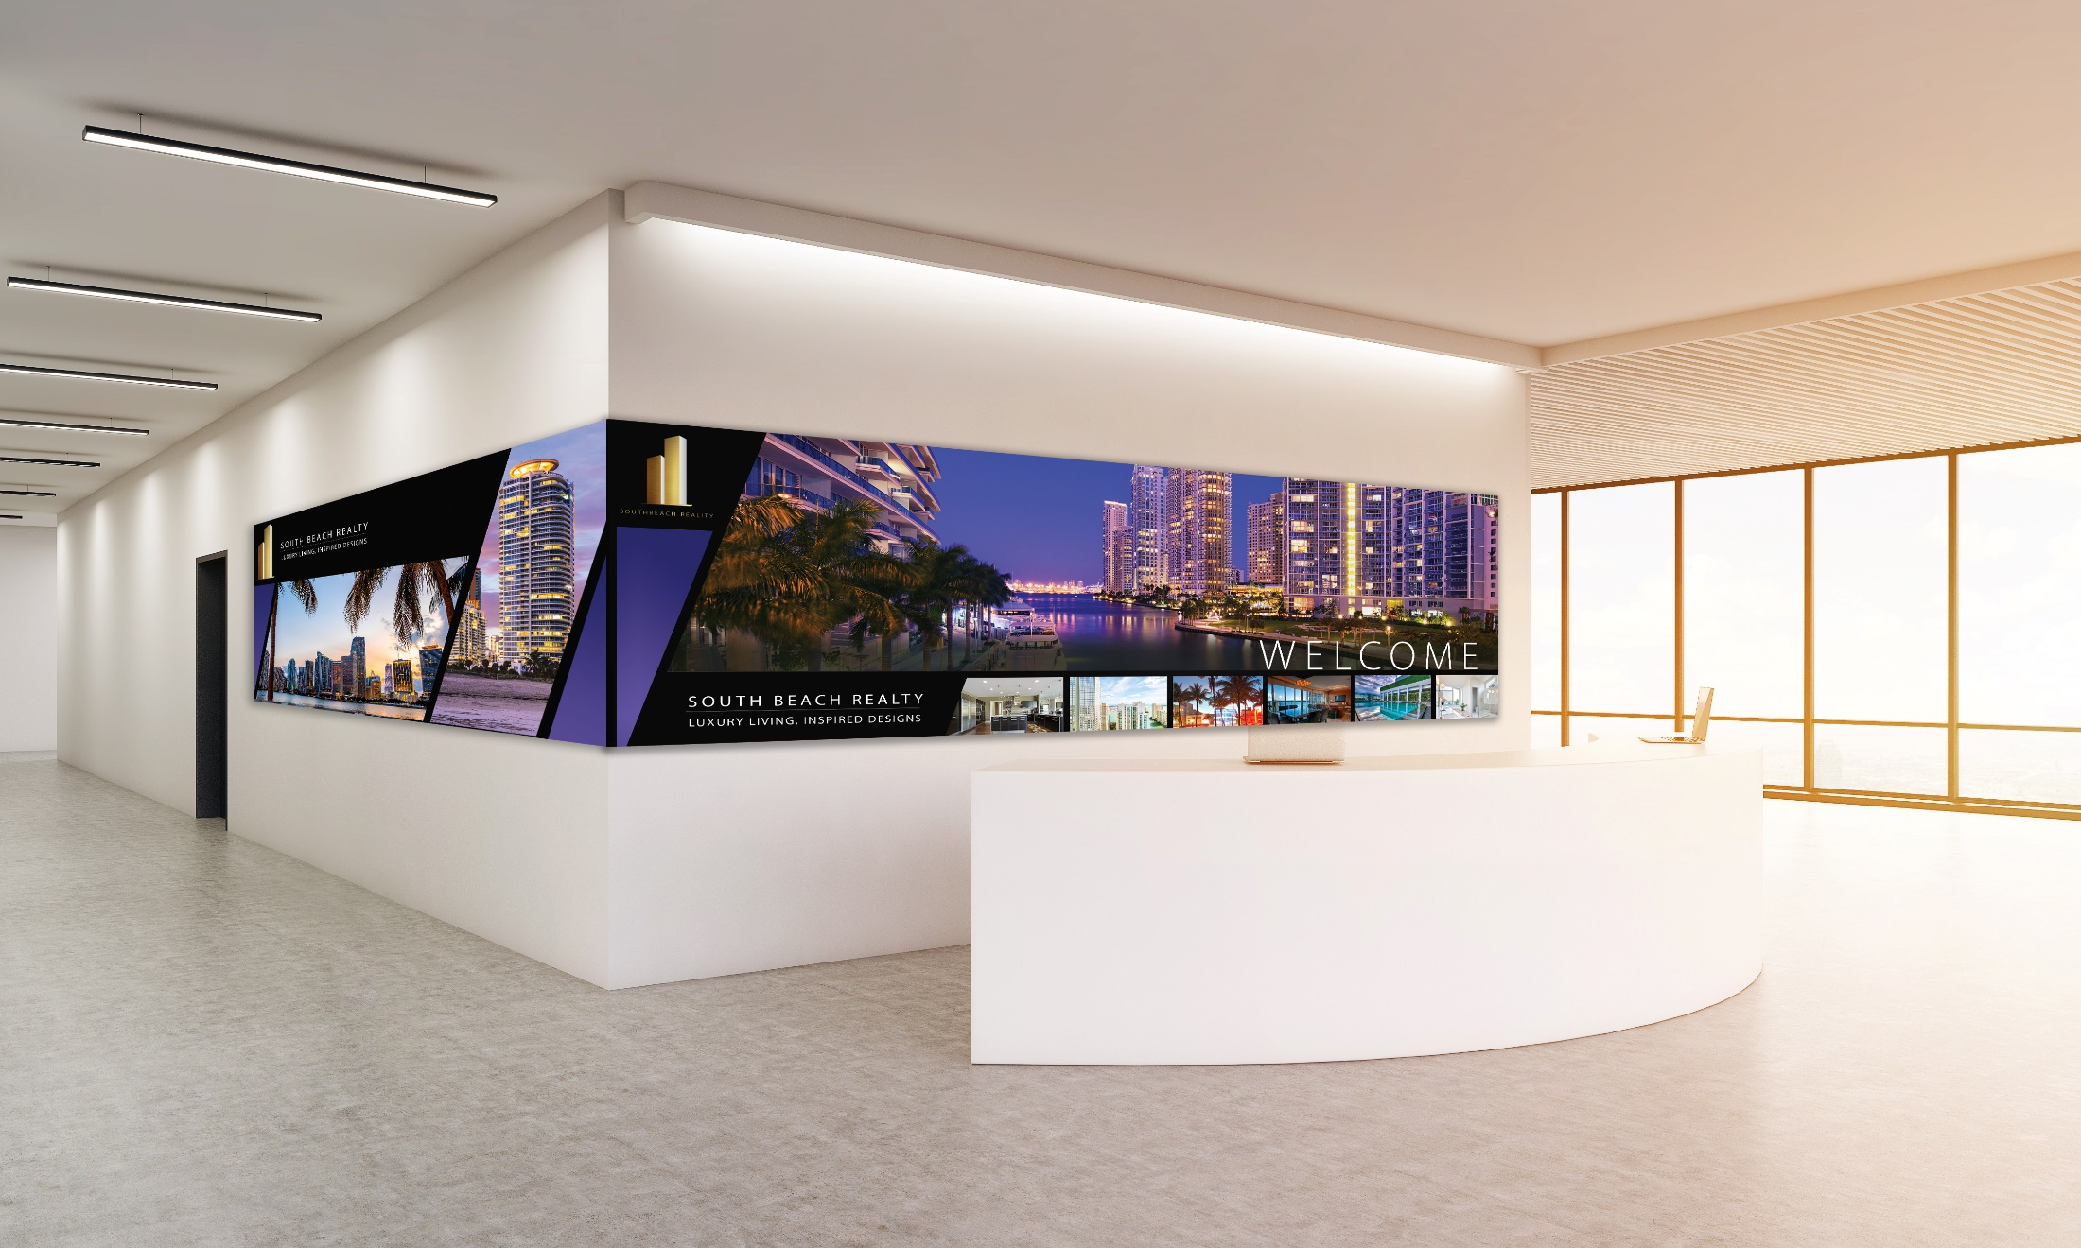
The Result is Highly Integrated Installations

Slide 20
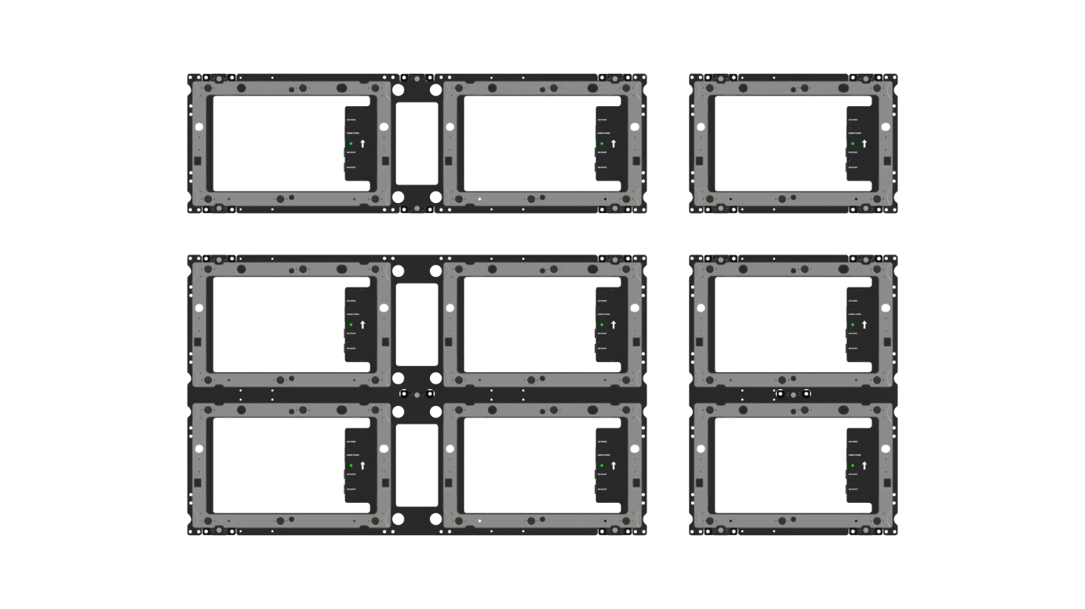
Mount Options – Auto Configured in PROs
Four configurations
2 wide by 1 high
Single
2 wide by 2 high
1 wide by 2 high

Slide 21
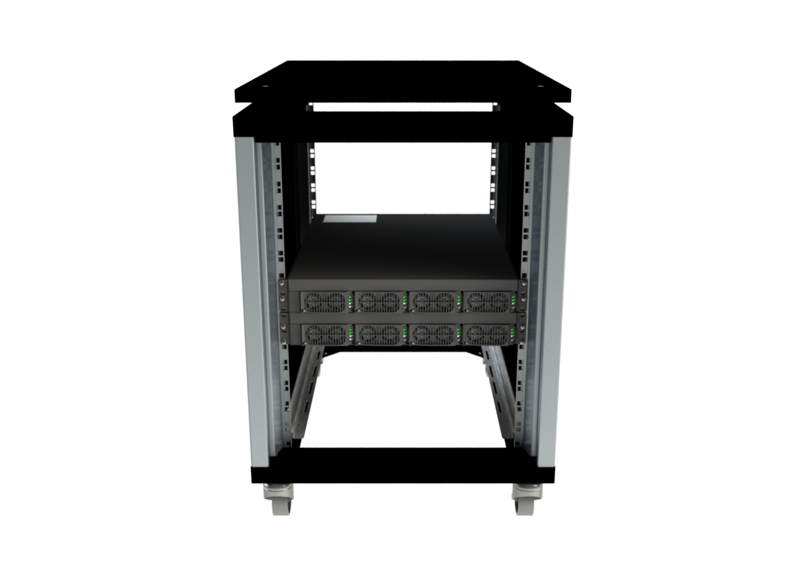
Why Remote Power?
Removes from the video wall
Depth
Weight
Heat
Points of service
No outlets required at the wall
And adds at the rack
Reliability
Redundancy – Power module and circuit level
Hot swap module replacement
Diagnostics

Slide 22
Introducing DirectLight 2 Remote Power Supply (RPS)
Power improvements
DirectLight 2 itself is a low power design
New RPS is 3-4 times higher power density – fewer RUs
Redundant and now Hot Swappable
220V support to further reduce circuits used
Ultra-low Standby power mode (< 3 Watts)

Slide 23
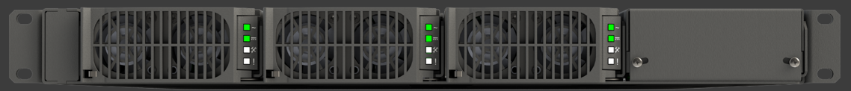
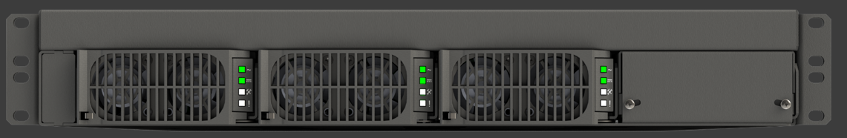
Correct RPS included with DirectLight Wall
Two form factors, depending on the installation
RPS110
100-240V. Maximum 3,600 Watts out. 1 RU
RPS220
200-240V. Maximum 7,200 Watts out. 1.5 RU - Greater power density

Slide 24
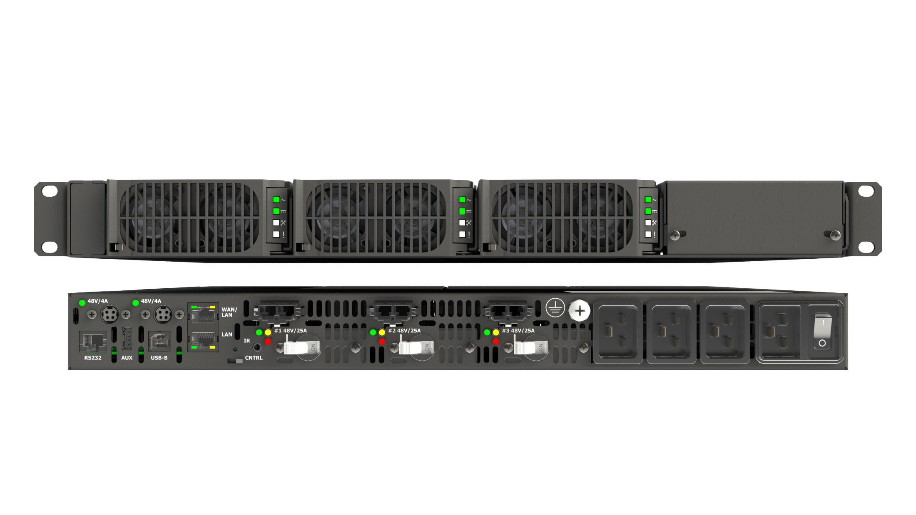
RPS110
RPS Module
Redundant Module bay
1 RU. 19” Rack
Control
1200 Watts / output
Circuit redundancy
Diagnostics lights
Switch per module

Slide 25
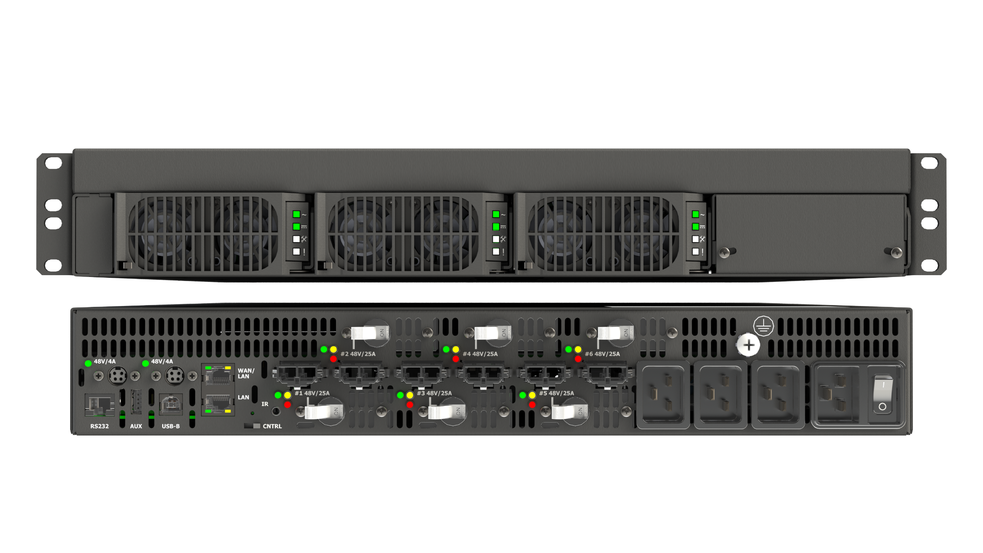
RPS220
RPS Module
Redundant Module bay
1.5 RU. 19” Rack
Control
1200 Watts / output
Circuit redundancy
Diagnostics lights
Switch per module

Slide 26
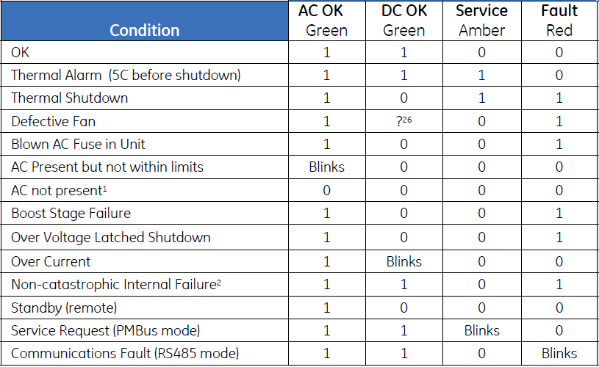
Per RPS Module Diagnostic Capability
Rich troubleshooting diagnostic for each module and RPS overall
Reduces downtime
Reduces service time

Slide 27
Leyard DirectLight Series
Key Selling Points
Full range of fine-pitch LED displays
  0.9, 1.2, 1.5, 1.8
Wall mounted – requires no mounting frame
Includes it’s own mount with EasyAlign™ features
Installs <4” to the wall – ADA compliant
Off-board power to reduce heat, points of failure from wall
No power outlets needed at the wall
Redundant and hot-swappable power supplies, with circuit redundancy
Power-efficient LED design and 220V support to reduce circuit requirements
90° corner wrap support, front tilted walls and more tightly concave walls with front service
Get Gen 2 of the DirectLight architecture while competitors are trying to copy Gen 1
MicroGrid™ Shader at 1.5mm produces deep black
Optimized for Full HD, 4K and 8K
From the worldwide market leader in fine-pitch LED

Slide 28
THANK YOU

