Slide 1
Planar directlight x led video wall system
Product Overview – January 2020

Slide 2
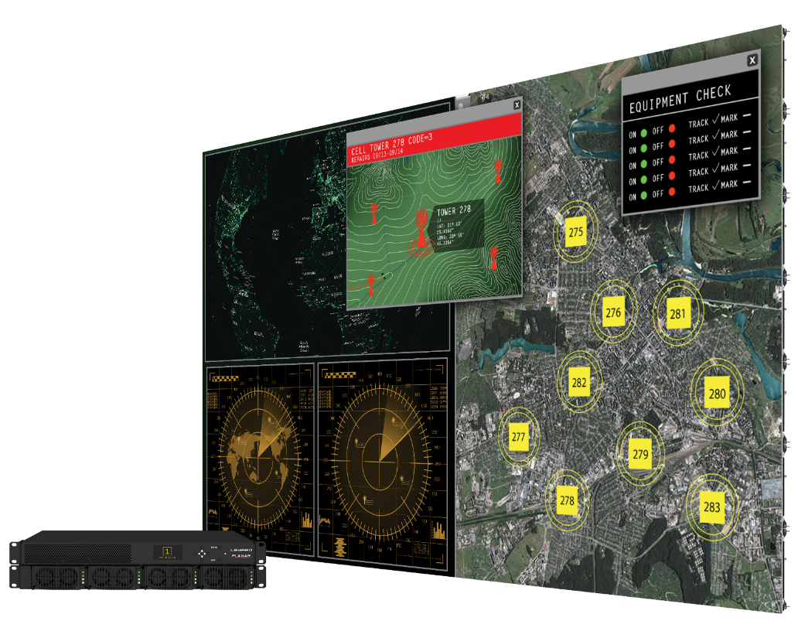
Introducing Planar® DirectLight® X
The Next Generation of the DirectLight LED Video Wall System
Planar DirectLight X adds advanced video processing to the award-winning DirectLight® family:
Advanced video wall processing with the Planar® Video Controller
User friendly and powerful web based control with Planar® WallDirector™ Software
Valuable video wall features like Planar® Big Picture Plus™ processing and Planar® WallSync™
Wall-mounted, full front access video wall with <4” depth
Planar® Remote Power Supply with hot swappable power modules and optional redundancy
Planar® DriveSense™ architecture for low power consumption
Select models available with Planar® ERO-LED™ protective technology
Select models available with Planar® LED MultiTouch

Slide 3
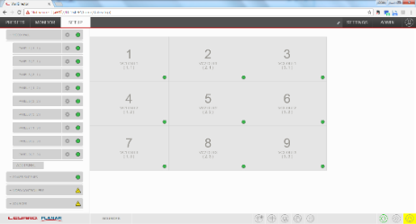
System Components
1
Planar DirectLight X LED Cabinets
27” LED Cabinets
Available in 0.7, 0.9, 1.2, 1.5 and 1.8mm pixel pitches
Slim, lightweight design
DirectLight® Interface (DLI) per each Full HD (1920 x 1080) section
Includes Planar® EasyAlign™ mounting and alignment system
1
2
Planar Video Controller (VC)
1U rack-mountable controller drives up to 9 Full HD (1920 x 1080) sections
Embedded video and control extension
Planar Big Picture Plus Processing with Planar WallSync genlock technology
3
Planar Remote Power Supply (RPS)
1U rack-mounted power supply powers complete system including LED Cabinets & Video Controllers (1.5U 220V Optional)
Hot-swappable redundant supply option
2
4
Planar WallDirector Software
Tool for setup, monitor and operate your video wall
Web-based browser interface
3
4
5
Planar® LED Control Software
Tool for setup and configuring LED’s

Slide 4
Off-Board Electronics Architecture
Key Features
Advanced off-board video wall processing with Planar Video Controller:
Windowing, scaling, picture-in-picture, layout storage and recall
HDMI 2.0 and DisplayPort 1.2 inputs (4K@60Hz)
DisplayPort 1.2 loop output
Drives non-standard resolution and aspect ratio output
Drives up to (9) Full HD (1920 x 1080) display sections
Up to 200ft (61m) transmission distance
Built-in video and control extension - eliminating the need for 3rd party video extension
Planar Remote Power Supply:
Redundant, hot-swappable power supply modules to maintain operation in the case of a power supply failure (Optional)
Compact power density
Low power standby mode
Planar Video Controller
Planar Remote Power Supply

Slide 5
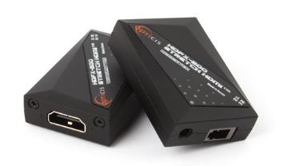
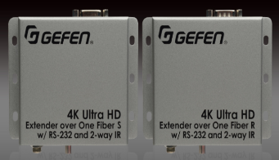
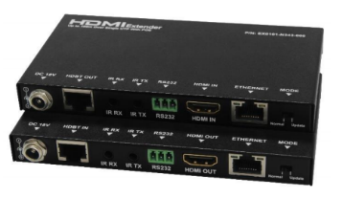
Built-in Extension with Planar DirectLight X
On Planar DirectLight X (DLX), the VC and DLI replace 3rd Party HDBT extenders formerly needed with past DirectLight products
DLX and Clarity Matrix G3 use the same Fiber Extension Module for fiber extension—which replaces other extenders formerly needed with DL2:
DLI
Fiber Extension Option
Planar Video Controller

Slide 6
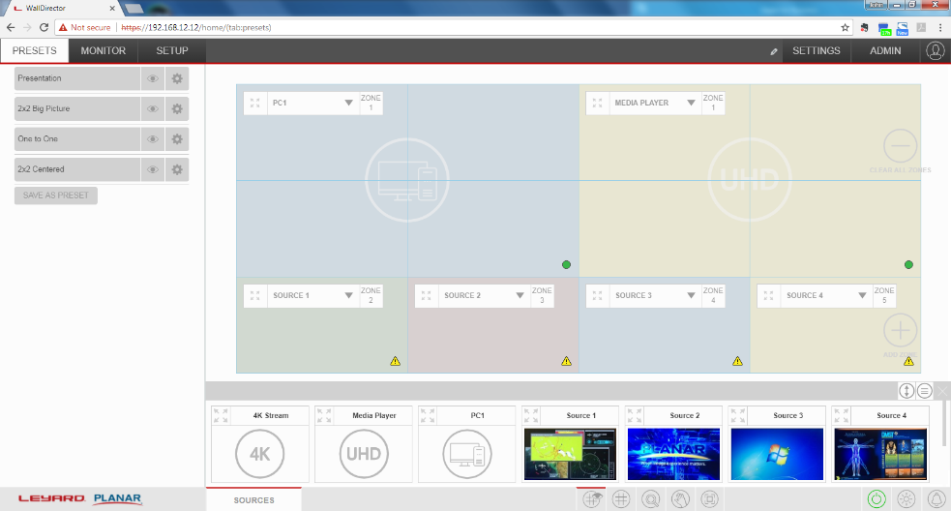
Planar WallDirector Software
Intuitive Software Simplify Configuration, Servicing, Monitoring & Operating
Cross-platform web browser based software locally hosted on the Video Controller
Modern, user-friendly interface
Intelligently detects components in the system
Remote monitoring and control
Administrative privileges and control
Alternative end user control interface
Touch-friendly

Slide 7
Introducing Planar WallSync
Industry’s First Fully Integrated Synchronized Video Wall Technology
Supports video wall synchronization to a range of customer selectable internal and external sync sources
Ensures perfectly synchronized video display without misalignment or tearing
Includes unique Smart Genlock feature that works in concert with Planar Big Picture Plus scaling technology

Slide 8
Addressing Challenges of LED with Planar WallSync
Accommodating Uncommon Resolutions
Sync or genlock to 1 source
Sync multiple VCs
> 4K video wall with perfectly synchronized video playback and no tearing between Full HD bezel-less sections
Scale 1 video across the video wall
4 x 3
VC 1, OUT 1 (1920 x 810)
4 x 3
VC 1, OUT 2
(1920 x 810)
3 x 3
VC 2, OUT 1
(1440 x 810)
Example:
Planar DirectLight X
1.2mm pixel pitch
11 x 7 LED cabinet configuration
2 Video Controllers
1890 pixels
4 x 4
VC 1, OUT 3
(1920 x 1080)
4 x 4
VC 1, OUT 4
(1920 x 1080)
3 x 4
VC 2, OUT 2
(1440 x 1080)
VC 1
5280 pixels
1 source
VC 1
VC 2
VC 2

Slide 9
Planar DirectLight X Video Wall System
Integrated
Video Wall Capabilities
Cabinets Only
Conventional
LED

Slide 10
Planar DirectLight X Video Wall System
Integrated
Video Wall Capabilities
System but…
Wall Mounts
Offboard Power
DL2
Cabinets Only
Conventional
LED

Slide 11
Planar DirectLight X Video Wall System
Integrated
Video Wall Capabilities
Sets the bar
WallDirector
WallSync
Genlock
Windowing
PiP
Big Picture Plus
User-defined Layouts
Clarity Matrix
G3
System but…
Wall Mounts
Offboard Power
DL2
Cabinets Only
Conventional
LED

Slide 12
Planar DirectLight X Video Wall System
Integrated
Video Wall Capabilities
Sets the bar
WallDirector
WallSync
Genlock
Windowing
PiP
Big Picture Plus
User-defined Layouts
VC
WallDirector
Matrix
G3
System but…
Wall Mounts
Offboard Power
DL2
DL2
Cabinets Only
Conventional
LED

Slide 13
Planar DirectLight X Video Wall System
Integrated
Video Wall Capabilities
Sets the bar for LED video walls
Sets the bar
WallDirector
WallSync
Genlock
Windowing
PiP
Big Picture Plus
User-defined Layouts
DLX
Matrix
G3
VC
WallDirector
System but…
Wall Mounts
Offboard Power
DL2
DL2
Cabinets Only
Conventional
LED

Slide 14
Off-Board Rack Components
Planar DirectLight X

Slide 15
Off-Board Electronics Architecture
Key Benefits
Components fit in standard racking units
Removes heat, weight, depth, noise and points of failure from the video wall
Rack can be co-located with sources and processing for convenient cabling, security, and climate control
Maintenance is easy to access and does not interfere with video wall
Redundant power supply option maintains operation in the case of a power supply failure
Planar Video Controller
Planar Remote Power Supply

Slide 16
Planar Video Controller (VC)
Key Features
Available Models: 9-Output Model (VC9H-BP+) & 4-Output Model (VC4H-BP+)
Purpose built, OS-agnostic video wall processing platform
Built-in video and control signal extension
Works with Planar Remote Power Supply
Monitor system status and easily troubleshoot with status LED and front-panel status display
Configuration storage and recall
Sync to external signals – i.e. house sync in Broadcast environments
Sync Video Controllers by cabling Sync Out and In
Genlock to any single input within the video wall
Mini-BNC connector with adapter to BNC
Available in 4-Output or 9-Output configurations

Slide 17
Available Video Controller Models
2 options available
VC9H-BP+
9-Output VC
VC4H-BP+
4-Output VC

Slide 18
Video Controller Models
Choosing the Right Model
VC9H-BP+ 9-Output Unit | VC4H-BP+ 4-Output Unit
Best for applications where: Rack space is a concern Planar Big Picture Plus is used Relatively small number of sources are required Matrix switcher is used Video processor with 4K outputs is used | Best for applications where: Rack space is not a concern Larger number of directly-attached sources are required More content zones or windows on the video wall are desired

Slide 19
Planar Video Controller
Front Panel View
Video Controller ID
Customer or Direct Connection Network Address – Default Address is 196.168.12.12
System Network Address – for that VC
Status LED – Blinks when receiving a command
Keypad Menu
System On/Off
Factory Reset
System Reset
Set IP for VC
System Network Address
3
Status LED
4
1
VC ID
2
Customer Network
Keypad
5
Front of Video Controller is the same for 9-Output and 4-Output models.

Slide 20
9-Output Planar Video Controller
Back Panel View - VC9H-BP+
4
9 Video Outputs (RJ45 8P8C)
5
Built-In Synchronization Board
IR Remote
6
8
Aux USB
9
Network Ports
2
HDMI 2.0 Inputs
3
DisplayPort 1.2 Loop In/Out
Power In/Out
1
7
RS-232 & USB Control
Power In/Out – Can loop up to 2 additional VCs
HDMI 2.0 Inputs – Each input capable of up to 4K at 60Hz
DisplayPort 1.2 Loop In/Out – Input capable of up to 4K at 60Hz
9 Video Outputs (RJ45 8P8C)–
Shielded CAT6 or greater
Up to 200ft / 60m
Built-In Synchronization Board
IR Remote - Used when VC is the Master
RS-232 and USB Control - Used when VC is the Master
Aux USB- Used for firmware download
Network Ports
Internal system communication
WAN/LAN is used for customer network when Master

Slide 21
4-Output Video Controller
Back Panel View - VC4H-BP+
4
4 Video Outputs (RJ45 8P8C)
5
Built-In Synchronization Board
IR Remote
6
8
Aux USB
9
Network Ports
2
HDMI 2.0 Inputs
3
DisplayPort 1.2 Loop In/Out
Power In/Out
1
7
RS-232 & USB Control
Power In/Out – Can loop up to 2 additional VCs
HDMI 2.0 Inputs – Each input capable of up to 4K at 60Hz
DisplayPort 1.2 Loop In/Out – Input capable of up to 4K at 60Hz
4 Video Outputs (RJ45 8P8C) –
Shielded CAT6 or greater
Up to 200ft / 60m
Built-In Synchronization Board
IR Remote - Used when VC is the Master
RS-232 and USB Control - Used when VC is the Master
Aux USB- Used for firmware download
Network Ports
Internal system communication
WAN/LAN is used for customer network when Master

Slide 22
Video Controller Models
Key Differences
 | VC9H-BP+ 9-Output Unit (Standard) | VC4H-BP+ 4-Output Unit (Optional)
Video Outputs (Full HD sections) | 9 | 4
Inputs | 4x HDMI, 1x DP | 4x HDMI, 1x DP
Zones | 9 | 9
Rack Space | 1 RU | 1 RU

Slide 23
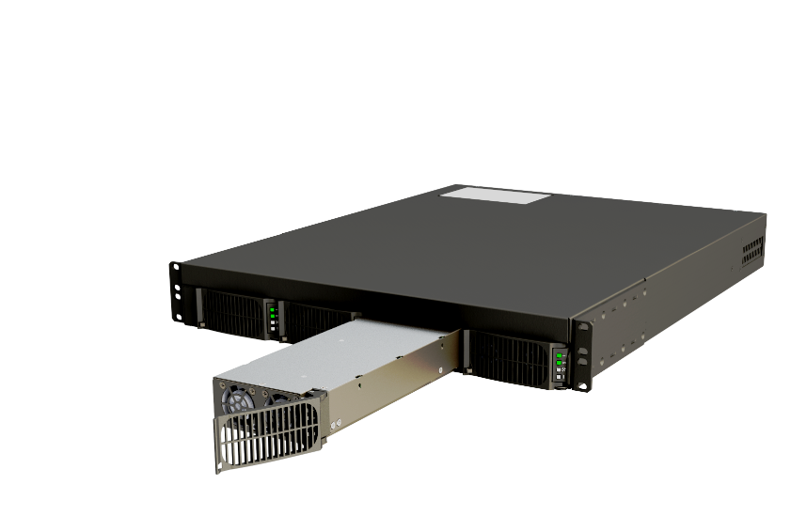
Planar Remote Power Supply (RPS)
Efficient, Reliable and Mission-Critical Off-Board Power Solution
24x7 Operation
Hot swappable power supply modules
Redundant power supply module option available
Redundant AC input circuitry
Health and status monitoring
Ultra-low standby power mode (< 3 Watts)
110V or 220V support to reduce circuits used
220V option for higher power density
Same physical design as Remote Power Supply (RPS) for Clarity Matrix G3 LCD Video Wall System

Slide 24
Planar Remote Power Supply Models
Two Form Factors, Configured Per Installation
RPS110
100-240V. Maximum 3,600 Watts out. 1 RU – Standard
RPS220
200-240V. Maximum 7,200 Watts out. 1.5 RU - Greater power density - Optional

Slide 25
Planar Remote Power Supply Models
RPS110
RPS module
Redundant module bay
1 RU. 19” Rack
Circuit redundancy
Each plug requires 20a circuit (or 2 on 30a)
RS-232 control
Diagnostics lights
(3)1200w output
Switch per module

Slide 26
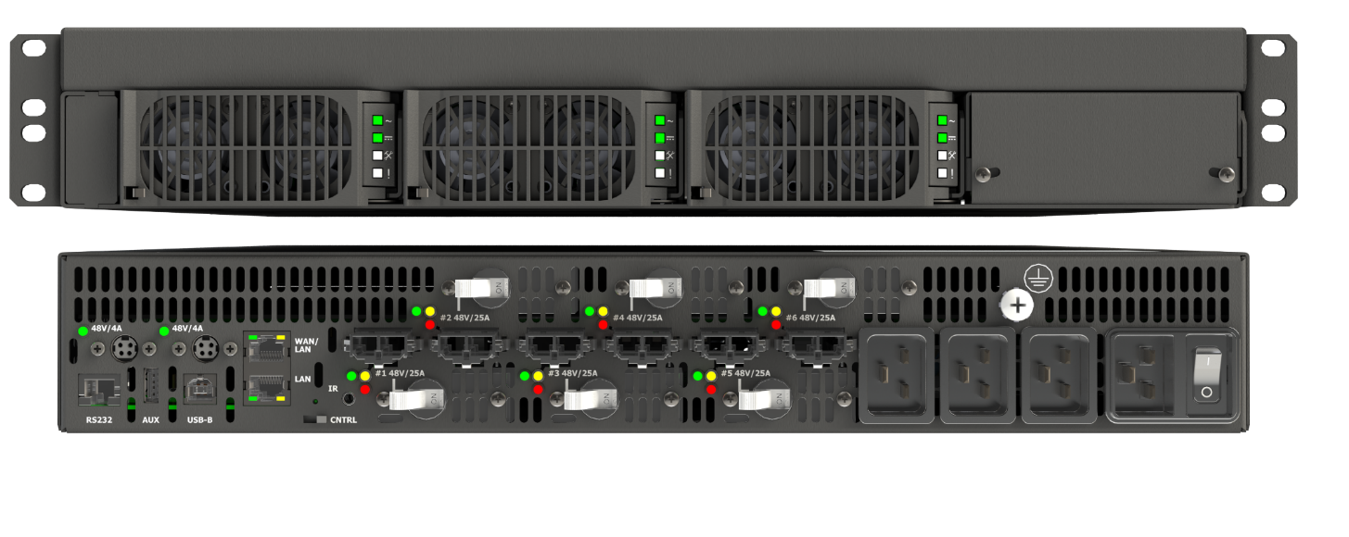
Planar Remote Power Supply Models
RPS220
RPS module
Redundant module bay
1.5 RU. 19” Rack
RS-232 control
Diagnostics lights
(6) 1200w output
Switch per module
Circuit redundancy

Slide 27
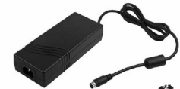
Fiber Video Extension Module
USB 2.0 input (Type-B connector)
SFP fiber transceiver connection output to the DLI
Fiber module power switch
DC Power (4-pin mini-DIN) for Fiber module powered by RPS or separate AC supply
Fiber Extension Module used in Planar DirectLight X & Clarity® Matrix® G3 Video Walls
Input from the Video Controller

Slide 28
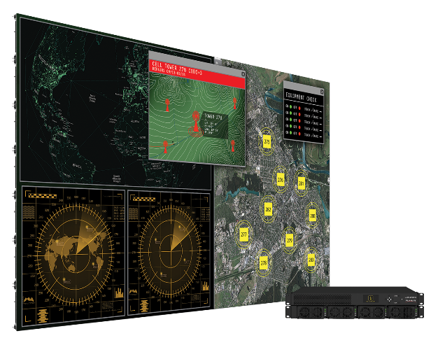
Supported Cable Lengths
Planar Video Controller
Standard length 200ft / 60m
Fiber Extension Module
Cat 6 Cable Lengths
Bulk cables and connectors support field-terminated lengths
25ft / 7.6m
50ft / 15.2m
75ft / 22.8m
100ft / 30.4m
200ft / 60m
Planar Remote Power Supply
Standard configuration support – 500ft / 152m
Power Cable Lengths
Bulk cables and connectors support field-terminated lengths
25ft / 7.6m
50ft / 15.2m
75ft / 22.8m
100ft / 30.4m
200ft / 60m
Fiber Extension Module
Multi-Mode 1000ft / 300m
Single Mode 10km (Requires customization)
Fiber Cable Lengths
Bulk cables and connectors to support field-terminated lengths available
65.6ft / 20m
98.4ft / 30m
Notes:
Reduces heat, etc
MTBF - ?
Co-Located - Short Cables, etc

Slide 29
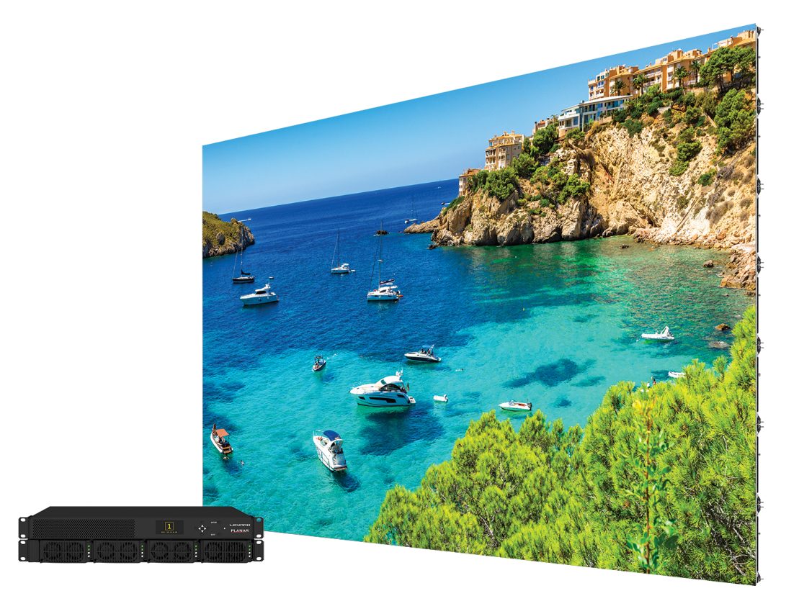
Planar DirectLight X
The Next Generation of the DirectLight LED Video Wall System
Advanced video wall processing with the Planar Video Controller
User friendly and powerful web based control with Planar WallDirector Software
Valuable video wall features like Planar Big Picture Plus processing and Planar WallSync
Wall-mounted, full front access video wall with <4” depth
Planar Remote Power Supply with hot swappable power modules and optional redundancy
Planar DriveSense architecture for low power consumption
Select models available with Planar ERO-LED protective technology
Select models available with Planar LED MultiTouch

Slide 30
Naming and Specifications
Planar DirectLight X

Slide 31
Planar DirectLight X Components
Product Components
Public name | Planar® DirectLight® X LED Video Wall System
Internal name | DirectLight X (DLX)
Power | Planar® Remote Power Supply (RPS)
Controller | Planar® Video Controller (VC)
Software | Planar® LED Control Software Planar® WallDirector™ Software
Mounting | Planar® EasyAlign™ Mounting System
Available Models:
DLX-0.7 | DLX-0.9 | DLX-1.2 | DLX-1.5 | DLX-1.8

Slide 32
Planar DirectLight X Specifications
Full Range of Pixel Pitch Models | 0.7, 0.9, 1.2, 1.5, 1.8mm
Full Front Service | Yes
ADA-Compliant | Yes
Mounting | Planar EasyAlign Mounting System
Power | Planar Remote Power Supply (RPS)
Video Controller | Planar Video Controller (VC)
Software | Planar WallDirector Software
CAT6 cable extension | Standard
Fiber cable extension | Option
4K Input Support | 4K @ 60Hz
HDMI 2.0 compliant | Yes
DisplayPort 1.2 compliant | Yes
HDCP 2.2 compliant | Yes
CAT6 cable extension | Standard
Downscaling 4K to Full HD | Yes
Upscaling Full HD to 4K | Yes

Slide 33
Planar DirectLight X Specifications
Full screen and partial screen scaling | Yes – Planar Big Picture Plus
Arbitrary resolution upscaling and downscaling | Yes
Picture-in-Picture (PiP) | Yes
Source windowing - Limited | Yes
Source switching | Yes
Preset layouts and recall | Yes
Create content Areas on video wall | Yes
Drag and drop source control | Yes via Planar WallDirector Software
Synchronization and genlock | Yes via Planar WallSync
Modern UI design | Yes
Browser-based, cross-platform | Yes
Graphical tablet-based control | Yes via browser
On-screen menu (OSD) and remote control | Yes
VC and RPS monitoring | Yes via Planar WallDirector Software
Simplified cabling | Yes
Ambient light sensor | Option via DLI

Slide 34
Thank you

